Slide 1
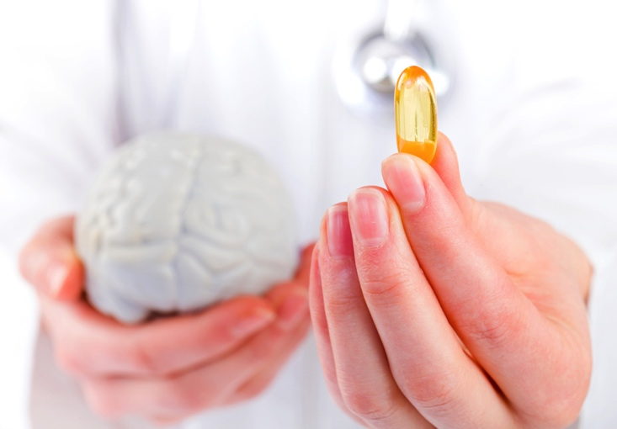
Applying Functional Medicine to Pediatric Brain Injury
Presented by:
Dr. Emily Gutierrez, DNP, CPNP, IFM-CP

Slide 2
Outline of Discussion
Functional medicine and the gut/brain connection
Strategies for controlling inflammation
  Dietary principles, ketogenic option
Nutrigenomics and biomarkers indicated for prolonged TBI recovery
  Serum markers and SNPs
Nutraceuticals for TBI recovery
  Resources and supplement pharmacovigilence

Slide 3

What is Functional Medicine?
A biological systems based approach to treating the root cause of illness by looking at the interactions between the genetic, environmental, and lifestyle factors of an individual. By shifting the traditional disease-centered focus of medical practice to a more patient-centered approach, functional medicine addresses the whole person, not just an isolated set of symptoms.

Slide 4
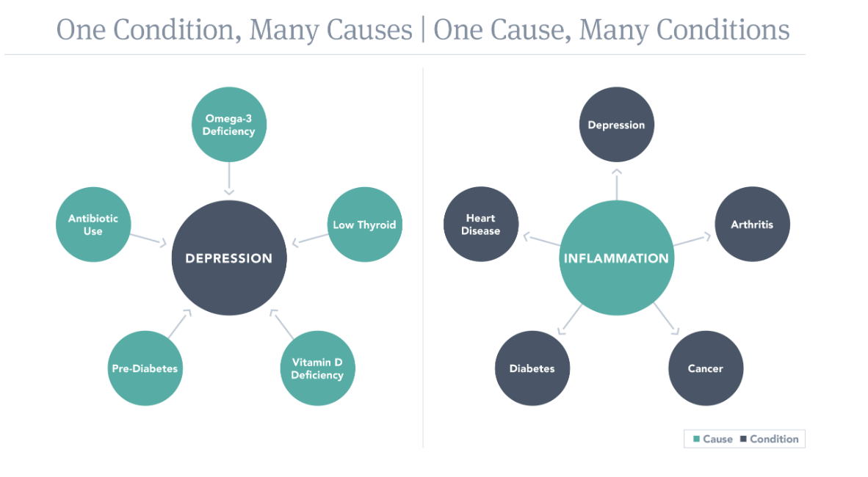

Slide 5
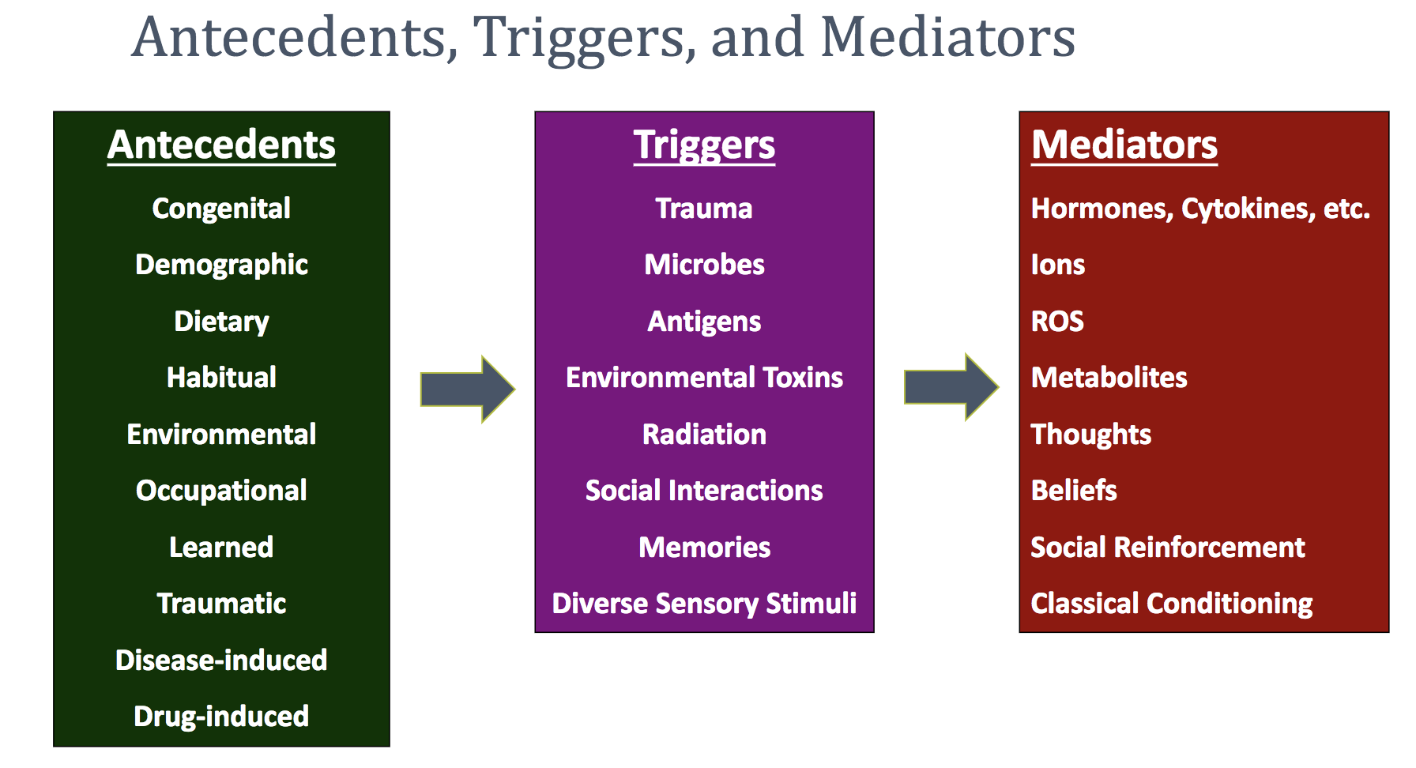

Slide 6
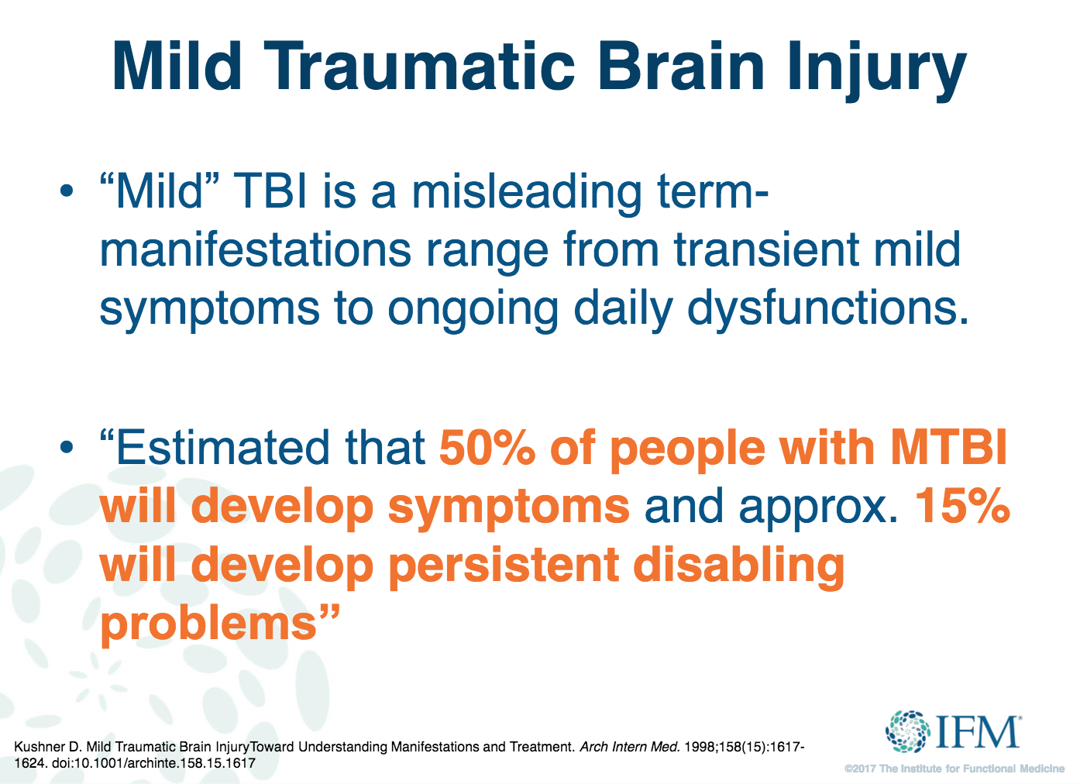

Slide 7
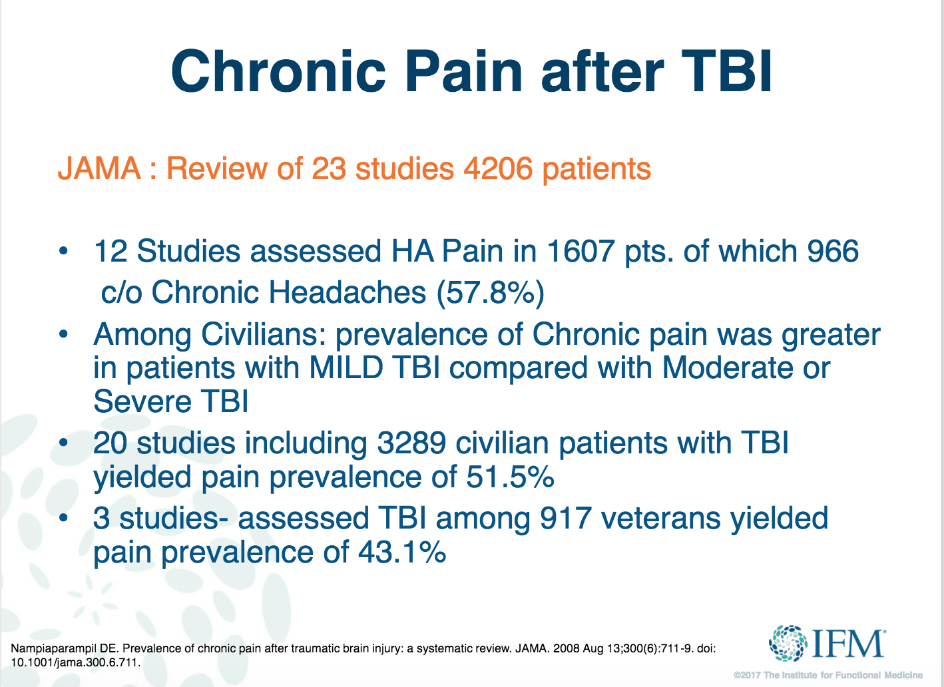

Slide 8
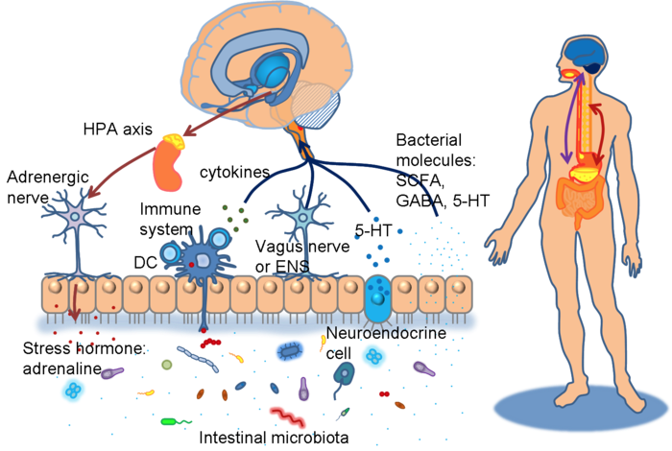
The Gut/Brain Axis
Notes:
Butterflies in your stomach
Thoughts create feelings and feelings create thoughts
Bidirectional communication via the vegas nerve
Enteric nervous system

Slide 9
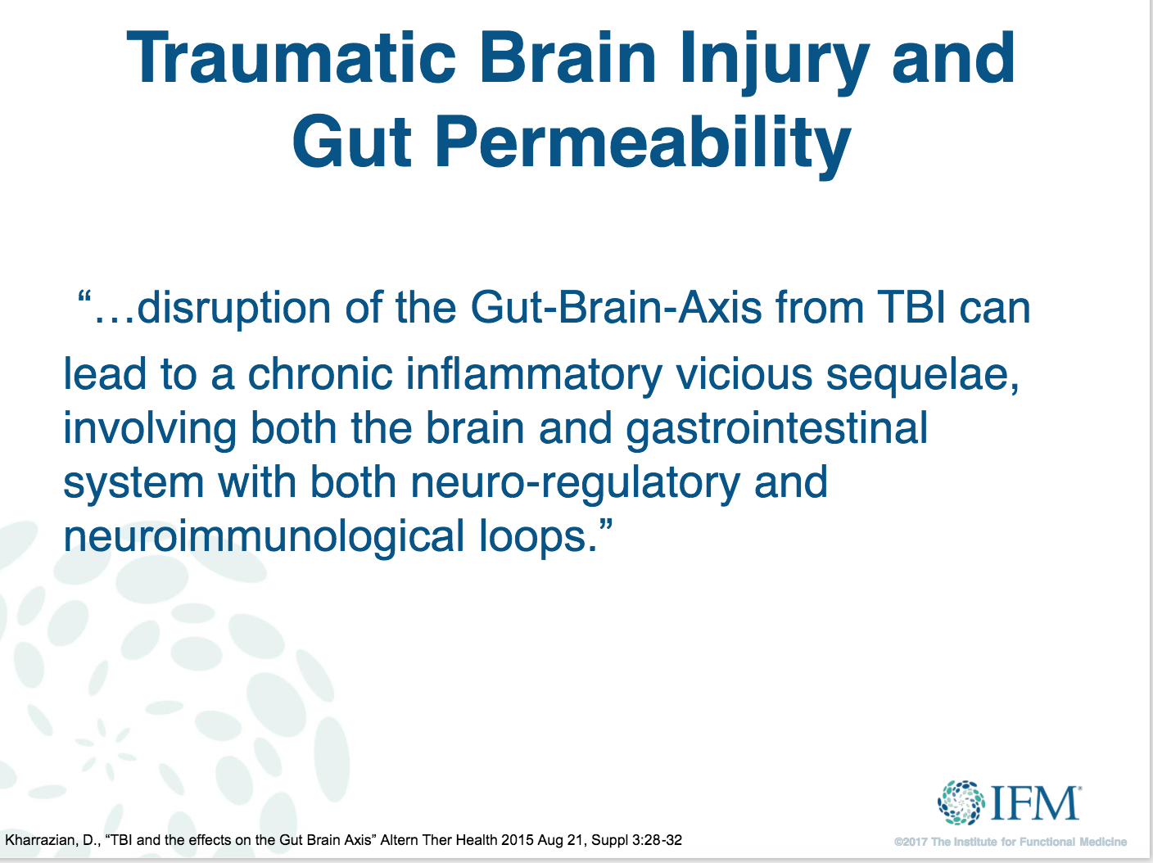

Slide 10
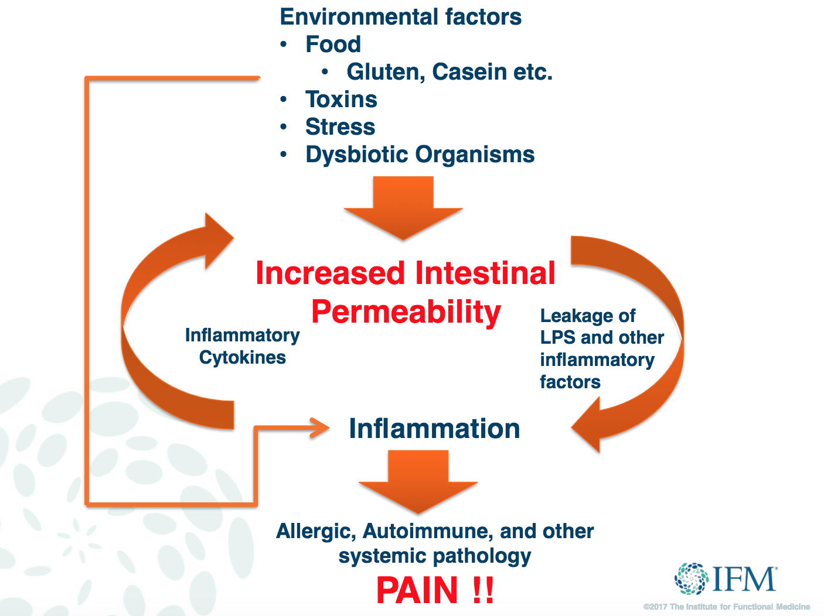
Notes:
Leaky Gut
Increased Intestinal Permeability

Slide 11
Controlling inflammation is KEY
Find the right diet for the right patient
Heal the gut (our enteric nervous system, or “second brain”)
Address methylation
Replete nutritional deficiencies
Nutraceutical anti-inflammatory support
Intermittent fasting (to increase BDNF)
Tipton, K. (2015).
Notes:
Foundation of health is the diet
We die if we don’t eat

Slide 12
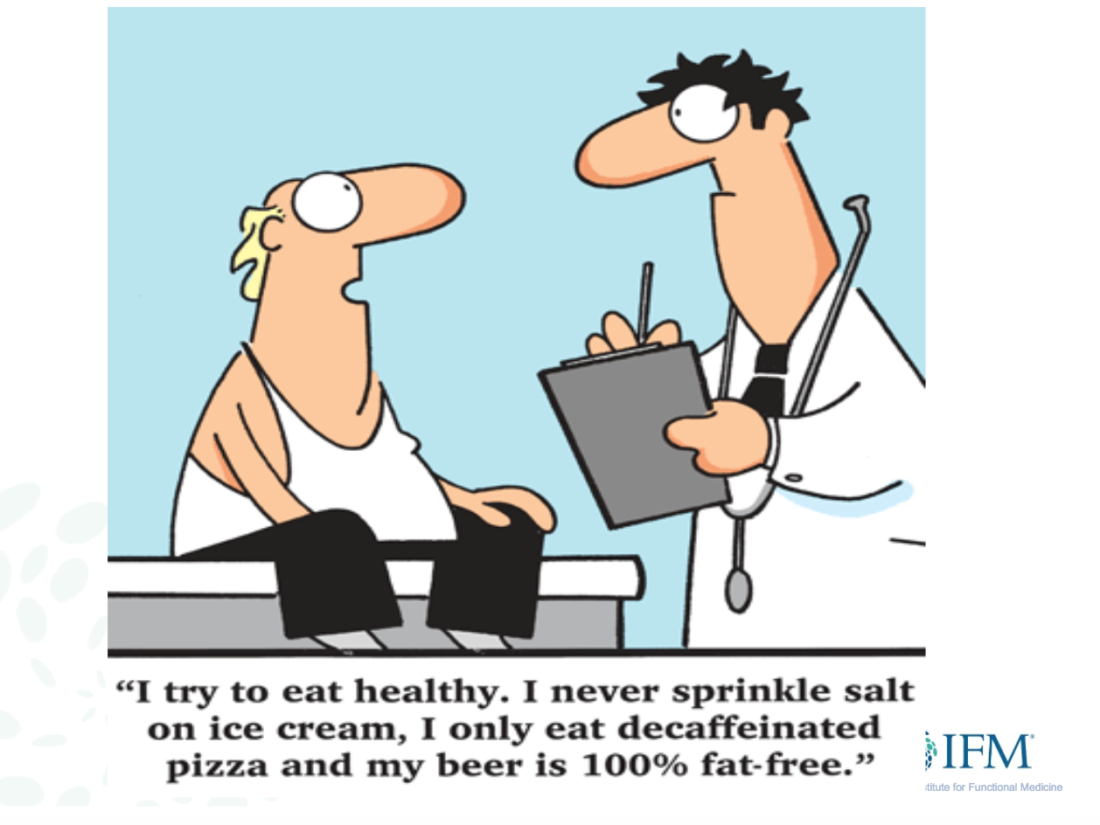

Slide 13
Core Principles of Good Gut Heath
Identify and avoid top allergens-
(gluten, dairy, soy, eggs, nuts)
21-day elimination diet
High protein (2–2.5 g protein/kg )
Phytonutrient diversity
Eat fermented foods (high in probiotics)
Eat prebiotic foods
Limit sugar and alcohol
Eat healthy fat
Drink H2O (half your weight in oz)

Slide 14
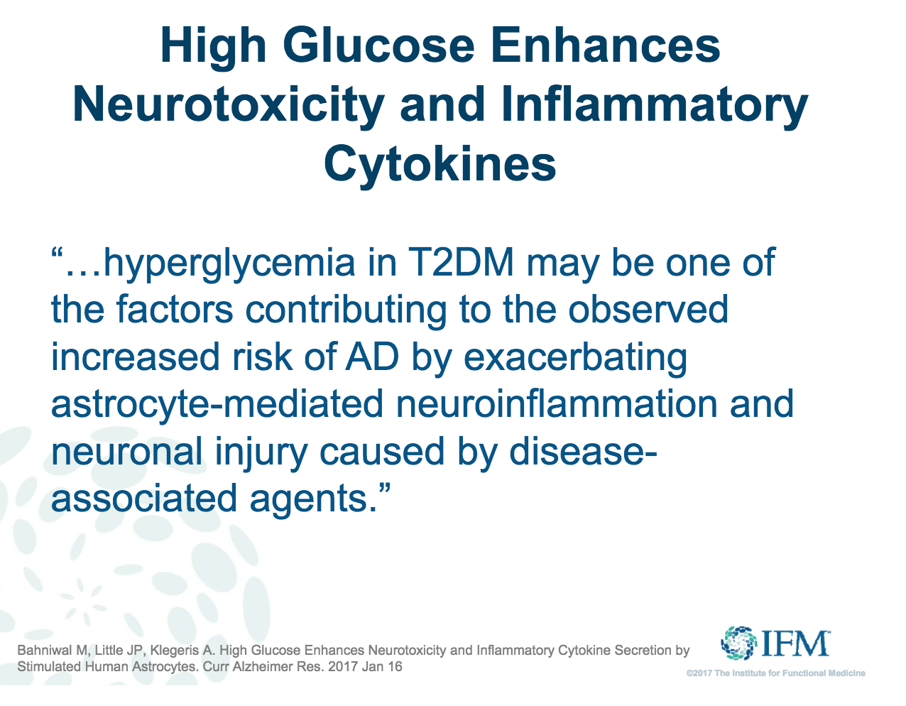
Notes:
Alzheimers disease
This begs the question…shouldn’t neurologist be running diabetic labs and managing diabetes? Managing the gut?
Funtional medicine is not an exclusion of one doctor for one system, rather all systems need co concurrent management

Slide 15
Ketogenic Diet Principles
Mimics fasting state- switches from metabolism of glucose to the metabolism of ketones
High fat- low carbohydrate diet (4:1 ratio)
Mechanism of action attributed to formation of ketone bodies, glycolysis, and enhancement of mitochondrial metabolism
Strict keto- <20 grams of carbs daily
Moderate keto 40-50 grams of carbs daily
Ketosis can be achieved after 3 days, urine test strips for monitoring
Pitfalls- limiting vegetables/fruits, picky eaters
Notes:
Urine tests sometimes will show false negatives- so blood strips can also be effective, they are just expensive

Slide 16
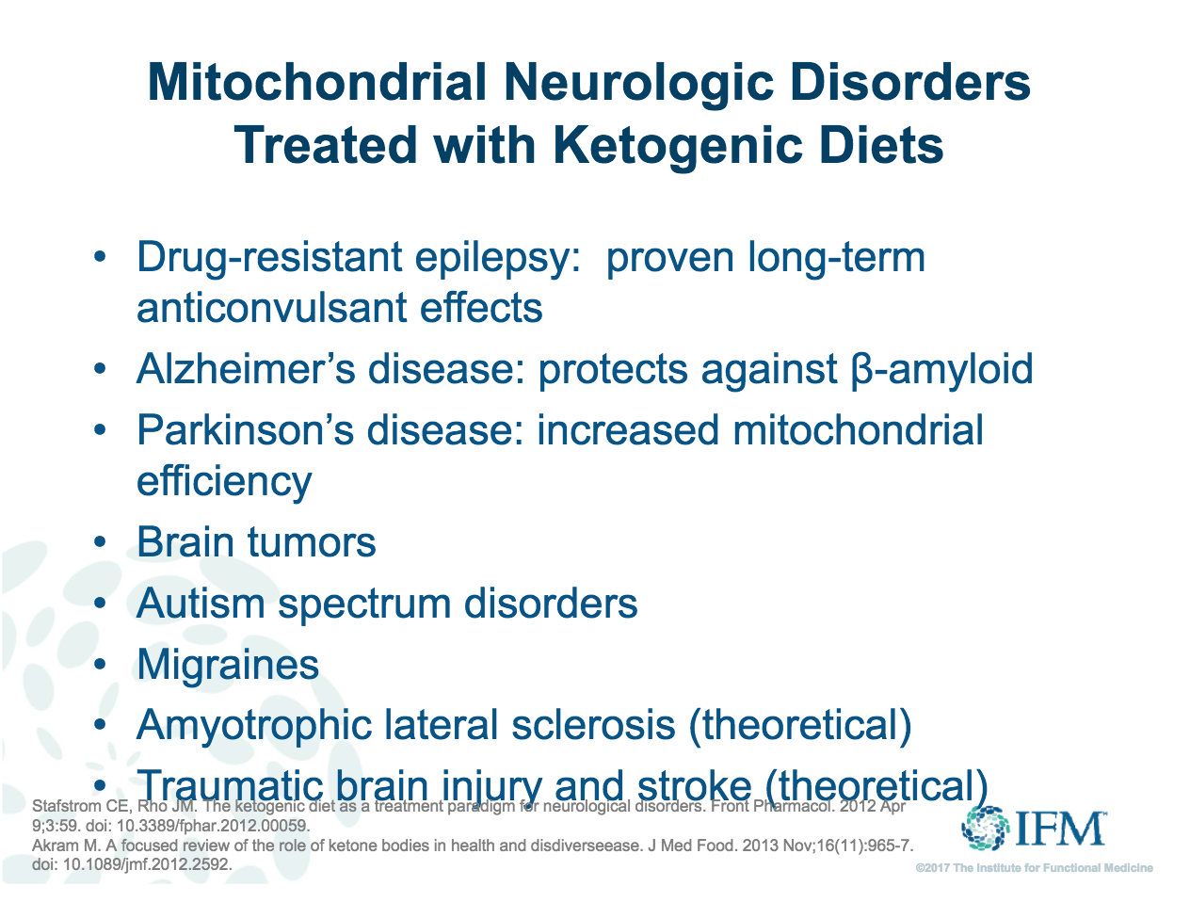
Notes:
Likely ASD since the comorbidity of seizures is about 40%

Slide 17
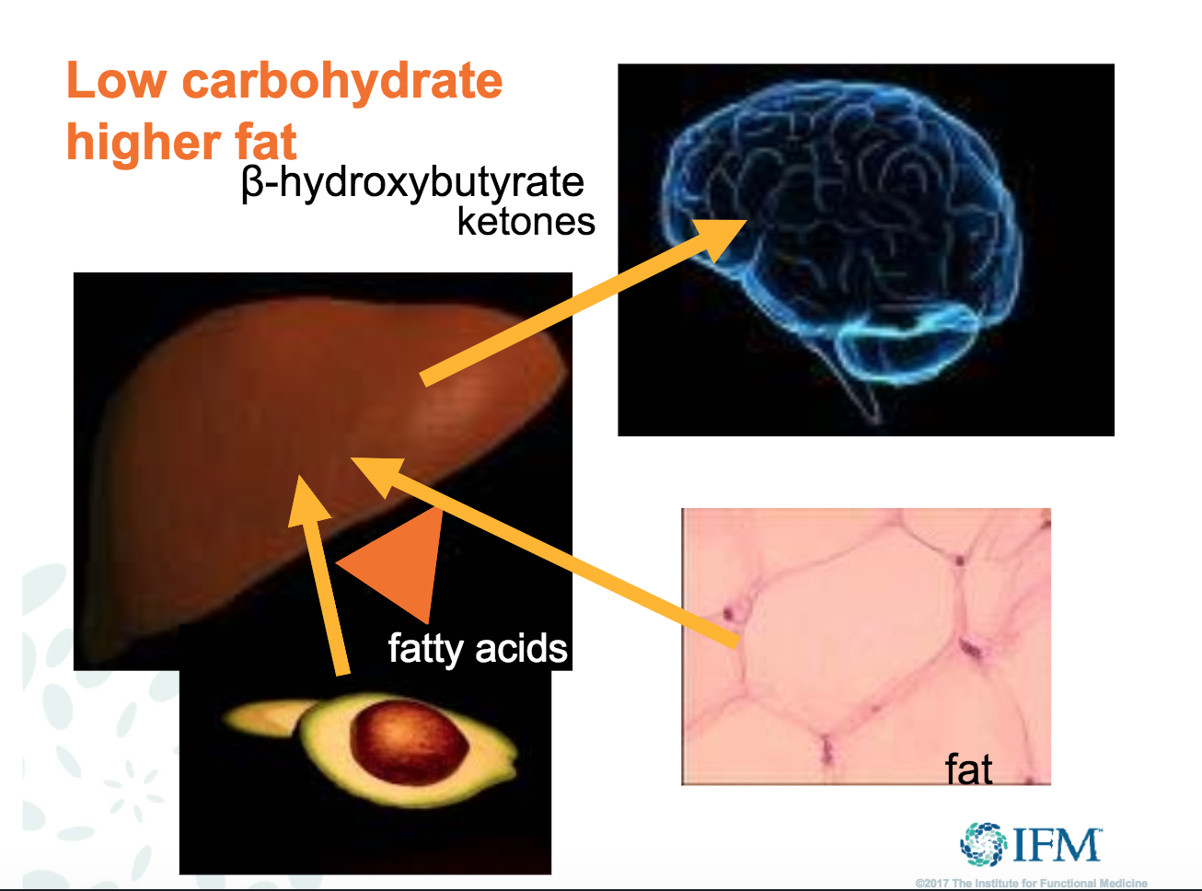

Slide 18
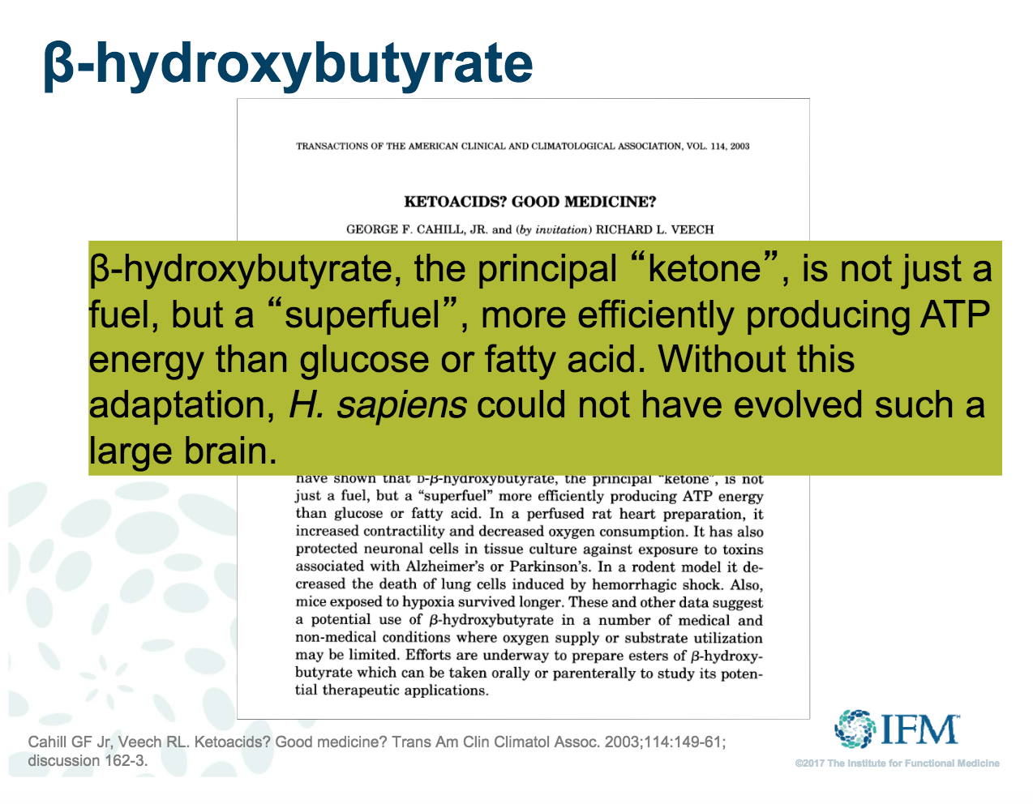

Slide 19
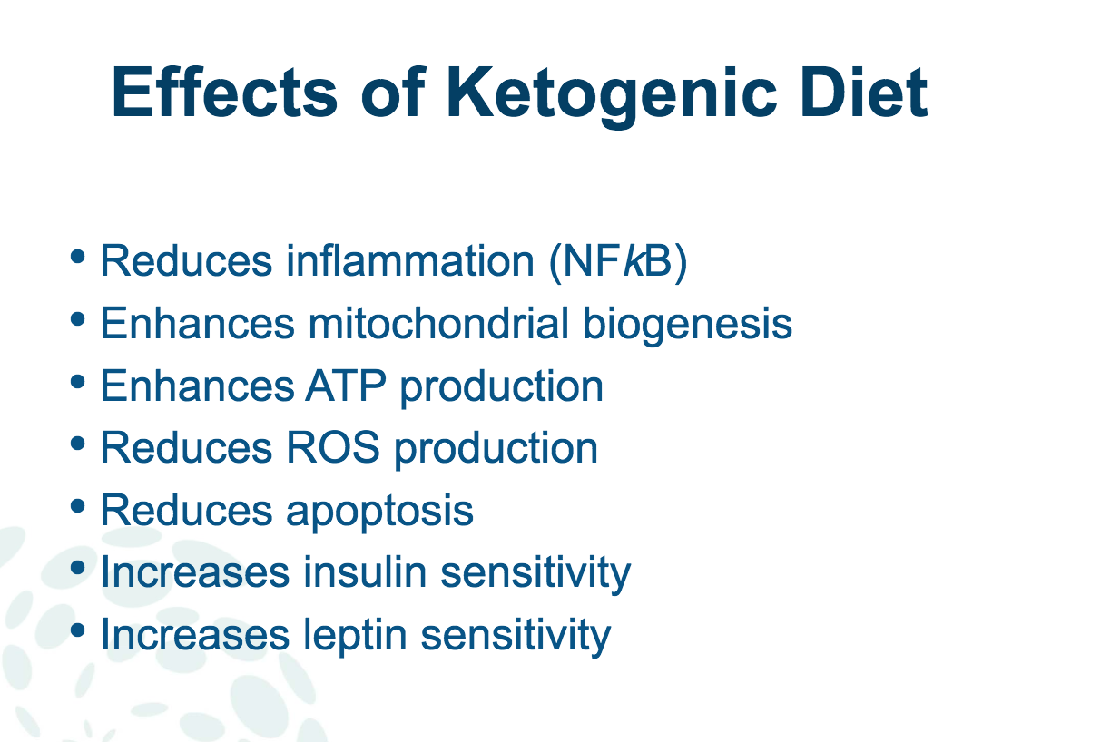
Notes:
Leptin is a satiety hormone- eating more fat helps you feel full and curbs hunger cravings

Slide 20
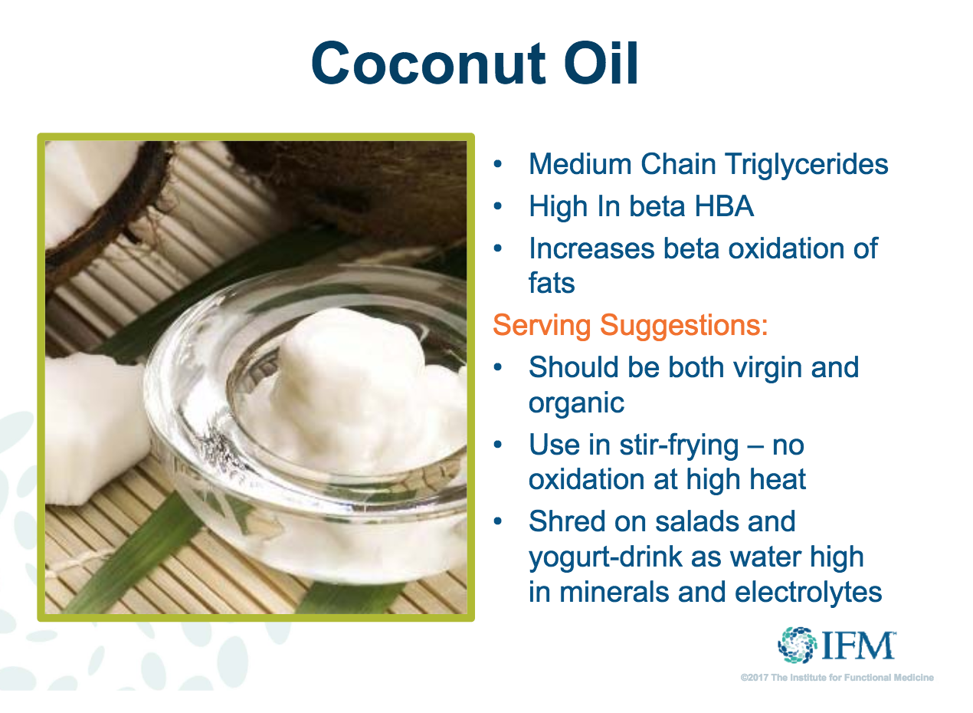
Notes:
Caution with coconut water with added sugar

Slide 21
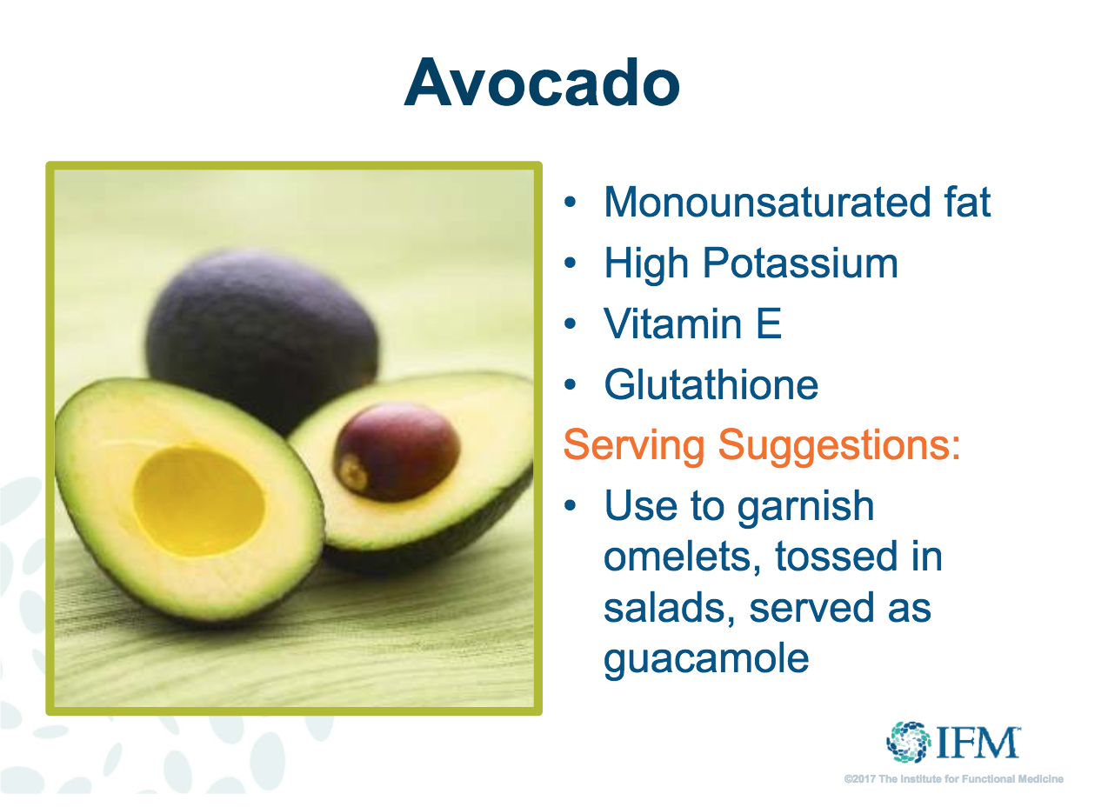

Slide 22
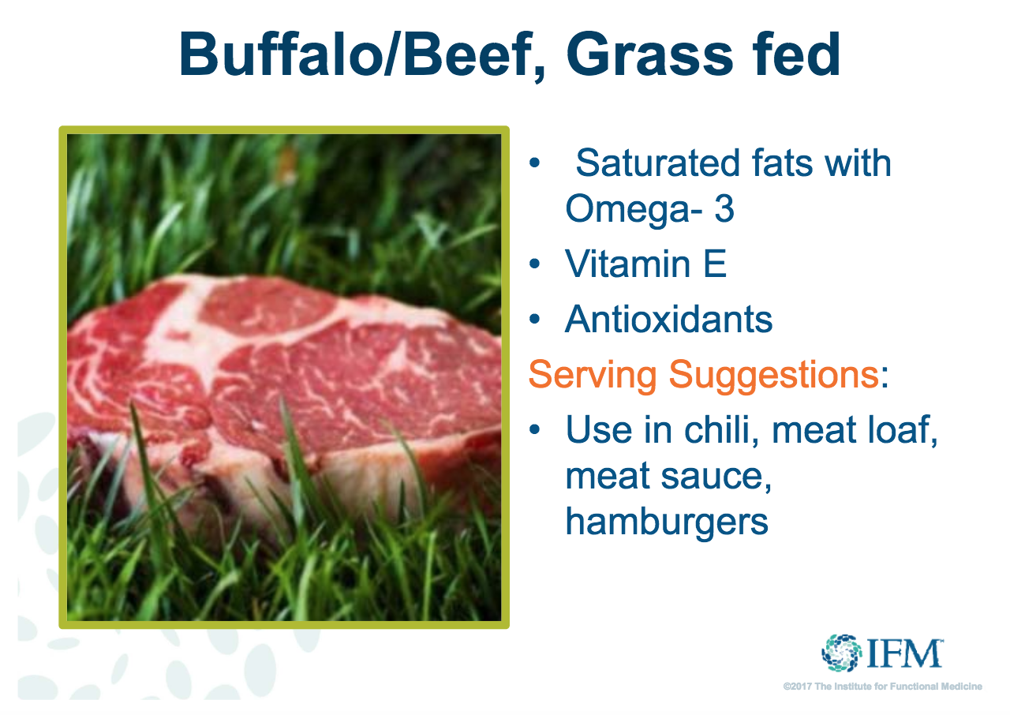

Slide 23
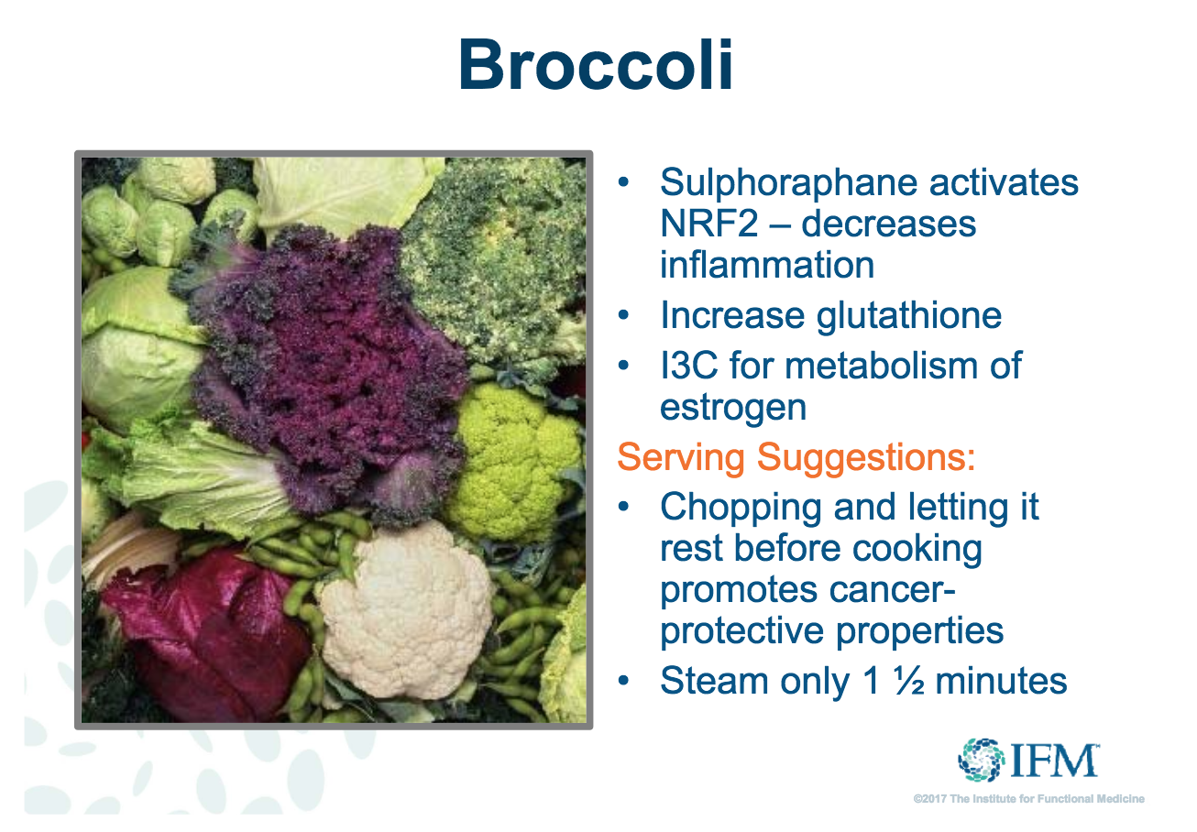
Notes:
Increase cruciferous veggies during PMS- helps metabolize estrogen

Slide 24
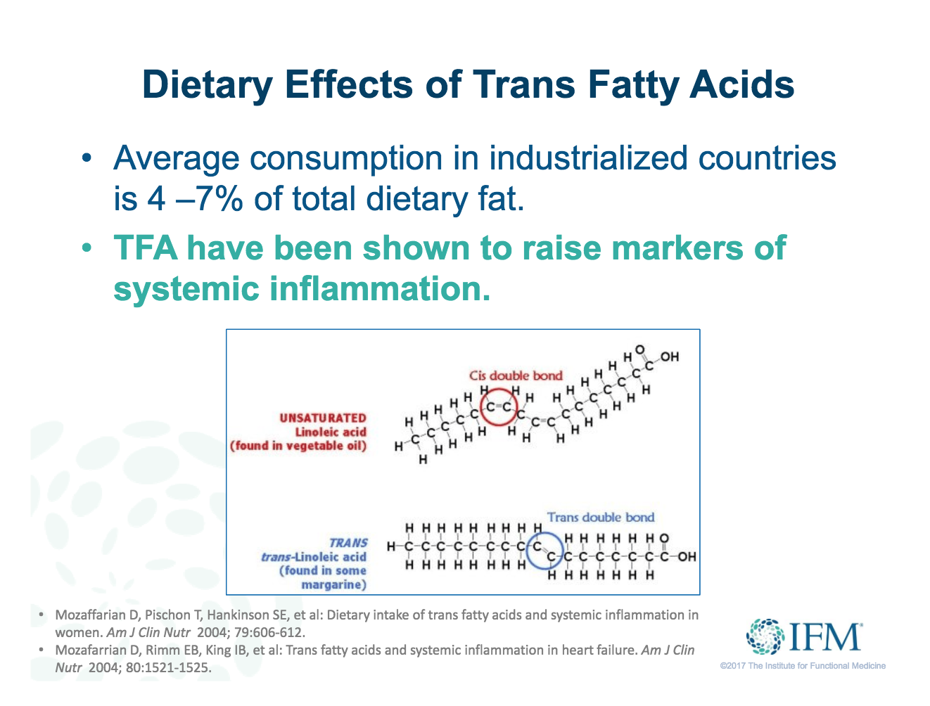
Notes:
Partially hydrogenated fats- they are made through an industrial process that adds hydrogen to vegetable oil (and in turn it has a longer shelf life). Raises LDL cholesterol and lowers HDL cholesterol.

Slide 25
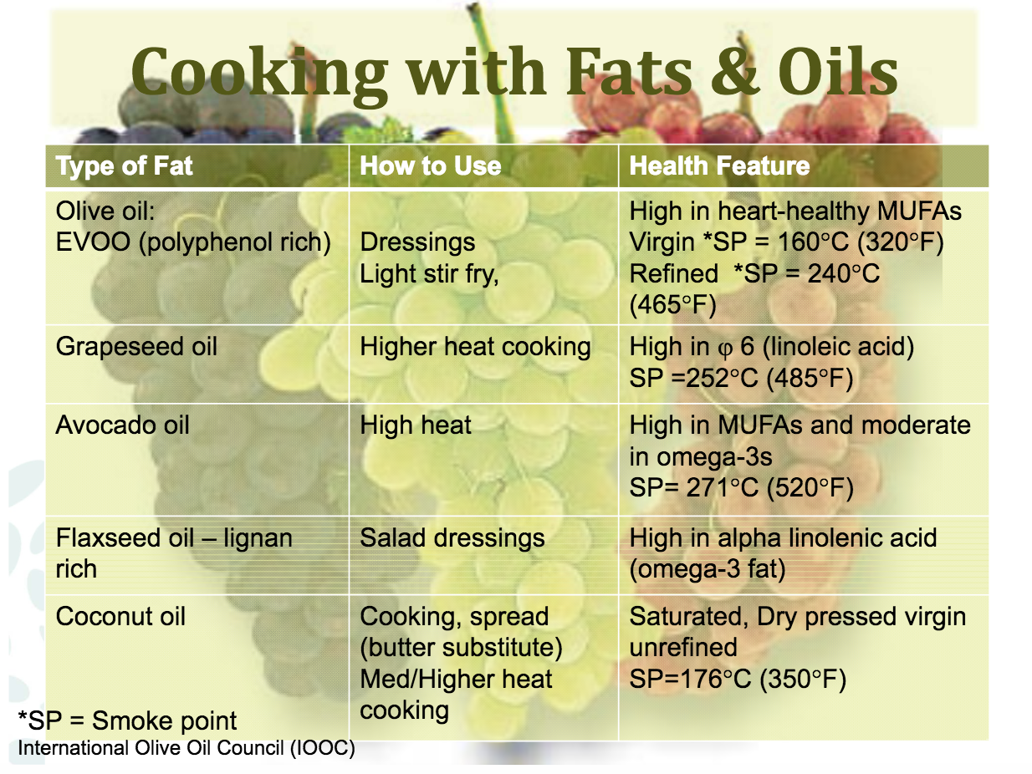

Slide 26
Addressing Methylation
Methylation pathways are regulated by enzymes, which are encoded by genes- one carbon metabolism.
Common variations in these genes, known as SNPs (single nucleotide polymorphisms), can affect the entire methylation balance.
Resulting in:
poor detoxification
decreased glutathione production
decreased neurotransmitter production
diminished nutrient assimilation

Slide 28
Predisposing Genetic Factors
Prolonging Recovery
Predisposing Genetic Conditions (SNPs):
MTHFR, FLOR, VDR, COMT, APOE, BDNF, and many more
Triggers: head trauma, overtraining, dehydration, concurrent illnesses
Propagation of Disorder:
Inflammation
Bennett, E., Reuter­Rice,K. & Laskowitz, D. (2016)
Notes:
Unmapped Human Genome in 2009- this science is cutting edge and new
No consensus for treatment- I will guide you based on the literature and my experience

Slide 29
Biomarkers
HsCRP/CRP
Essential fatty acid profile
Magnesium RBC
Folic acid: >24 poor cellular utilization
Vitamin D3: Optimal range 70-80
Homocysteine: Optimal range 7-9
Low needs glutathione/NAC, low and high needs methyl folate
MTHFR (1298C and C677T)
Serum glutathione
Notes:
HsCRP is my preference, some doctors like CRP
Genetics are your blueprint
Unique phenotypic variability

Slide 30
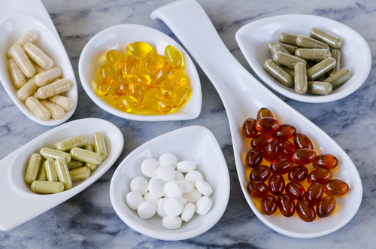
Nutraceuticals in
TBI Recovery
Essential Fatty Acids
Vitamin D
Methyl Folate
Curcumin
Glutathione
Magnesium

Slide 31
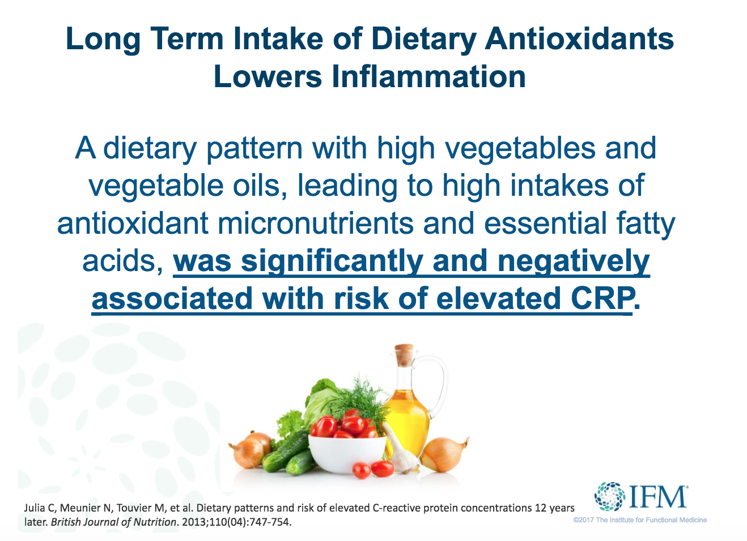

Slide 32
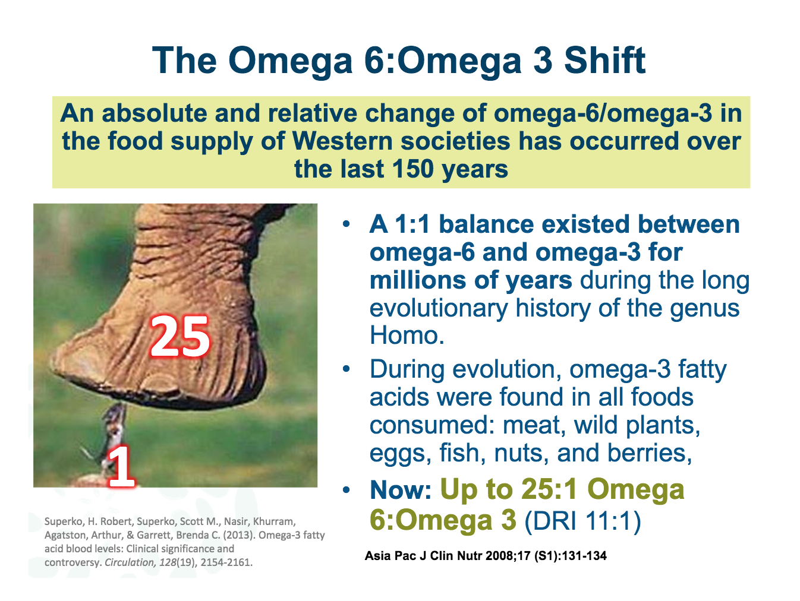

Slide 33
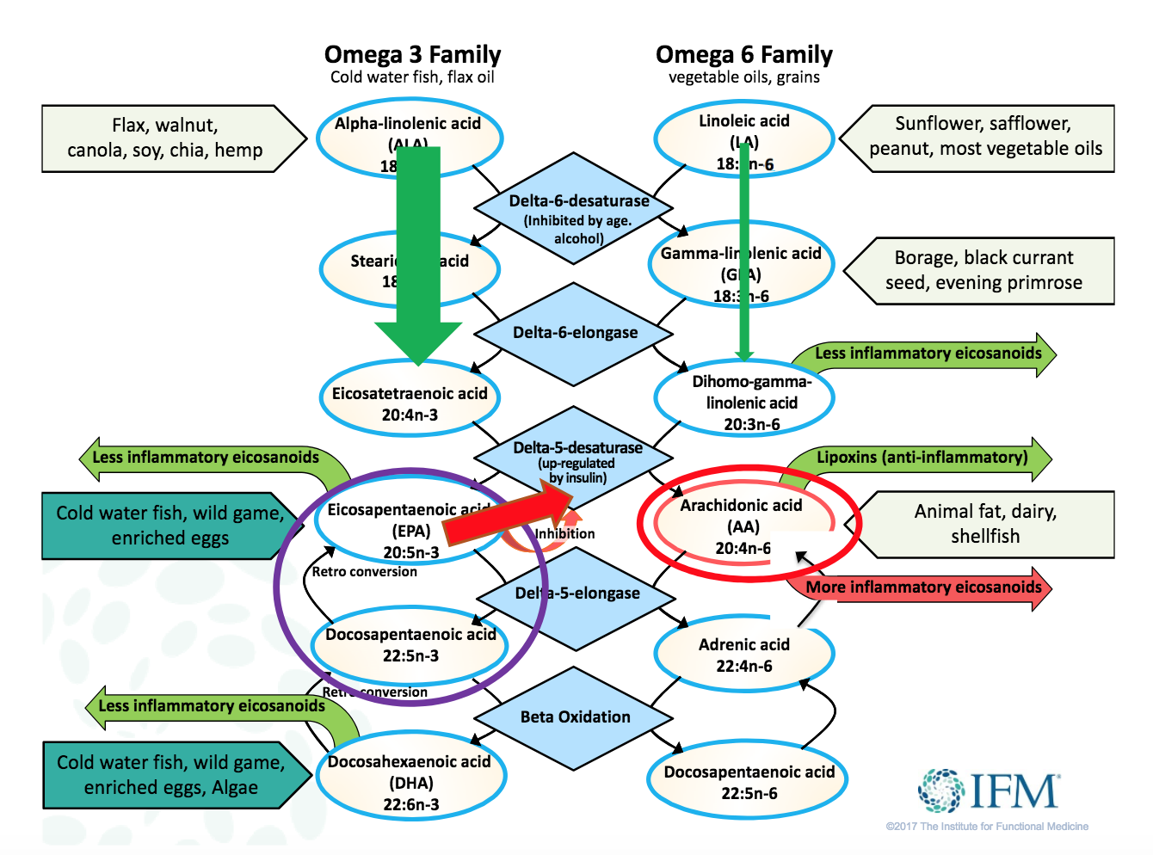

Slide 34
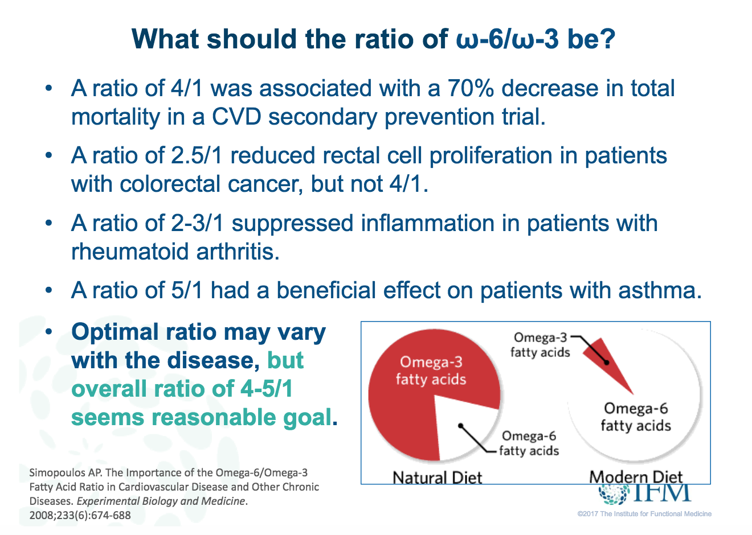

Slide 35
Docosahexaenoic Acid (DHA)
DHA has demonstrated the ability to address several of the hallmark pathologic features of TBI/concussion, namely excitotoxicity, oxidative stress, and inflammation.
DHA has been shown to reduce glutamate-induced excitotoxicity and both axonal and neuronal injury through modulation of ion channels.
DHA has been shown to reduce oxidative stress by restoring/increasing the activity of antioxidant systems that enzymatically inactivate reactive oxygen species as well.
Barrett, E., McBurney, M., & Ciappio, E. (2014)
Notes:
DHA in children is great, but we also need EPA

Slide 36
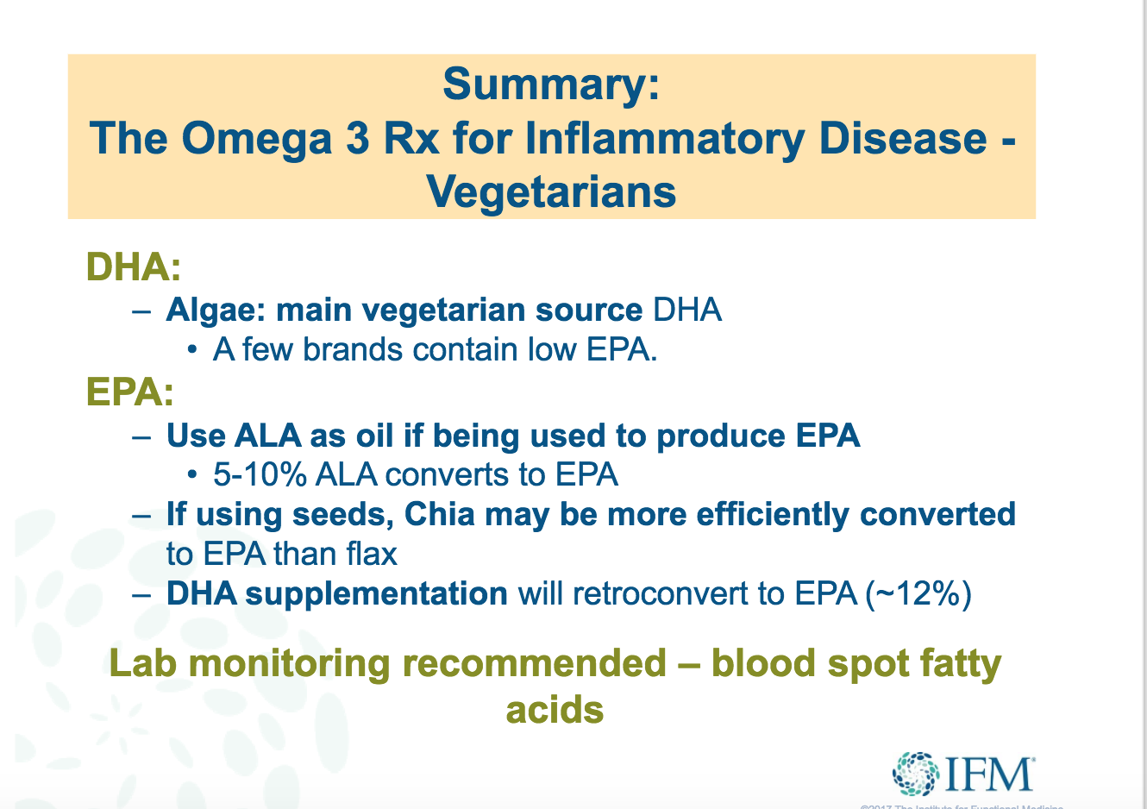
Notes:
ALA= chia, hemp, flax, walnut, canola (non GMO)
Functional Medicine providers will likely have blood spots, not in traditional settings

Slide 37
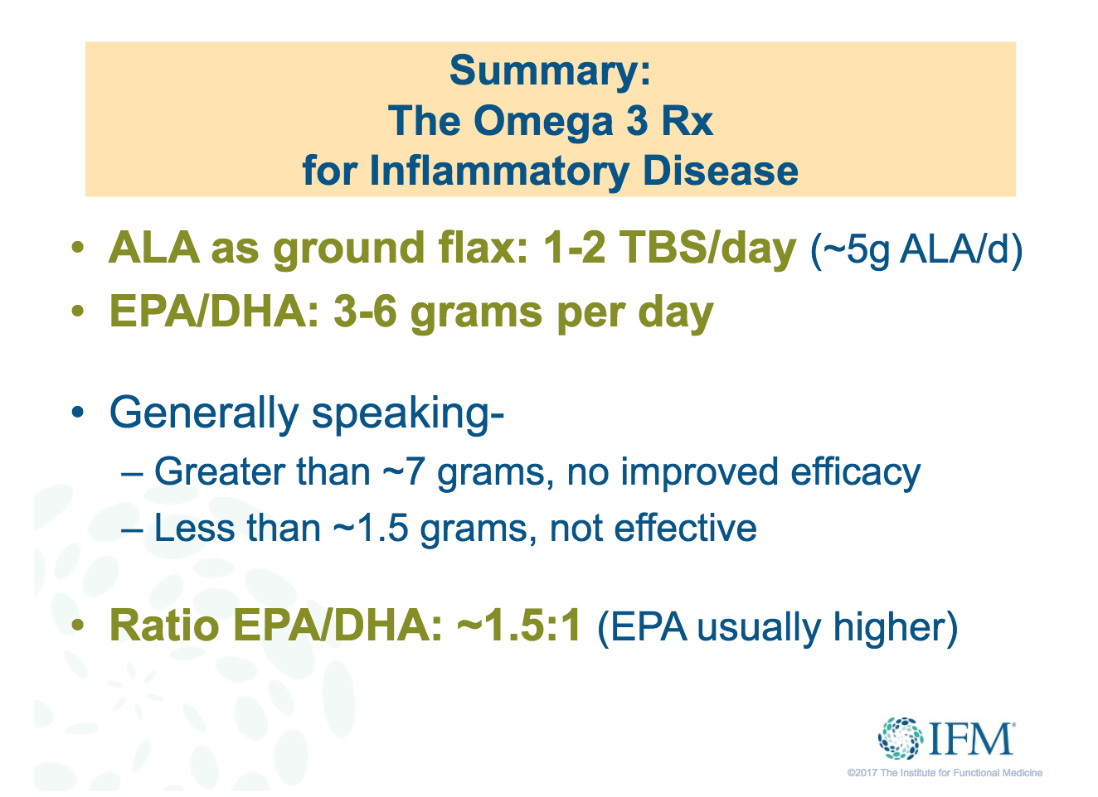

Slide 38
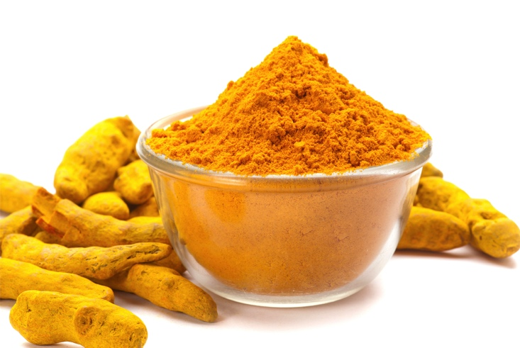
Curcumin/Tumeric
Curcumin is the active
ingredient in turmeric.
The powerful antioxidant
effects of tumeric have been
found sufficient to reduce the action of oxidative stress on the BDNF system, synaptic plasticity, and cognitive function.
Synergistic effects with essential fatty acids
Wu, A., Zing, Y., & Pinilia, F. (2005)
& Wu, A., Zing, Y., & Pinilia, F. (2014)

Slide 39
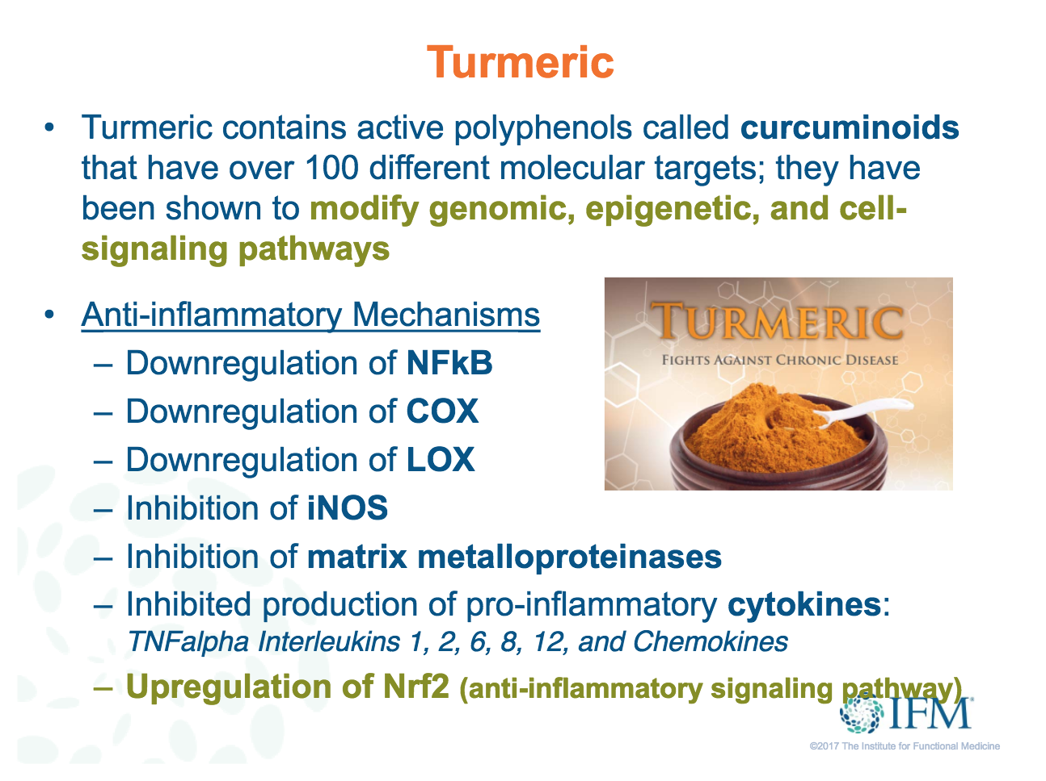

Slide 40
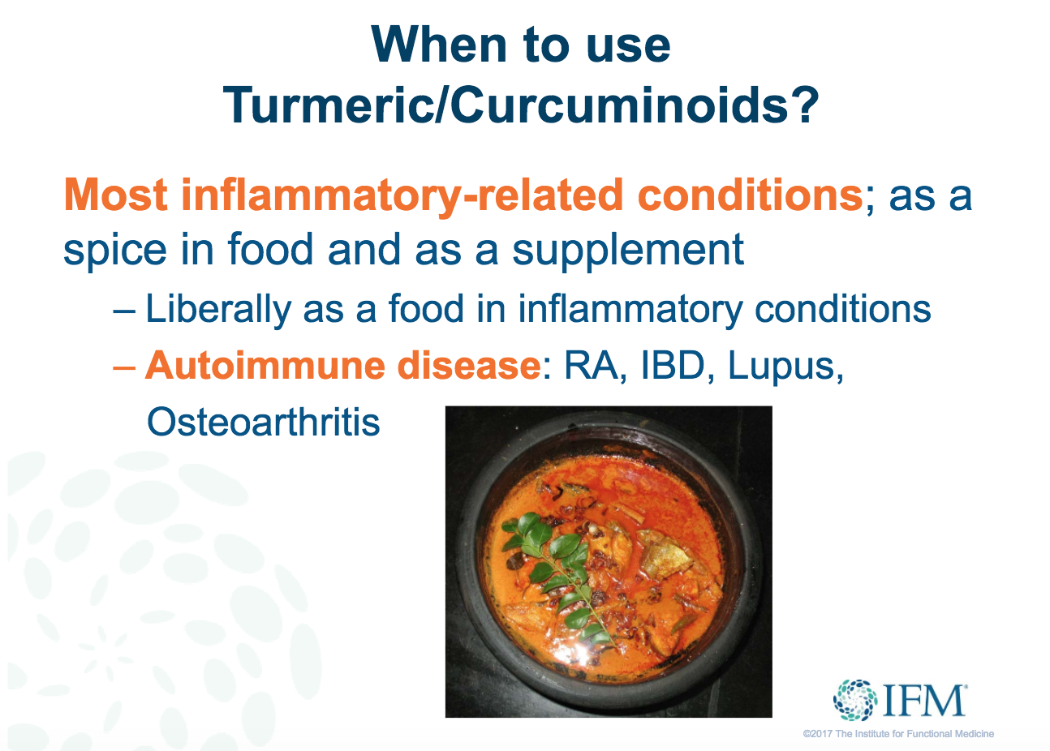

Slide 41
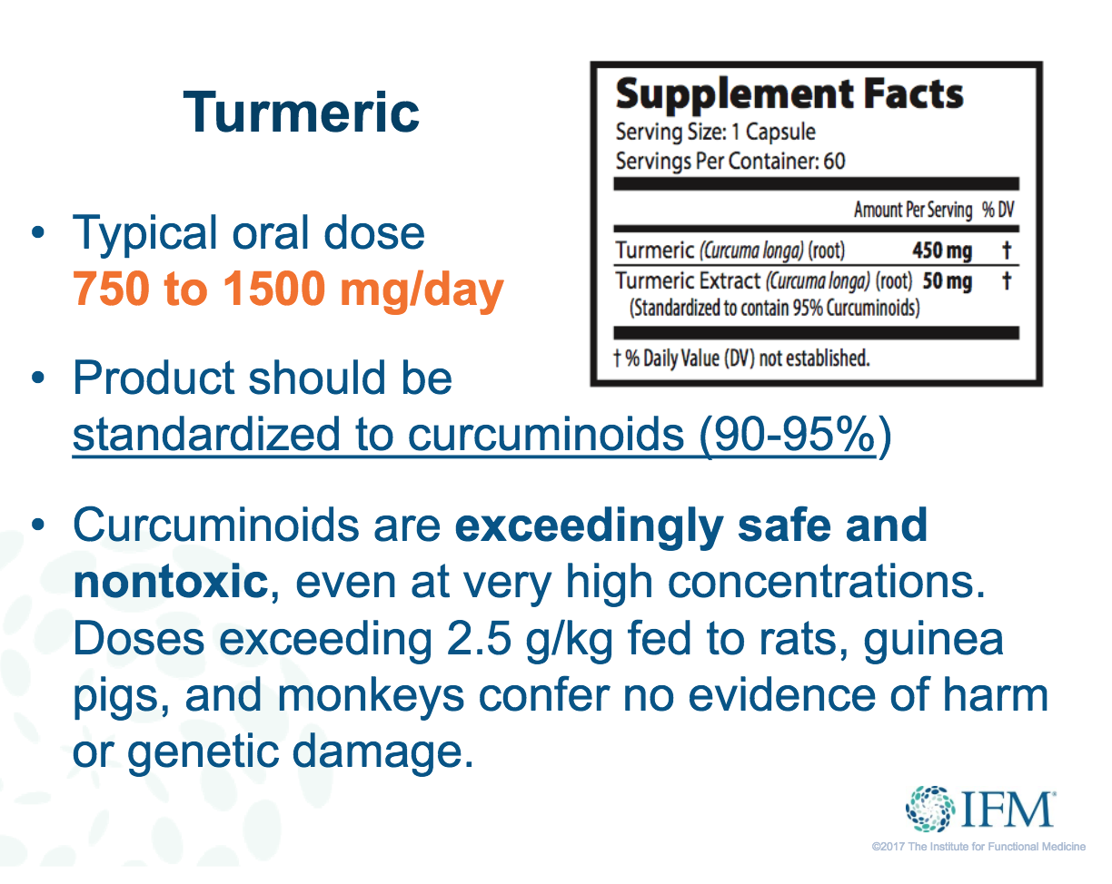

Slide 42

The Hormone, “Vitamin” D
Hormone: Vitamins help regulate cellular enzyme activity, hormones bind to cells to regulate cellular function
  D2 plant derivative
  D3 made by human skin when exposed to sunlight
Has neuroprotective and/or vasculoprotective roles relevant to mild TBI
Deficiency Symptoms: Asymptomatic, immune & endocrine dysfunction, cognitive impairments, & more
Scrimgeour, A. & Condlin, M. (2014)

Slide 43
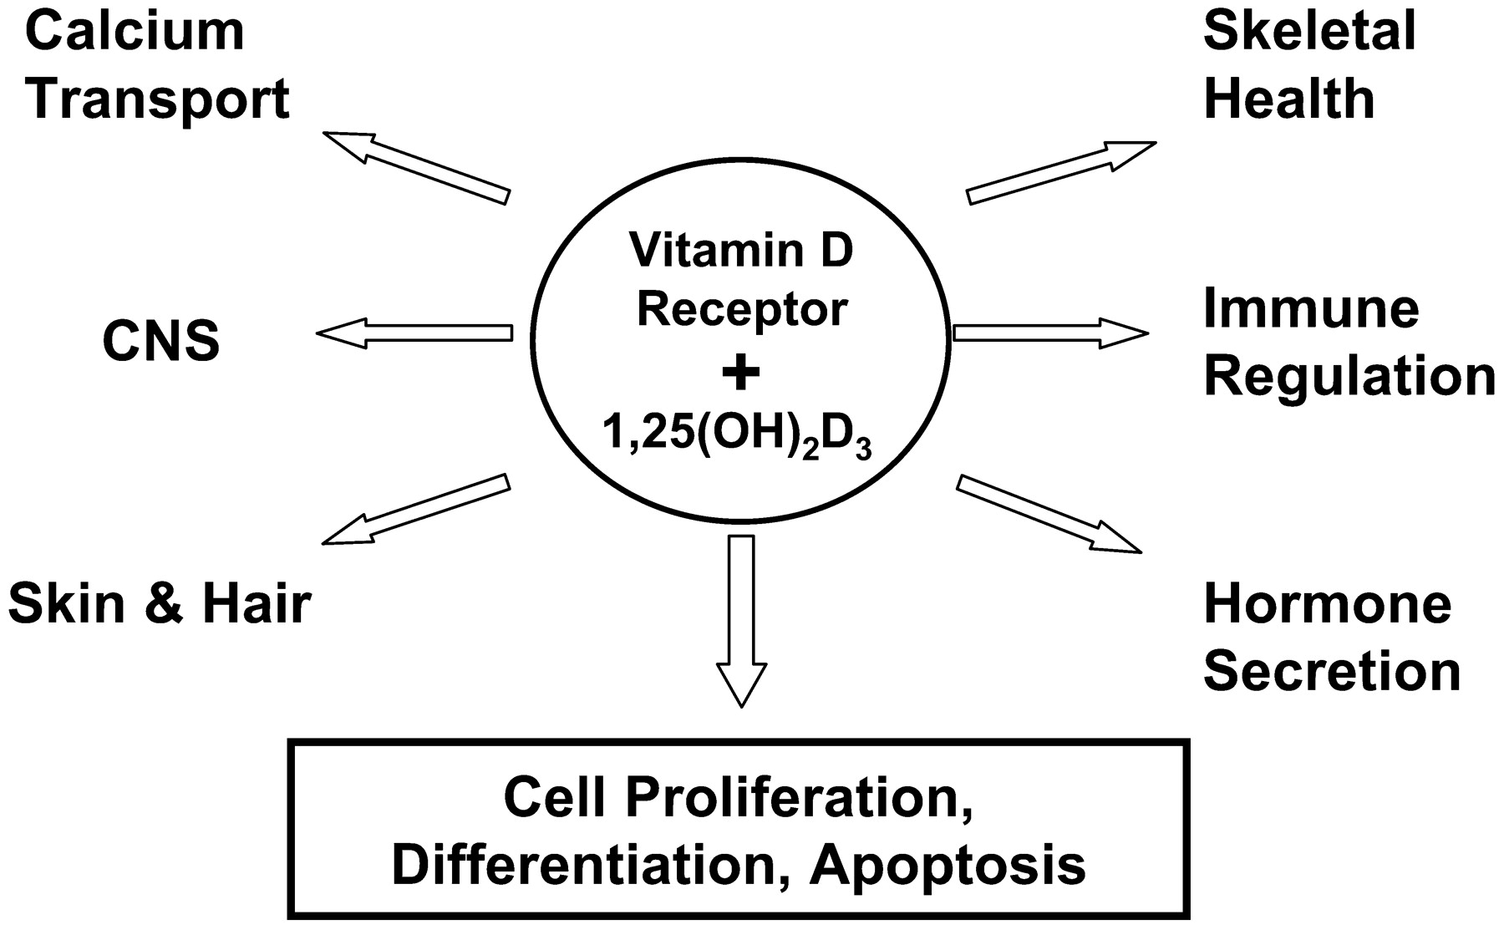

Slide 44
Vitamin D Supplementation
Important to check serum levels after 3 months of supplementing
<10 ng/mL- 10,000 units per day
10-20 ng/mL- 10,000 units per day
20-30 ng/mL- 8,000 units per day
30-40 ng/mL- 5,000 units per day
40-50 ng/mL- 2,000 units per day

Slide 45
5-Methyltetrahydrofolate
Folate-deficiency increases susceptibility to cerebral ischemia in animal studies
Folate is protective of the brain from neuro degeneration during cerebral ischemia
MTHFR and FLOR SNPs have a significant increased need for methyl folate
B12 is a necessary cofactor in administration
Endres, M. et. al, (2004)
Ramaekers, V., Sequeira, J., & Quadros, E. (2013)

Slide 46
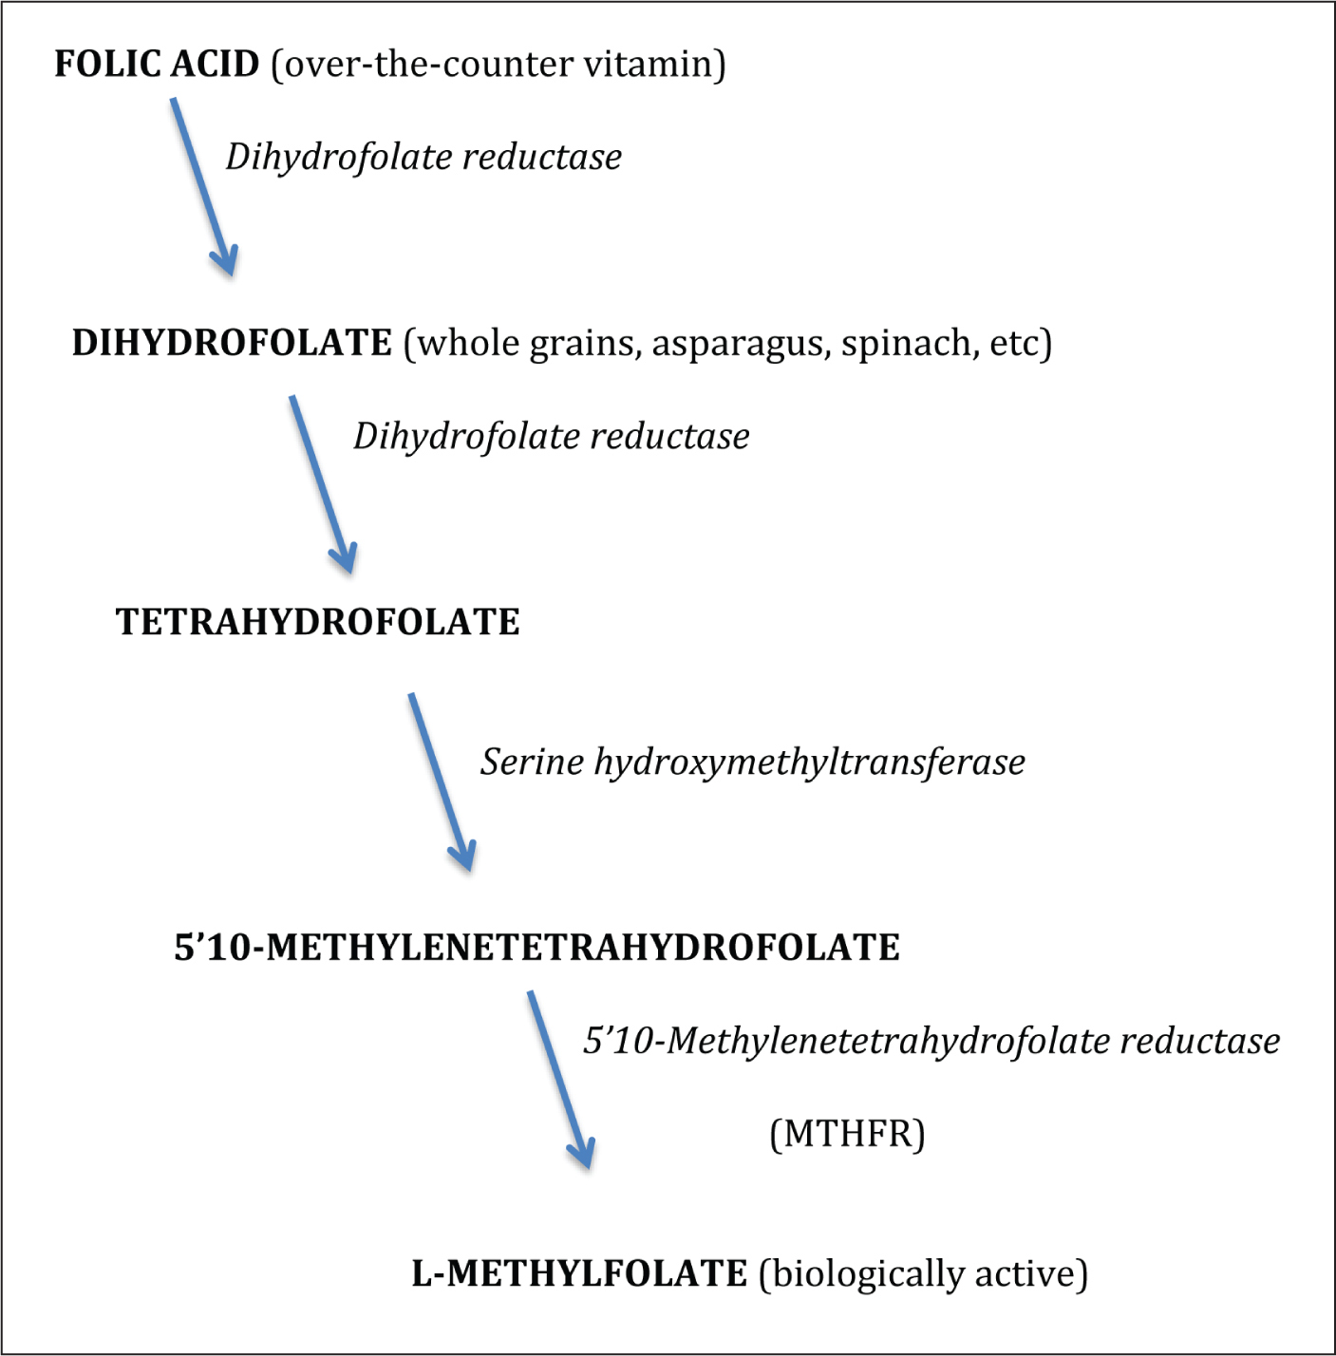
Notes:
Folinic acid- leucovorin is 5’10 MTHF

Slide 47
Glutathione
Most powerful anti-oxidant in our body
Helps to prevent damage to cells caused by reactive oxygen species
65x more potent than Vitamin C
Helps detoxify drugs (phase 2 detox)
Liver protective

Slide 48
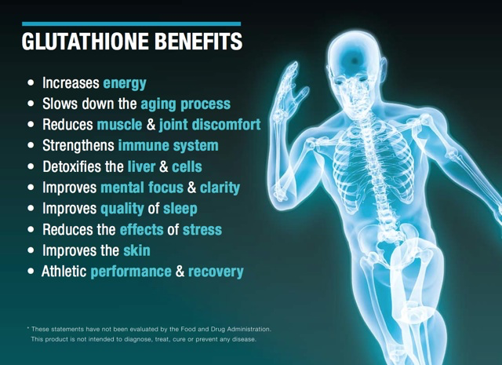

Slide 49

Magnesium
Plays an essential role in more than 300 cellular reactions.
Extracellular magnesium is critical to both maintaining nerve and muscle electrical potentials and transmitting impulses across neuromuscular junctions.
Magnesium has been shown to have neuroprotective effects, preventing post-hypoxic brain injury by blocking the excess release of glutamate in the calcium channel.

Slide 50
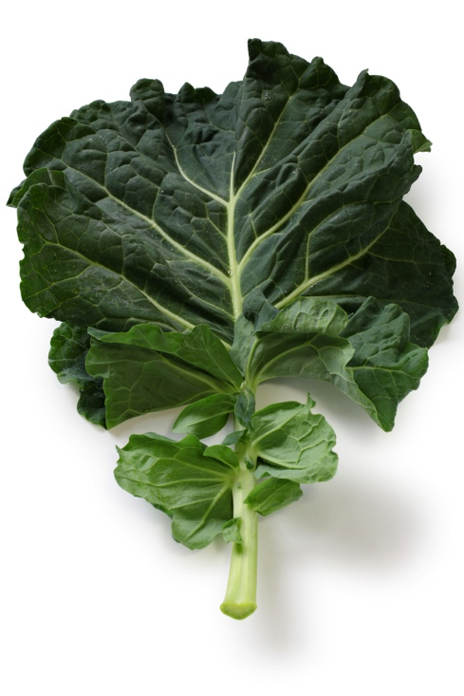
Dietary sources of magnesium include legumes, whole grains, vegetables (especially broccoli, squash, and green leafy vegetables), seeds, and nuts (especially almonds).
Picky eaters are at risk for deficiency.
Multiple different salt forms: magnesium threonate found enhance memory and learning.
Dosing studied with headaches 300-3625 mg divided twice daily (>8 years).
Epsom salts (mg sulfate) baths alternative to oral administration.
Neuron 65, 165–177, January 28, 2010
Notes:
Imag T
Citrate good for bowel clearance

Slide 51
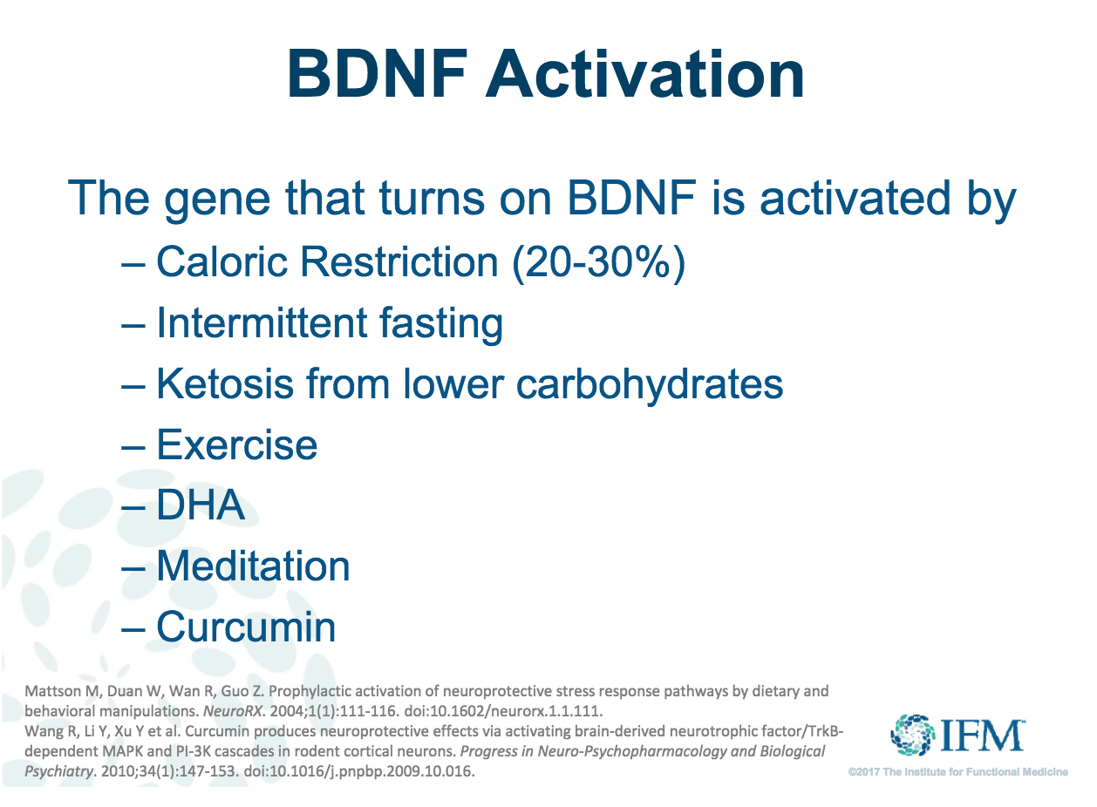
Notes:
BDNF is a protein that increases the growth of new brain cells

Slide 52
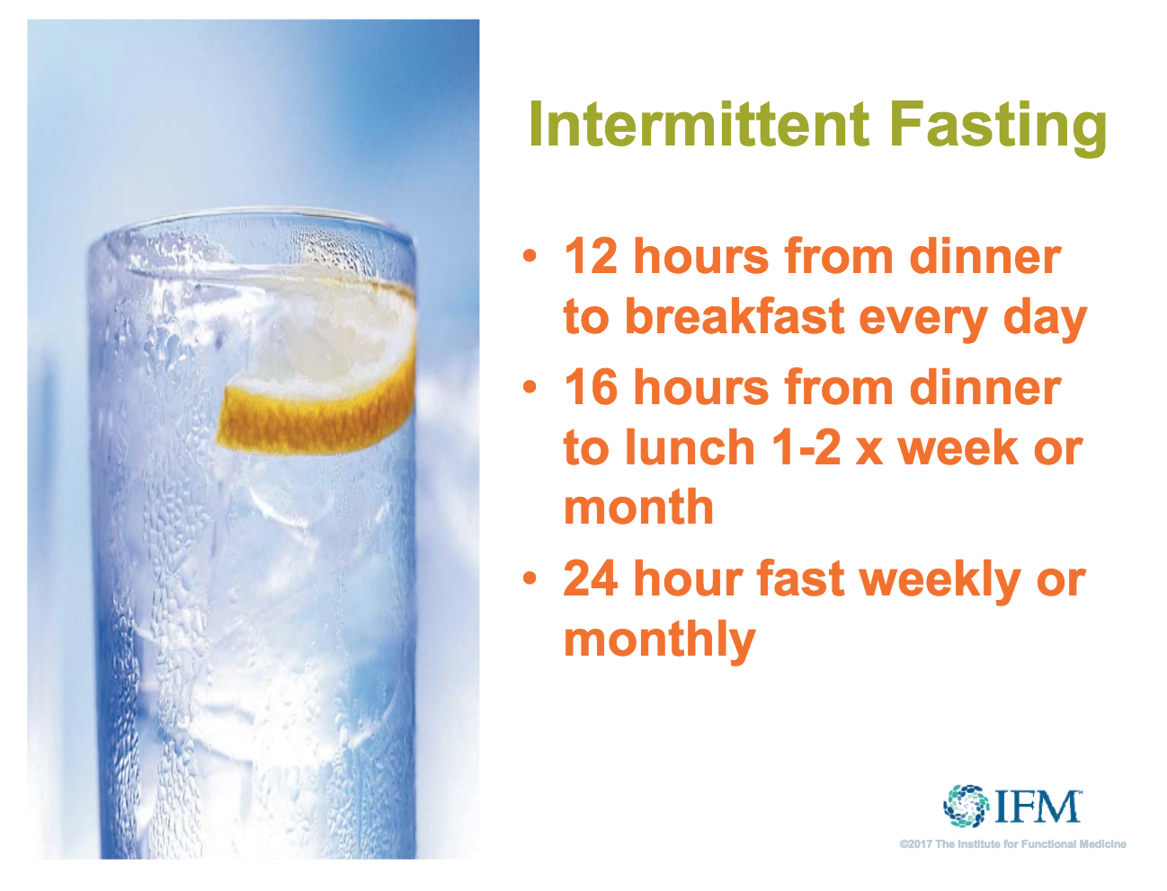

Slide 53


Slide 54

Neuronutrition Associates Online Store
Functional labs to purchase on your own
Educational modules for autism appropriate for TBI
Website: www.neuronutritionassociates.com

Slide 55

Dietary Supplements = Food products
“intended to supplement the usual food and drink of man”
(FDA, 2013)
Notes:
The US Dietary Supplement and Health Education Act (DSHEA) of 1994 placed dietary supplements under the same category as dietary ingredients, placing these products under the umbrella of “food products” (US FDA, 2013).
DS are “intended to supplement the usual food or drink of man “

Slide 56

Good Manufacturing Practice Law
  Poor Compliance
  Poor Clinician Confidence
  Look for Certification
(Fabricant, 2013)
Notes:
To tighten regulation, the lawmakers passed the good manufacturing practice law 2007 and was fully applied to the industry in 2010. This law defines the basic principles of manufacturing, process control and testing.
Despite the good manufacturing practice law, the FDA reports the basic tenets of this law are not being adhered to (especially testing), or in many instances are completely absent (Fabricant, 2013).

Slide 57
NHP Labeling Requirements
Labels cannot claim to:
  diagnose
  treat
  cure
  prevent a disease
FDA DOES NOT WANT CONSUMERS TO
DELAY SEEKING MEDICAL CARE
(FDA, 2014)
Notes:
The Federal Drug Administration requires mandatory disclaimers that products cannot claim to diagnose, treat, cure, or prevent a disease so that consumers do not delay seeking medical care (FDA, 2013).
FDA are not the “bad guys”, they just have limited manpower to regulate NHPs, therefore clinicians need to be aware of these regulatory laws and practices in order to be competent while attempting to manage NHPs with their patients.

Slide 58
All NHPs are not created equal
Contamination
Unidentified herbs, pesticides, metals,
and prescription medicines
Serving Sizes
Absent, ambiguous, or exceed RDA’s
Numerous Ingredients
Synergistic effects with herbs or Rx’s
(American Society of Health Pharmacists, 2004)
Notes:
Natural health products may be contaminated with other herbs, pesticides, or metals, or even adulterated with unlabeled, illegal ingredients such as prescription drugs (NCCAM, 2013).
Serving sizes can be absent, ambiguous, or exceed daily recommended allowances
The more ingredients a product has, the harder it is to determine and evaluate it efficacy or synergistic effect with the other ingredients or other prescription medications

Slide 59




Third Party Product Evaluators
National Sanitation
Foundation
US Pharmacopeia
Consumerlab.com
Good Manufacturing Practice
    Certification

Slide 60
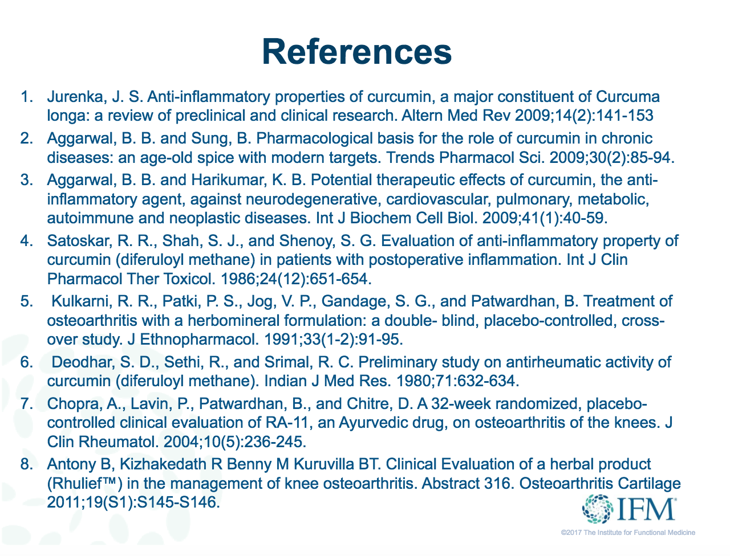

Slide 61
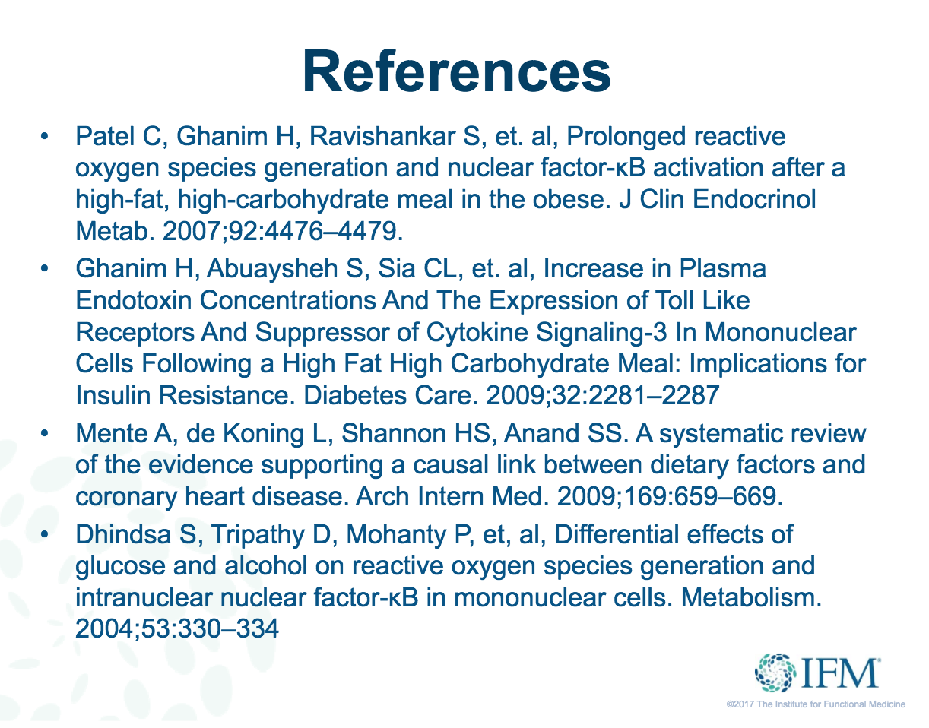

Slide 62
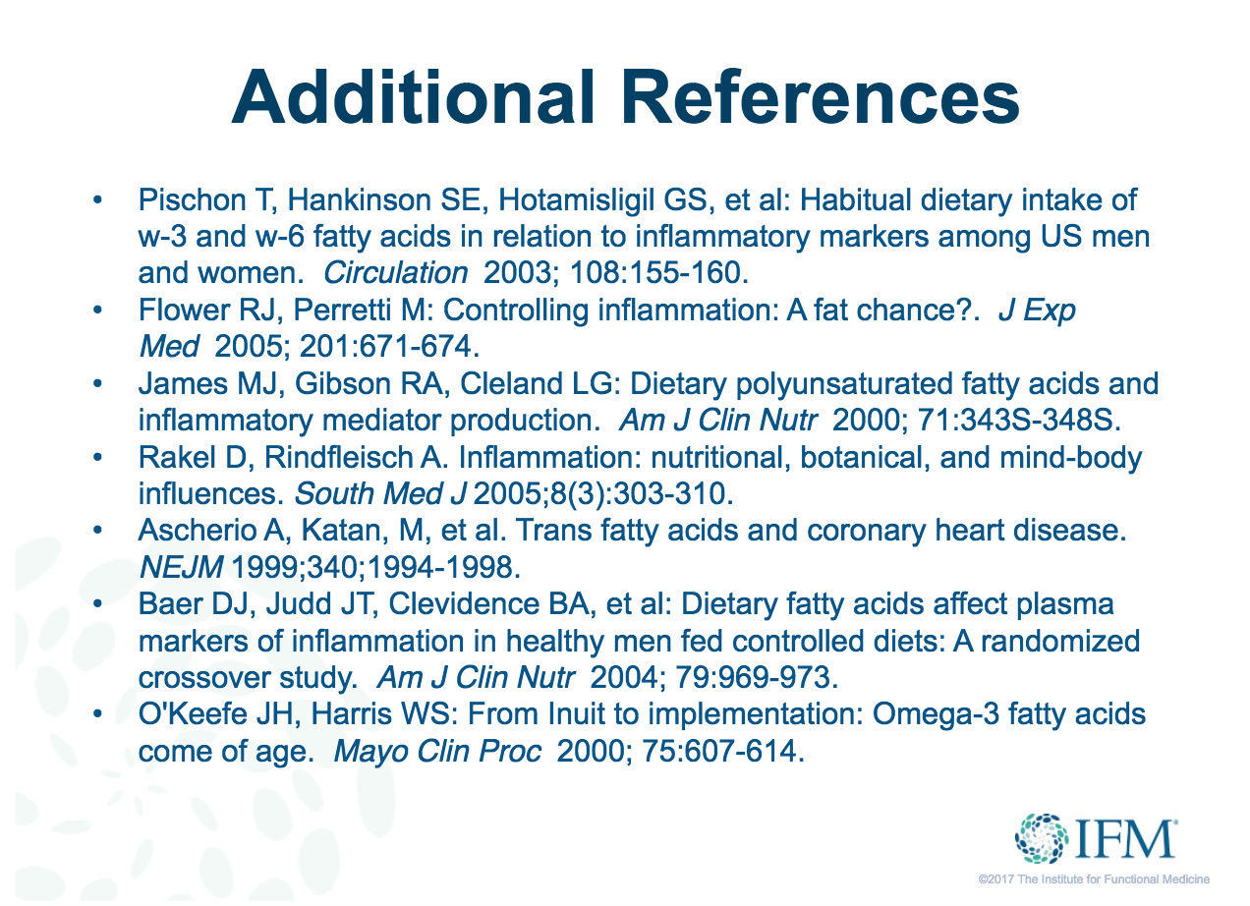

Slide 63
American Psychological Association, 2016. That gut feeling. Retrieved from http://www.apa.org/monitor/2012/09/gut-feeling.aspx
American Society of Health-System Pharmacists. (2004). ASHP statement on the use of dietary supplements. Medication Therapy and Patient Care: Specific Practice Areas-Statements, , 311-315.
Barrett, E., McBurney, M., & Ciappio, E. (2014). Fatty Acid Supplementation as a Potential
Therapeutic Aid for the Recovery from Mild
Traumatic Brain Injury/Concussion. Adv. Nutr. 5: 268–277, doi:10.3945/an.113.005280
Barrett, J. R., Tracy, D. K., & Giaroli, G. (2013). To sleep or not to sleep: A systematic review of the literature of pharmacological treatments of insomnia in children and adolescents with attention-deficit/hyperactivity disorder. Journal of Child and Adolescent Psychopharmacology, 23(10), 640-647. doi:10.1089/cap.2013.0059 [doi]
Beaudin, A. & Stover, P. (2007). Folate-Mediated One-Carbon Metabolism and Neural Tube Defects: Balancing Genome Synthesis and Gene Expression. Birth Defects Research (Part C) 81:183–203
Cheng, G. (2011). Mitochondria in traumatic brain injury and mitochondrial-targeted multipotential therapeutic strategies. British Journal of Pharmacology. DOI:10.1111/j.1476-5381.2012.02025
Cools, R. (2008). Role of Dopamine in the Motivational and Cognitive Control of Behavior
Neuroscientist 14: 381-395

Slide 64
Cools, R., & D’Esposito, M. (2011). Inverted-U shaped dopamine actions on human working memory and cognitive control. Biological Psychiatry, 69(12), e113–e125. http://doi.org/10.1016/j.biopsych.2011.03.028
Endres, M. et. al, (2004). Folate Deficiency Increases Postischemic Brain Injury Stroke. 2005;36:321-325.
Frabricant, D. (2013). In Office of Dietary Supplement Practicum (Ed.), What the FDA does Oral Presentation
Frank, M. J., & Fossella, J. A. (2011). Neurogenetics and Pharmacology of Learning, Motivation, and Cognition. Neuropsychopharmacology, 36(1), 133–152. http://doi.org/10.1038/npp.2010.96
Gilbody, S., Lewis, S., & Lightfoot, T. (2006). Methylenetetrahydrofolate reductase (MTHFR) genetic polymorphisms and psychiatric disorders: a HuGE review
Am. J. Epidemiol. (2007) 165 (1): 1-13
Institute of Medicine (US) Committee on Nutrition, Trauma, and the Brain; Erdman J, Oria M, Pillsbury L, editors. Nutrition and Traumatic Brain Injury: Improving Acute and Subacute Health Outcomes in Military Personnel.
Washington (DC): National Academies Press (US); 2011.
Laskowitz D & Grant G, (2016). Genetic Influences in Traumatic Brain Injury
Translational Research in Traumatic Brain Injury. Boca Raton (FL): CRC Press/Taylor and Francis Group; Chapter 9.
Loffler S, Gasca F, Richter L, Leipscher U, Trillenberg P, Moser A. The effect of repetitive transcranial magnetic stimulation on monoamine outflow in the nucleus accumbens shell in freely moving rats. Neuropharmacology. Oct 2012;63(5):898-904.

Slide 65
McClain, C.J., Twyman, D.L., Ott, L.G., Rapp, R.P., Tibbs, P.A.,
Norton, J.A., Kasarskis, E.J., Dempsey, R.J., and Young, B. (1986).
Serum and urine zinc response in head-injured patients. J. Neurosurg.
64, 224–230.
Ramaekers, V., Sequeira, J., & Quadros, E. (2013). Clinical recognition and aspects of the cerebral folate deficiency syndromes Clin Chem Lab Med 2013; 51(3): 497–511
Scrimgeour, A. & Condlin, M. (2014). Nutritional Treatment for Traumatic Brain Injury. Journal of Neurotrauma :989–999.
Sheldrick, A.J. et al. Effect of COMT val158met genotype on cognition and personality
European Psychiatry , Volume 23 , Issue 6 , 385 - 389
Stahl, S. (2008). Brainstorms: L-Methylfolate: A vitamin for your monoamines. Clinical Psychiatry 69 (9): 1352-1353
Tang, H. et. al (2014). Progesterone and vitamin D: Improvement after traumatic brain injury in middle-aged rats. Hormones and Behavior 64 (2013) 527–538
Tipton, K. (2015). Nutritional Support for Exercise-Induced Injuries. Sports Med (2015) 45 (Suppl 1):S93–S104
United States Food and Drug Administration. (2012). Dietary supplements- Q&A. Retrieved 10/01, 2012, fromwww.fda.gov/food/dietary supplements/consumerinformation
United States Food and Drug Administration. (2012). Tips for the savvy supplement user: Making informed decisions and evaluating information. Retrieved 10/01, 2012, from www.fda.gov/food/dietary supplements/consumerinformation

Slide 66
Wu, A., Zing, Y., & Pinilia, F. (2006). Dietary curcumin counteracts the outcome of traumatic brain injury on oxidative stress, synaptic plasticity, and cognition. Experimental Neurology 197 (2006) 309 – 317.
Wu A, Ying Z, Gomez-Pinilla F (2014). Dietary strategy to repair plasma membrane after brain trauma: implications for plasticity and cognition. Neurorehabil Neural Repair. 28:75–84.
Yi-Le Wu, et. al, (2013). Association between MTHFR C677T polymorphism and depression: An updated meta-analysis of 26 studies, Progress in Neuro-Psychopharmacology and Biological Psychiatry, Volume 46, 78-85
Zhang, Q. et. al, (2011). The neuroprotective action of pyrroloquinoline quinone against glutamate-induced apoptosis in hippocampal neurons is mediated through the activation of PI3K/Akt pathway. Toxicology and Applied Pharmacology 252; 62–72
Peikert A, Wilimzig C, Kohne-Volland R. Prophylaxis of migraine with oral magnesium: results from a prospective, multi-center, placebo-controlled and double-blind randomized study. Cephalalgia 1996;16:257-63.
Covington TR, et al. Handbook of Nonprescription Drugs. 11th ed. Washington, DC: American Pharmaceutical Association, 1996.
McDonald, J. W., Silverstein, F. S., and Johnston, M. V. Magnesium reduces N-methyl-D-aspartate (NMDA)-mediated brain injury in perinatal rats. Neurosci.Lett. 2-5-1990;109(1-2):234-238.

