Slide 1
Outpatient Cognitive Rehabilitation of Executive Function
M. Cullen Gibbs, Ph.D.
Clinical Neuropsychologist
Pediatric Service Line Leader
TIRR Memorial Hermann
Adjunct Assistant Professor
Dept. of Physical Medicine and Rehab.
Baylor College of Medicine

Slide 2
Goal/ Plan
Understanding Traumatic Brain Injury
Relationship between Frontal Lobe and Executive Functions
What are the “Executive Functions?”
Executive Function Deficits
Interventions Principles
Domain Specific Goals
Domain Specific Strategies

Slide 3
The Silent Epidemic
This epidemic is the leading killer and cause of disability in children and young adults.
Academic and/or behavioral problems can emerge later and not be attributed to the earlier brain injury.
Many children and their families are not aware that special attention is needed.
Family members, school personnel, and even medical professionals often have trouble figuring out why a child’s behavior or abilities have changed when symptoms finally appear.

Slide 4
Understanding Traumatic Brain Injury

Slide 5
What is a Traumatic Brain Injury?
A traumatic brain injury (TBI) is:
physical injury to brain tissue
temporarily or permanently impairs brain function.
TBI’s vary in severity
Mild
Moderate
Severe

Slide 6
Defining The Severity Of Traumatic Brain Injury
Mild (or minor)
Brief (<1 hour) or no loss of consciousness (LOC)
Possible symptoms of a concussion
Moderate
LOC more than 1 hour but less than 24 hours
Neurological evaluation finds evidence of brain trauma
Possible positive findings on CT scan or EEG
Severe
Coma > 24 hours

Slide 7
Pathology of TBI
Structural changes may be gross or microscopic.
Patients with less severe brain injury may have no structural damage.
Clinical manifestation vary largely in severity.
Injuries are commonly categorized as open or closed.

Slide 8
Open Head Injuries
Involve penetration of the scalp and skull.
They typically involve bullets or sharp objects.
A skull fracture with an overlying laceration due to severe blunt force is also considered an open injury.

Slide 9
Closed Head Injury
Occurs when the head is struck, strikes an object, or is shook violently.
Acceleration/deceleration are the rapid movements of the brain forward and backward. For example, this can happen during a car crash, during a bicycle fall when the head hits the ground, or when a baby is shaken.
Acceleration or deceleration injuries can injure tissue at the point of impact have an impact (coup) and at its opposite pole (contrecoup).
Shearing/rotation occurs as the twisting and rotation of the brain damages blood vessels and nerve fibers.

Slide 10
Coup and Contrecoup

Slide 11
Pathology of Traumatic Brain Injury
Primary Factors
Skull Fracture
Intracranial contusions and hemorrhage
Shear strain injury
Secondary Factors
Brain swelling
Cerebral edema
Elevated intracranial pressure
Metabolic crisis
Hypoxia- Ischemia
Mass lesions (hematoma)

Slide 12
Pathology of Traumatic Brain Injury
Neurochemical
Excessive production of free radicals
Excessive release of excitatory neurotransmitters
Disruption of cellular calcium homeostasis
Delayed Effects
White matter degeneration and cerebral atrophy
Posttraumatic Hydrocephalus
Posttraumatic seizures

Slide 13
Traumatic Brain Injury and Executive Function

Slide 14
TBI predominantly causes damage to the frontal/temporal regions, regardless of the pathophysiology.
There are well known associations between frontal and executive functions.
Executive function deficits are common after childhood TBI.

Slide 15
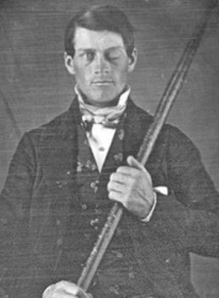
Frontal Lobes and Executive Function

Slide 16
What are the Executive Functions?
“An “umbrella” term, encompassing… those interrelated skills necessary for purposeful, goal-directed activity” (Anderson, 1998)
“Capacities that enable a person to engage successfully in independent, purposeful, self-serving behaviors” (Lezak, 1993)

Slide 17
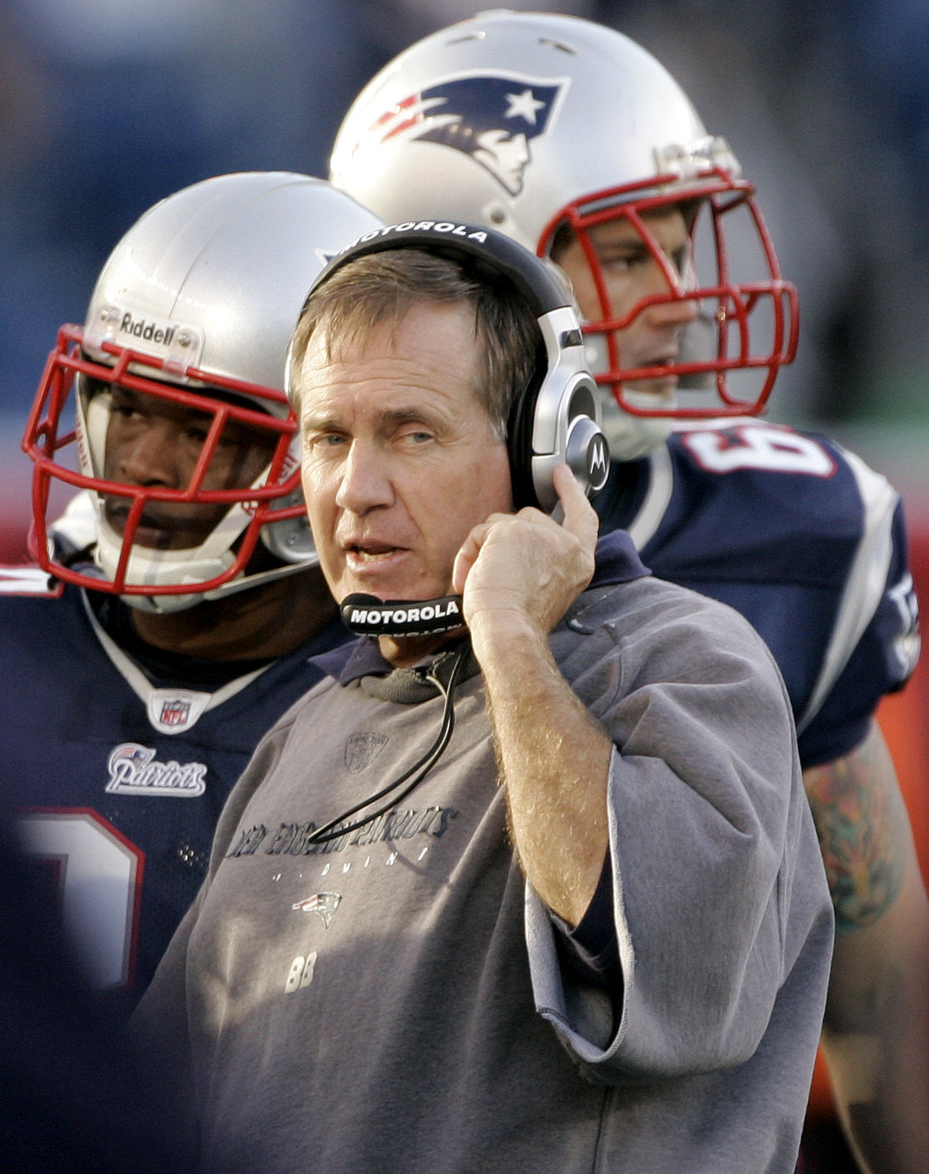
Role of the Executive
"conductor of the orchestra"
“CEO of the corporation”
“general of the army”
“head coach of the team”

Slide 18
Executive Functions as the “Conductor of the Orchestra”

Slide 19
Functions of the “Conductor”
Initiate goal-oriented action
Working Memory
Plan & Organize
Self-monitor & evaluate
Inhibit
Flexibility
Emotional regulation
Self-awareness

Slide 20
Functional Domains of The Executive
Inhibit - stop an action or not react to impulse
Shift - move from one task or situation to another
Emotional Control - regulate emotional response
Initiate - begin task, activity, attention
Working Memory - hold information actively in mind
Plan - anticipate future events and develop steps
Organize - establish, maintain order
Self-monitor - attend to behavior/output; revise

Slide 21
Functions of the “Orchestra”
1. Perception
2. Conceptual thinking
3. Language processes
3. Visual-spatial processes
4. Memory
5. Sensory inputs
6. Motor outputs
7. Emotion
8. Knowledge & skills
social
non-social

Slide 22
Functions of the “Conductor”
1. Initiate goal-oriented action
2. Working Memory
3. Plan & Organize
4. Self-monitor & evaluate
5. Inhibit
6. Flexibility
7. Emotional regulation
8. Self-awareness
Functions of the “Orchestra”
1. Perception
2. Conceptual thinking
3. Language processes
3. Visual-spatial processes
4. Memory
5. Sensory inputs
6. Motor outputs
7. Emotion
8. Knowledge & skills
social
non-social

Slide 23
Critical Features of Executive Control Functions (Denckla 1995)
Provide for delayed responding
Future-oriented
Strategic action selection
Intentionality
Anticipatory Set
Freedom from interference
Ability to sequence behavioral outputs

Slide 24
Demand Situations for Executive Functions
Multi-step tasks/ learning
Novelty (lack of experience base) vs Automaticity (familiar)
High vs low stress
Future vs present orientation
Intentional action selection

Slide 25
Outcome of “Good” Executive Function
Purposeful, goal-directed activity
Active problem solving
Self-control
Independence
Reliability and consistency
Positive self-efficacy
Internal locus of control

Slide 26
Contribution of EF to Other Areas of Functioning
Language-based Problem Solving
Reading & Writing - Working Memory, Organization
Nonverbal Problem Solving
Novelty, Organization, Flexibility
Communication Problems
Organization, Impulsivity, Working Memory

Slide 27
How are deficits in executive function identified?

Slide 28
Assessment of Executive Functions
EF are dynamic, fluid
“Executive” is often provided by the examiner, family members, environmental structure
All formal tests and informal tasks are multi-dimensional, requiring both content and EF
EF deficits should be seen across domains
Need measures of a client’s real-world expression of executive dysfuncion to have a complete picture

Slide 29
Assessing the Executive Functions
No formal, single test of EF
Indirect observation; inferences made
IQ: tasks may be too structured to involve EF.

Slide 30
Methods of Assessing EF
“Micro” Level - Tests
Specific processes (e.g., working memory, response inhibition, organization, flexibility)
Performance Tests
“Macro” Level - Real-world action
Everyday behavior and performance in context
Behavior ratings (Self, Others)
In vivo observation

Slide 31
Principles of Executive Function Intervention

Slide 32
Interventions: General Principles
Good Assessment:
Define relevant EF deficit, associated domain specific abilities or deficits, and task/situational demands
Determine the overall functioning level of client and what are appropriate expectations for EF.

Slide 33
Interventions: General Principles
Teach goal-directed problem-solving process,
within everyday meaningful routines,
having real-world relevance and application,
using key people (family members/ friends) as models, “coaches” (Co-conductor).

Slide 34
Interventions: General Principles
External to internal process
External models of multi-step problem-solving routines
External guidance to develop & implement everyday routines
Practice application/ use of routines
Fade external support to cueing internal generation & use of routines

Slide 35
Interventions: General Principles
External to internal process
Internal control to generate & use specific problem-solving routine
Generalization to new situation, requiring some external guidance
Accumulate experience, examine conditions for selective use of various routines
Feedback throughout (i.e., reward)

Slide 36
Structuring an Executive Function Rehabilitation Program
Use of everyday routines with (e.g., Goal-Plan-Do-Review)
Support working memory via “hard copy” of routine
Allowing client to become increasingly more active in formulating plans and reviewing their performance
Notes:
18

Slide 37
Goal-Plan-Do-Review
GOAL
What do I want to accomplish?
PLAN
How am I going to accomplish my goal?
MATERIALS/ EQUIPMENT STEPS/ASSIGNMENTS
1. 1.
2. 2.
PREDICTION: HOW WELL WILL I DO?
Self rating 1 2 3 4 5 6 7 8 9 10
Other Rating 1 2 3 4 5 6 7 8 9 10
How much will I get done?
DO
PROBLEMS SOLUTIONS
1. 1.
2. 2.
3. 3.
REVIEW: HOW DID I DO?
Self rating 1 2 3 4 5 6 7 8 9 10
Other rating 1 2 3 4 5 6 7 8 9 10
WHAT WORKED? WHAT DIDN'T WORK
1. 1.
2. 2.
WHAT WILL I TRY NEXT TIME?
Ylvisaker and Feeney, 1998

Slide 38
Reasons for a Reduced Executive Function Focus
Belief that executive functions are “higher order” and must wait on their treatment until “lower order” cognitive and social processes are developed/ treated
Desire to protect the individual, resulting in family or care providers assuming responsibility for all executive aspects of the individual’s behavior
Notes:
14

Slide 39
Reasons for a Reduced Executive Function Focus
Tendency to assume that role as helping professional, spouse, or parent requires assuming control for executive dimensions of tasks (identifying weaknesses, setting task/ treatment goals, planning and organizing activities, etc.)
Notes:
15

Slide 40
Reasons for a Reduced Executive Function Focus
Lack of focus of executive function aspects of treatment within professional training programs
Client gives appearance of being in control under more familiar circumstances that rely on old knowledge, well-established routines
Notes:
16

Slide 41
Result of No Focus on Executive Function Treatment
With luck, the client will develop some sporadic independent problem-solving skills
More likely,
Develop learned helplessness
Promote dependency
Opposition toward caregivers
Notes:
17

Slide 42
Executive Function Intervention Across Contexts
Coordinate executive function intervention across therapies and environments
Recognizing common executive routines between settings
Utilizing similar strategies (e.g., Goal-Plan-Do-Review)
Use of common Executive Routines notebook
COMMUNICATION
Notes:
20

Slide 43
What Executive Function Intervention is Not
Specific set of skills/ information to “teach” client
List of steps taped to the closet door
Simple behavior modification to increase motivation
A “client thing” - listing treatment goals without attention to the “how, who, where, when” of the delivery system

Slide 44
Domain-Specific Executive Function Intervention

Slide 45
Initiating:
Increase structure of tasks
Establish and rely on routines
Determine minimal level of cue to help start and reduce cue over time
Break tasks into small, manageable steps
Place client with partner or group for modeling and cuing from peers
Reframe "lack of motivation" as initiation deficit for client, spouse, other therapists

Slide 46
Sustaining:
Increase salience in task- rely on high interest tasks
Hands-on activities support sustained attention problems
Ask client to choose among topics of interest to increase investment
Use verbal mediation to help remain focused
Write down list of what to attend to for a specific task

Slide 47
Sustained Working Memory:
Repeat instructions as needed, perhaps quietly to the client
Keep instructions clear and concise
Concrete reference
Use of script

Slide 48
Inhibiting:
Increase structure in environment to set limits for inhibition problems
Make behavior and work expectations clear and explicit; review with client
Post rules for behavior in view; point to them when client breaks rule
Teach response delay techniques (counting to ten before acting)

Slide 49
Shifting:
Increase routine to the day
Make schedule clear and public
Forewarn of any changes in schedule
Give 2 minute warnings of time to change
Make changes from one task to the next, or one topic to the next, clear and explicit
Shifting may be a problem of inhibiting, so apply strategies for inhibition problems

Slide 50
Organizing:
Increase organization in milieu
Increase organization of therapy to serve as model and help client grasp structure of novel material
Present the framework of new information to be learned at the outset, and review again at the end of a lesson
Begin with tasks with only few steps and increase gradually

Slide 51
Planning:
Practice with tasks with only a few steps first
Teach simple flow charting as planning tool
Practice with planning tasks (e.g., mazes)
Ask client to verbalize plan before beginning work
Ask client to verbalize second plan if first doesn't work
Ask client to verbalize possible consequences of actions before beginning
Review incidents of poor planning/anticipation with client

Slide 52
Creating Executive Function Focused Treatment Plan/ Individual Education Plan Goals

Slide 53
EF Focused Treatment Plan Goals
Macro (Long-Term) Goal: The Client will independently employ a systematic problem-solving method (e.g., Goal-Plan-Do-Review - GPDR) for tasks that involve multiple steps and/or require long-term planning.

Slide 54
EF Focused Treatment Plan Goals
Note: For clients who are younger or with severe executive dysfunction, the objectives should be prefaced by the following statement: “With directed assistance, Johnny/ Jenny will . . .”

Slide 55
Goal Setting:
(1) The Client will participate with therapists in setting instructional goals (e.g., "I want to be able to read this book, write this paragraph, etc.”)
(2) The Client will accurately predict how effectively he will accomplish a task. For example, he will accurately predict whether or not he will be able to complete a task; predict how many (of something) he can finish; predict his grade on tests; predict how many problems he will be able to complete in a specific time period; etc.

Slide 56
Planning:
(1) Given a routine (e.g., hygiene, clean his room), the Client will indicate what steps or items are needed and the order of the events.
(2) Given a selection of 3 actions necessary for an instructional session, the Client will indicate their order, create a plan on paper, and stick to the plan.
(3) Given a task that he correctly identifies as difficult for him, the Client will create a plan for accomplishing the task.
(4) Having failed to achieve a predicted grade on a test, the Client will create a plan for improving performance for the next test.

Slide 57
Organizing:
(1) The Client will follow/ create a system for organizing personal items in his locker.
(2) The Client will select and use a system to organize his assignments and other school work.
(3) Given a complex task, the Client will organize the task on paper, including the materials needed, the steps to accomplish the task, and a time frame.
(4) The Client will prepare an organized outline before proceeding with writing projects.

Slide 58
Self-Monitoring, Self-Evaluating:
(1) The Client will keep a journal in which he records his plans and predictions for success and also records his actual level of performance and its relation to his predictions.
(2) The Client will identify errors in his work without therapist assistance.
(3) The Client’s rating of his performance on a 10-point scale will be within one point of the therapist's rating.

Slide 59
Self-Awareness:
(1) The Client will accurately identify tasks that are easy/difficult for him.
(2) The Client will accurately identify his/her strengths and weaknesses.
(3) The Client will explain why some tasks are easy/difficult for him.
Self-Initiating:
When the Client does not know what to do, he will ask for help.
(2) With regular/ minimal prompting from others, the Client will begin his assigned tasks, initiate work on his plan, etc.

Slide 60
Example with ADL’s
Written statement of client’s goal for the ADL task
Specific list of all the steps needed to accomplish the task
Rate the performance (Self, Other)
Discuss discrepancies in ratings
Record what worked in one column and what didn’t work in another column
Retain the written sheet in a notebook
Notes:
19

Slide 61
Thank you for your attention!
Questions?

