Slide 1
Strategies for Managing Challenging Behaviors in Children and Adolescents with Traumatic Brain Injury: General Principles
M. Cullen Gibbs, Ph.D.
Clinical Neuropsychologist

Slide 2
Learner Objectives
The learner will:
Describe the basic behavioral principles that support effective behavior modification strategies
Identify common behavioral problems & disorders that may affect child compliance with interventions
Understand & apply 2-3 behavioral strategies within everyday clinical practice settings.

Slide 3

Faculty Introduction
For the past 10 years Dr. Gibbs has worked at TIRR Memorial Hermann performing neuropsychological evaluations, cognitive rehabilitation, and clinical research with persons who have brain injury. He received an award for an investigation of progressive cardiovascular intervention for the treatment of persistent physical and neurocognitive symptoms in adolescents with sports concussion. Dr. Gibbs has been an investigator on two NIH funded studies. He is currently the site primary investigator for a PCORI funded study investigating problem solving skills training for adolescents with traumatic brain injury and their parents. His clinical and research interests include cognitive rehabilitation and the neurocognitive and neurobehavioral correlates of traumatic brain injury, stroke, sports concussion, and neurodevelopmental disorders.

Slide 4
AGENDA
Basic Behavioral Principles
Understanding Models of Behavioral Reinforcement
Understanding Differential Attention
Case Studies and Videos
Notes:
Professional background and disclosures
Define educational goals and objectives
Provide an overview/advanced organizer of curriculum & learning activities
Cathedral building
The word cathedral is derived from the Latin word cathedra ("seat" or "chair"), and refers to the presence of the bishop's or archbishop's chair or throne. In the ancient world, the chair was the symbol of a teacher and thus of the bishop's role as teacher, and also of an official presiding as a magistrate and thus of the bishop's role in governing a diocese.
The role of the cathedral is chiefly to serve God in the community, through its hierarchical and organizational position in the church structure. A cathedral, its bishop and dignitaries have traditional functions which are mostly religious in nature, but may also be closely associated with the civil and communal life of the city and region.
Births, marriages and deaths are often celebrated by services at cathedrals and the cathedral often acts as a repository of local history by recording these events. The cathedral marks times of national and local civic celebration and sadness with special services. The funerals of those famous within the community are invariably held at cathedrals. People who have served the community or the church are often buried within the cathedral with which they are associated. Alternately, they may be commemorated by a memorial.
Another civic function of the cathedral is the imparting of significant civil information. Announcements may be to the populace from the steps of the cathedral, or within the cathedral itself.
Most cathedrals have a bell or bells. Bells are also used to convey information or announce the beginning of a celebration. The ringing of bells signifies a time of rejoicing, such as a wedding. An extended ringing of bells or "changes" conveys a time of great civic celebration. The slow tolling of the deepest bell signifies a death or disaster. Many cathedrals have a clock with associated chimes which announce the time. The bells of a cathedral are traditionally used signal the outbreak and the ending of war.
Cathedrals are often associated with significant secular organizations such as the office of the local mayor and council, the local court, the local regiment, schools, sporting organizations and service clubs. The cathedral often has its own school, primarily for the education of choristers, but often including other children as well.
The cathedral, often being a large building, serves as a meeting place for many people. The cathedral often forms a centre of different activities related to community service, youth activities, study, music and decorative arts.

Slide 5
Why do children misbehave?
Notes:
Interactive teacher discussion –

Slide 6
Key Behavioral Treatment Assumptions
Behavior is functional
Behavior is predictable
Behavior is changeable

Slide 7
Neurological Origins of Disruptive Behavior in Traumatic Brain Injury
Orbital frontal injury- disinhibition and impulsivity
Dorsolateral or mesial frontal injury- reduced initiation or difficulty getting started
Ventromedial prefrontal injury- inefficient learning from consequences
Dorsolateral or mesial prefrontal injury- impaired working or ability to manage multiple considerations before acting
Hippocampal injury- impaired declarative memory (i.e. conscious recollection) inefficient learning from consequences.
Notes:
Neurological/biologically-bound conditions
ADHD,
Birth Hx, Autism,
Chronic Health issues such as Hearing Loss, Sickle-cell disease, Spina Bifida, Diabetes
Learning difficulties (dyslexia, dyscalculia, etc.)
Disorders of Phonological Awareness, Reading, Written Expression, Calculation, etc.
Social difficulties (ASD, immaturity, conflict, bullying)
Immaturity (early school placement, social delay)
Bullying, social aggression
Asperger’s Disorder / High Functioning Autism
Language problems
- Developmental speech delay (Expressive or Receptive Language Disorder)
Family problems / psychosocial stressors
Family Transitions/Adjustment Disorders
Abuse/Neglect
Psychosocial Stressors
Oppositional Defiant Disorder/ Conduct Disorder
Emotional Problems
Anxiety and Mood Disorders (e.g. separation anxiety, depression, etc.)
Anger Problems - Oppositional Defiant Disorder/Conduct Disorder
Developmental delays
- Developmental motor/coordination problems
- Autism Spectrum Disorders (e.g. Autism, PDD, Asperger’s etc.)

Slide 8
Psychosocial Origins of Disruptive Behavior in Traumatic Brain Injury
Learning difficulties
Social difficulties
Language problems
Family problems/ support
Emotional problems
Worsening of preexisting difficulties
Lack of appropriate supports in the classroom
Notes:
Neurological/biologically-bound conditions
ADHD,
Birth Hx, Autism,
Chronic Health issues such as Hearing Loss, Sickle-cell disease, Spina Bifida, Diabetes
Learning difficulties (dyslexia, dyscalculia, etc.)
Disorders of Phonological Awareness, Reading, Written Expression, Calculation, etc.
Social difficulties (ASD, immaturity, conflict, bullying)
Immaturity (early school placement, social delay)
Bullying, social aggression
Asperger’s Disorder / High Functioning Autism
Language problems
- Developmental speech delay (Expressive or Receptive Language Disorder)
Family problems / psychosocial stressors
Family Transitions/Adjustment Disorders
Abuse/Neglect
Psychosocial Stressors
Oppositional Defiant Disorder/ Conduct Disorder
Emotional Problems
Anxiety and Mood Disorders (e.g. separation anxiety, depression, etc.)
Anger Problems - Oppositional Defiant Disorder/Conduct Disorder
Developmental delays
- Developmental motor/coordination problems
- Autism Spectrum Disorders (e.g. Autism, PDD, Asperger’s etc.)

Slide 9
Behavior Management: Treatment and Principles
Notes:
Interactive teacher discussion –

Slide 10
Common Elements of Behavioral Treatments:
Environmental Control
  Requires consistent adult support/guidance
  Improves behavioral expectations & limit setting
  Increases structure & routines
Contingency Management Strategies
  Uses reward systems to improve motivation
  Rigorous behavioral methods to address ABCs
    Antecedents, Behaviors, & Consequences
    A B C

Slide 11
Behavioral Principles at a Glance
Reinforcement Types
Punishment Types
Reinforcement Schedules
Extinction
Over-learning
Notes:
ADHD: -We modify behavior through the use of principles
Teach kids to perform consistently

Slide 12
Reinforcement
  Increases the likelihood of a future behavior
  Types:
    - Positive Reinforcement: increases a desired future behavior by adding a stimulus (e.g. tangible rewards, token rewards, symbolic rewards)
    - Negative Reinforcement: increases a desired future behavior by removing a stimulus (e.g. taking away attention/ignoring, removing distractions, etc.)
Notes:
Positive vs Negative = application or removal to increase behavior NOT good/bad
Thorndike-Any response that is followed by a satisfying state of affairs is likely to be reproduced
= removal of School as negative reinforce for faking stomach ache

Slide 13
Punishment
  Decreases the likelihood of a future behavior
  Types:
    - Positive Punishment: decreases a future behavior by adding an aversive stimulus (e.g. extra chores) out) rewards, token rewards, symbolic rewards)
    - Negative Punishment: decreases a future behavior by removing a stimulus (e.g. time out, grounding, losing iPad privileges)
Notes:
Positive vs Negative = application or removal to increase behavior NOT good/bad
Thorndike-Any response that is followed by a satisfying state of affairs is likely to be reproduced
= removal of School as negative reinforce for faking stomach ache

Slide 14
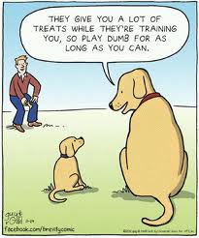
Positive Reinforcement in Action
“They give you a lot of treats while they’re training you, so play dumb for as long as you can.”

Slide 15
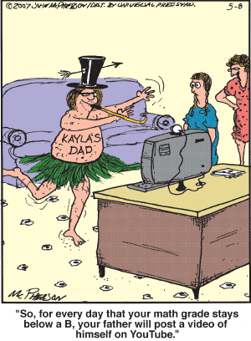
Negative Reinforcement in Action
“So, for every day that your math grade stays below a B, your father will post a video of himself on YouTube.”

Slide 16
“Differential” Reinforcement
  Applies both Positive and Negative Reinforcement to promote a desired behavior
  Uses contrast effect to increase reinforcement value
  Example: parent/ teacher use of attention
    - Giving specific, positive attention (e.g. praise) to desired behaviors (positive reinforcement)
    - Withdrawing attention or actively ignoring unwanted behaviors (negative reinforcement)
Notes:
Positive vs Negative = application or removal to increase behavior NOT good/bad
Thorndike-Any response that is followed by a satisfying state of affairs is likely to be reproduced
= removal of School as negative reinforce for faking stomach ache

Slide 17
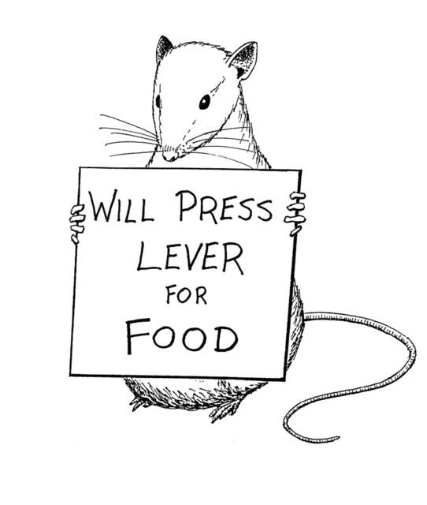
Reinforcement Schedules
1) Continuous
2) Intermittent
Fixed Interval
Variable Interval
Fixed Ratio
Variable Ratio
Notes:
1) Continuous
Every time target behavior is demonstrated, you
reinforce
Examples:
-Child receives a ticket every time they raise
their hand/make eye contact
Often used to teach new behaviors
Saturation is a concern
2) Intermittent Schedule
Reinforcers provided sporadically after either (a) a variable or fixed number of responses, or (b) a variable or fixed interval of time.
Examples:
Slot machines for gambling
Need 2 positive statements to earn piece of candy, then 5, then 10
Highest responding / Resistant to extinction

Slide 18
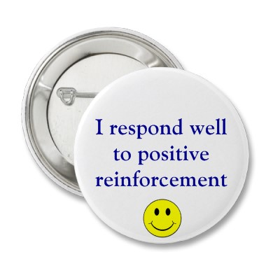
Applying in the home or classroom
  The best way to promote…
  …learning / mastery of a new behavior is to use a Continuous Reinforcement Schedule
  …maintenance of a learned / mastered behavior is to apply an Intermittent Reinforcement Schedule
  Once a behavior is mastered, reinforcement is “faded” & continuous reinforcement shifts to a new behavior
Notes:
Kids with adhd learn through strategies what works for them and adjust life/environment to make them successful
To Teach: Promotes optimal learning
To Maintain: Maintains goals

Slide 19
Reinforcement to Promote Overlearning
Emphasize “high frequency” behavior demands
Employ modeling & multiple rehearsals
Provide continuous reinforcement for target behaviors
Provide intermittent reinforcement for (already) mastered behaviors
Utilize tangible reinforcers with token rewards or prizes to increase patient motivation
Notes:
Positive Practice (Do Over Multiple Times)
Restitution
Hand-Over-Hand
Examples:
-Slam refrigerator door
-Interruptions

Slide 20
Foundations for Promoting Behavior Change:Traditional Model
“A failure to understand how a child’s typical behaviors reflect his disability can result in misperceptions such as viewing the child as noncompliant, willfully stubborn, or unmotivated, rather than confused, involved in repetitive routines, or focusing on less relevant aspects of the situation.” (Kunce & Mesibov, 1998).
Slide 20

Slide 21
Before the Task
Problem Prevention
  Post/ discuss rules, behavior goals, daily tasks, & rewards
Structuring Tasks
  Establish a consistent start-up & closing routine
  Set up “Check-Ins” & “Check-Outs”
Attention Orienting Techniques
Effective Commands
Notes:
STRUCTURING SESSIONS
Establishing effective routines will improve behavior during daily transitions (e.g. warm-up time, dismissal routine)
Clearly defining & communicating behavioral expectations (e.g. posting classroom rules/constitution)
Establishing clear & timely consequences for compliance & noncompliance
Conducting behavioral rehearsal of routines

Slide 22
Attention Orienting
Multi-sensory Prompting / Executive Functioning
Examples
  Physical Prompts
    Dimming the lights
    Clapping/Snapping
  Keywords/Statements
    Freeze command
    Echo (Broccoli Taco, Marco Polo)

Slide 23

Effective Commands
Gaining Attention & Minimizing Distractions
Key word activation of attending skills
  “Instructions”, “Directions”
  “Freeze!”
Establish Physical Contact
Shift Parent/ Teacher Attention from Attitude to Compliance
  Emphasis Placed on Giving Positive Attention
  Use of Ask, Say, Do & Differential Attention (Zisser & Eyberg 2018).
Compliance Trials- using “Fetch Commands” (Barkley, 2020) or chained commands (e.g., “Touch nose”; “Clap hands”).
Notes:
Focus on COMPLIANCE over ATTITUDE
Reduce Logistical Barriers To Communication
Give Instructions Within Close Proximity to the Student
Do Not Shout Instructions Across the Room
Establish Physical Contact
Touch the Child’s Shoulder & Lower Yourself To His/Her Eye-Level
Limit Environmental Distractions
Pull the Student Out of a Group Activity Before Giving an Instruction
Instruct the Child To Look At You
Use Key Words for Instructions
Specifically State: “I Am Giving You An Instruction”
“Your Direction Is…..”
Use a 1-Word or nonverbal prompt (e.g. “FREEZE”)
Practice “Ask, Say, Do”

Slide 24
Differential Attention
What is it?
How can it be used to support behavior?
Slide 24

Slide 25

Differential Attention
Increasing the value of positive attention (Allen, Harrington, & Cooke, 2018)
Planned ignoring of minor misbehaviors
Positive attention of target behaviors
  Narrating activities (e.g. I noticed that you…)
  Providing labeled praise
  Mimicking/matching child behaviors
Shifting the priority of commands to emphasize compliance, not positive attitude (i.e. reinforcing task compliance despite the manner in which it was completed)

Slide 26
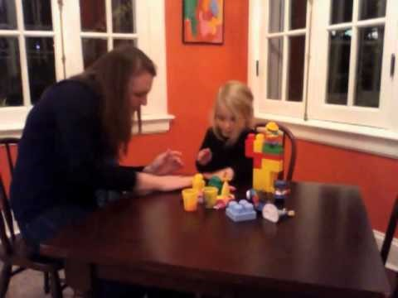
Positive Attention
Positive Attention in Action
https://www.youtube.com/watch?v=r-euHPfAAiM

Slide 27
Competing Behavior Model
Problem behaviors are replaced by alternatives that successfully compete
The likelihood that a child will use a positive alternative behavior increases when the positive alternative:
  provides the child control
  is easier, or more efficient, than problem behaviors
Gibbs, M.C.

Slide 28
Competing Behavior Model
Example:
  Antecedent- participating in learning activity
  Problem behavior- self-injurious, hitting self with hand
  Replacement behavior- reinforce clapping hands to replace hitting
Gibbs, M.C.

Slide 29
Competing Behavior Model:
Case Study 1
Case 1
Kara is teacher of a child with TBI. The child recently began to pinch his arms. She takes data on the behavior and discovers that it functions for attention. (When he pinches his arms, she comes over and tells him “no pinching.”)

Slide 30
Competing Behavior Model:
Case Study 1
Intervention
Kara decided to implement an intervention that utilizes DRI. She taught him to sit with his hands intertwined on his desk. This is an incompatible behavior with pinching because he is not able to pinch while his hands are intertwined. She reinforces him for intertwining his hands (tells him, “Great job” or “I like how you’re sitting”) and does not provide attention when he engages in arm pinching.

Slide 31
Competing Behavior Model:
Case Study 2
Case 2
Carly is a parent of child with TBI. When her child wants a break from homework, she reaches over and hits Carly’s arm. Carly typically says, “Do you need a break now?” Then, she allows her to take a five-minute break. Carly recognized that her child’s intensity with hitting seemed to be increasing, and she was worried she might get hurt.

Slide 32
Competing Behavior Model:
Case Study 2
Intervention
Carly decided to implement an intervention that utilized DRI. She put a timer on the table within her child’s reach, and taught her to touch the timer when she wanted a break. This is an incompatible behavior because the patient cannot simultaneously touch the timer and hit Carly. When Carly’s child touched the timer, she immediately received a break. When the child hit Carly, she did not receive a break. This was an especially useful intervention because, over time, Carly taught her child to set the timer on her own and become more independent with managing break times.

Slide 33
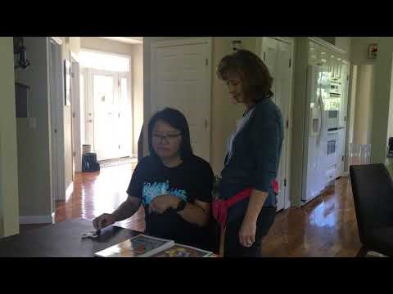
Competing Behavior Model
Competing Behavior Model in Action
https://www.youtube.com/watch?v=BGf2NE0VGgc

Slide 34
Foundations for Promoting Behavior Change: Contextual, Antecedent Focused Model
A B C
Slide 34

Slide 35
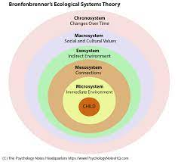
Contextual, Antecedent Focused Model
The preceding behavioral principles and strategies remain helpful and/ or necessary for children and adolescents;
However, when and how the strategies are applied should be carefully considered.
Awareness of the context in which the child or adolescent operates is important
For instance, adolescents may outright reject a token economy system because:
    Seems infantilizing
    Seen as overly restrictive
    Rewards may seem arbitrary, unrelated to the task, and meaningless

Slide 36
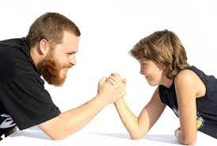
Older Children and Adolescents
Behavioral interventions for older children and adolescents should:
    Avoid power struggles
    Focus on antecedent conditions
    Provide positive support without creating learned helplessness
    Cultivate an environment that produce positive setting events
    Develop improved problem solving and greater independence

Slide 37

Setting Events
Setting events provide the internal and external context within which people act and which influence behavior
Internal States | Internal State/ External Event | Positive Setting Events | Negative Setting Events
 | Physical | Rest, relaxation, satiation | Pain, illness, hunger, fatigue
 | Cognitive States | Oriented to task, familiar routine, adequate recall/ recognition | Confusion, frustration, inadequate recall/ recognition
 | Emotional | Accomplishment, success, achievement | Anxiety, anger, depression, sense of failure
 | Meaning | Tasks are meaningful and accomplishable | Tasks are meaningless, infantilizing, or impossible
External Events/ States | Presence or Absence of Preferred People | Preferred people are present | Absence of preferred people, presence of non-preferred people
 | History of Interaction | Recent positive interactions | Recent conflict, disagreement
 | Environmental | Appropriate and desirable environment | Too loud, bright, noisy, distracting
 | Time of Day | Best time of day of for child | Bad time of day for child
Ylvisaker & Feeney, 1998

Slide 38

Positive Behavioral Momentum
Motivation and compliance are challenges that parents and teachers of children with brain injury deal with often because their requests and instructions are often met with resistance.
Positive Behavioral Momentum
  Involves making a series of easy, or “high-probability,” requests followed by a difficult or “low-probability” request.
Ylvisaker & Feeney, 1998

Slide 39
Positive Behavioral Momentum
  The goal of behavioral momentum is to get the individual accustomed to responding to easy requests, thereby increasing the likelihood that he or she will comply with the more difficult ones.
  When people are feeling good physically, feeling good about themselves, and experiencing success on important tasks, they are better able to do challenging things.
  One way to establish positive behavioral momentum throughout the day for persons with brain injury is creating daily routines with considerable efforts devoted to positive setting events before the introduction of difficult tasks.

Slide 40
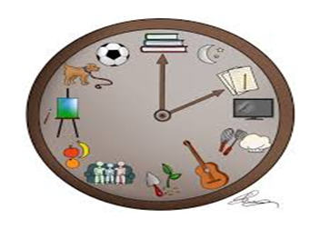
Create Daily Routines
Develop a Routine:
  Children/ adolescents with brain injury may have difficulty planning and organizing their daily tasks.
  It is helpful to plan out a consistent routine at home and school that is predictable and involves (e.g., get up at the same time each day, perform hygiene tasks in the same order, eat scheduled meals, use of checklists where necessary to help stay on track, etc.)
  A predictable daily routine helps children/ adolescents with brain injury better anticipate, initiate, and complete daily activities.

Slide 41
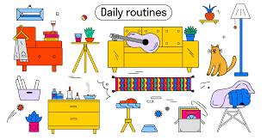
Create Daily Routines
  Engage the child/ adolescent in creating a schedule including for all of the activities that he or she might choose or be required to participate during the day.
  Provide a preferred activity before every mandated or non-preferred activity (positive behavioral momentum).
  The schedule provides a sequence that guides the child/ adolescent through activities without relying on reminders from parents/ teachers.
  For some children or adolescents it may be helpful for the routine to be picture based.

Slide 42

Create Daily Routines
 | 2021 Planner
 | Saturday
6AM-8AM | Shower, get dressed, eat breakfast
8AM-10AM | Physical therapy
10AM-12PM | Zoom meeting with classmates to work on history project
12PM-2PM | Eat Lunch and do Physical therapy home exercises
2PM-4PM | Listen to music, fold and put away laundry
4PM-6PM | Help with and eat dinner with family
6PM-8PM | Chat with friends on Discord and play videogames together
8PM-10PM | Videogames until 9:30 then get ready for bed Bedtime at 10

Slide 43
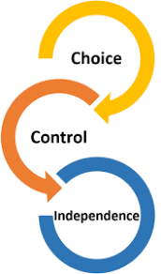
Choice and Control
Provide Choice and Control:
  After brain injury, there may be an increased need to exercise control.
  This easily results in parents and teachers engaging in power struggles with the child.
  Begin activities by giving the child/ adolescent a set of choices (maybe using photographs).
  This does not allow the child/ adolescent to dictate activities but routinely provides choices about her participation within an activity.
Ylvisaker & Feeney, 1998

Slide 44

Choice v. No Choice
Select Non-Negotiable Activities
  Some activities may be non-negotiable:
    going to school
    riding the bus,
    dining times,
    taking medicine, etc.
  Use the words “choice” or no “choice” at the beginning of instructions and activities.
Ylvisaker & Feeney, 1998

Slide 45
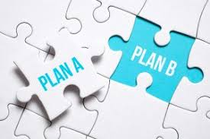

Contingency Plans
Develop Contingency Plans
  Even with good routines, a child/ adolescent may still occasionally refuse to do what is expected,
  With this occurs, respond with a script:
    Remind child he’s refusing his own plan;
    Invitation to the child to change an aspect of the plan; and
    With continued refusal, invite the child to let caregivers/ teachers know when he’s ready to resume his plan

Slide 46

Overload
Be Aware of and Prevent Overload
  Children/ adolescents with brain injury may become more easily overloaded during daily activities.
  Triggers for a child becoming overloaded may include:
    Attempting to manage larger quantities of material, new presentations of novel or unusual information.
    Settings that include large numbers of people, high social demands, or require adjustment to new and unusual demands may also be overloading.
  When overloaded, the child/ adolescent is more likely to misbehave

Slide 47

Escape Communication
Teach Escape Communication as a Response to Overload
  Misbehavior in response to overload is often a reflection of the need to escape
  Escape communication creates a positive alternative to misbehavior by teaching the child/ adolescent a simple word or phrase to communicate the need to escape.
  Examples of escape communication include:
    “Break”
    “Time-out”
    “I’m done”
    “I’m finished”
  After providing the escape communication, allow the child/ adolescent to stop the activity/ leave the activity area.
Ylvisaker & Feeney, 1998

Slide 48
Develop Problem Solving Routines:
Case Study
Prevent behavioral problems by teaching problem solving routines
  Problem: Maddie is a 12-year-old girl with a brain injury. She keeps a messy room. Maddie’s parents ask her to clean her room and check in with her after 15 minutes. They find her sitting in her room looking at her tablet device, having made no headway on her room. Her parents are frustrated, which Maddie reacts to disproportionately by having a meltdown.
  Assumption: At first glance, it may seem that Maddie is noncompliant, stubborn, unmotivated, or just lazy.
  Reality: Because of her brain injury, Maddie has difficulty with initiation. She is not resisting the task but has difficulty getting started. Moreover, she is also having trouble with planning and organization due to her brain injury, and the demands of cleaning her are overwhelming and frustrating for her.
  Strategy: Understanding the underlying reason for not keeping her room clean, her parents work with her to develop a problem solving recipe or routine to help with the task.

Slide 49
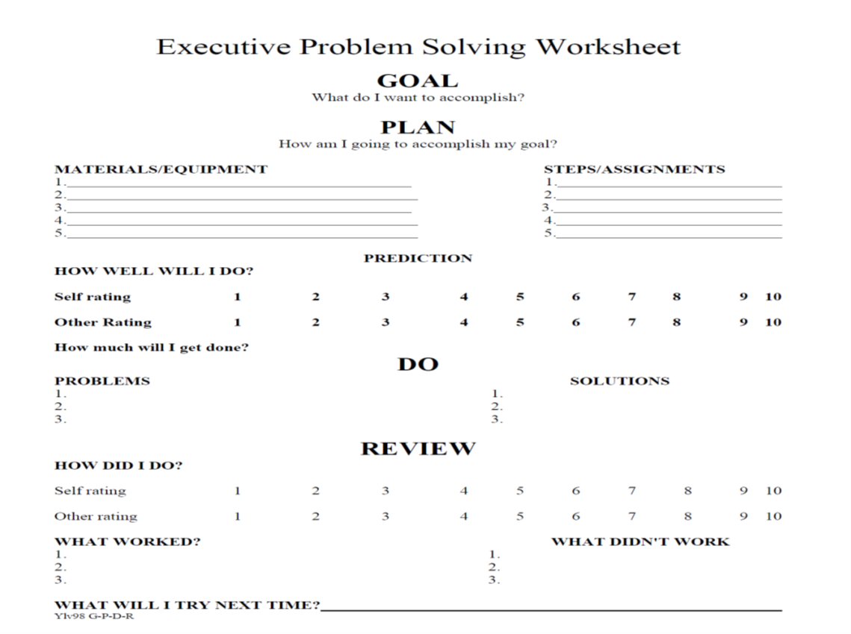


Slide 51
Teen Online Problem Solving (TOPS)

Slide 52
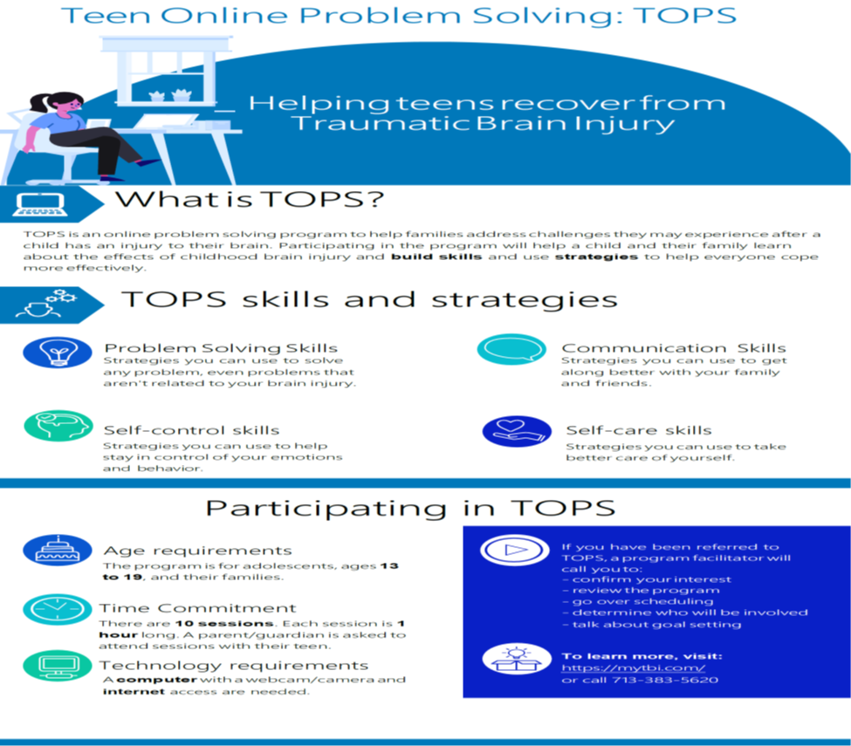

Slide 53

Teen Online Problem Solving (TOPS)
TIRR Memorial Hermann IRB approved research study for parents, caregivers, and teens with brain injury
10 sessions 1-hour sessions, one session per week
Can be completed online, self-guided format for FREE
Contact:
  M. Cullen Gibbs, PhD
  cullen.gibbs@memorialhermann.org
  713-383-5620

Slide 54

Presentation Review / In Summary
By completing this course attendees have:
  Learned basic behavioral principles that support effective behavior modification strategies
  Understand & apply 2-3 behavioral strategies within everyday clinical practice settings.
  Learned the importance of context and focusing on antecedents of behavior problems
  Understand and apply 2-3 antecedent focused strategies to prevent behavior problems and facilitate independent behavior

Slide 55
References
Allen K., Harrington J.W., Cooke C. (2018) PCIT for children with severe behavior problems and autism spectrum disorder. In: McNeil C., Quetsch L., Anderson C. (eds) Handbook of Parent-Child Interaction Therapy for Children on the Autism Spectrum. Springer.
Barkley, R.A., (2020) Taking charge of ADHD, Fourth Edition: The complete, authoritative guide for parents(4th ed.). Guilford Publications.
Bronfenbrenner, U. (1979). The ecology of human development. Harvard University Press.
Kunce, L, Mesibov, GB (1998) Educational approaches to high-functioning autism and Asperger syndrome. In: Schoepler, E, Mesibov, GB, Kunce, L (eds) Asperger Syndrome or High-Functioning Autism? New York: Plenum Press, pp. 227–261.
Ylvisaker, M., & Feeney, T. J. (1998). Collaborative brain injury intervention: positive everyday routines. San Diego: Singular Pub. Group.
Zisser-Nathenson, A. R., Herschell, A. D., & Eyberg, S. M. (2018). Parent-child interaction therapy and the treatment of disruptive behavior disorders. In J. R. Weisz & A. E. Kazdin (Eds.), Evidence-based psychotherapies for children and adolescents (p. 103–121). The Guilford Press.

Slide 56
Thank You!
Cullen.Gibbs@MemorialHermann.org

Slide 58


Slide 59
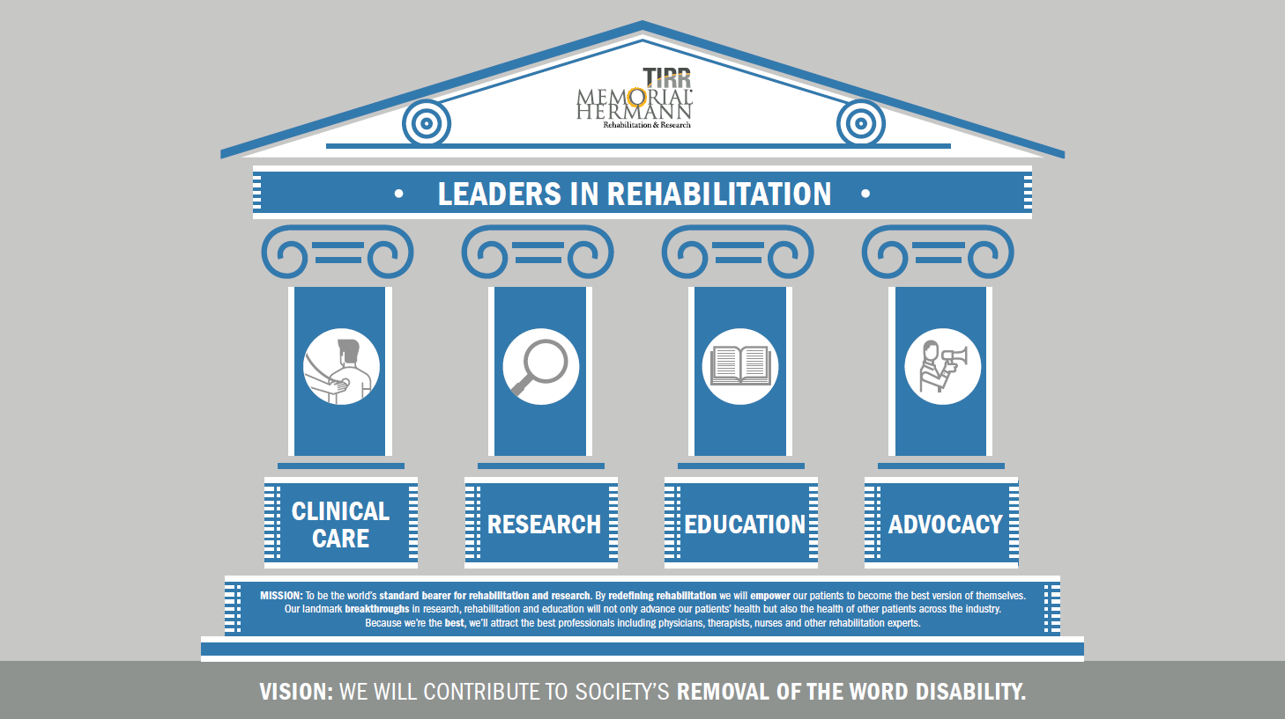

Slide 60


Slide 61


