Slide 1

Shoulders, Elbows, Knees, and Toes…and Everything in Between
The Orthopaedic Management of Brain Injury Patients
Brian E. Kaufman, MD
Assistant Professor of Surgery and Perioperative Care
Dell Medical School, The University of Texas at Austin
Chief of Orthopedic Surgery
Dell Children’s Medical Center of Central Texas

Slide 2


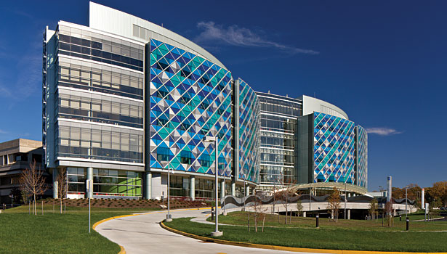



But First, Who I Am:

Slide 3

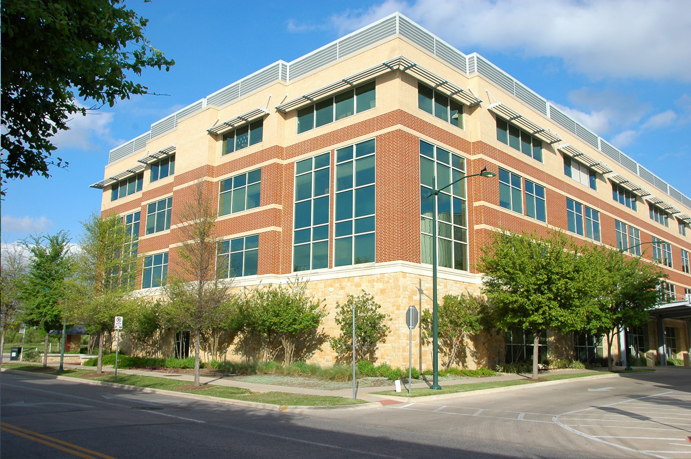
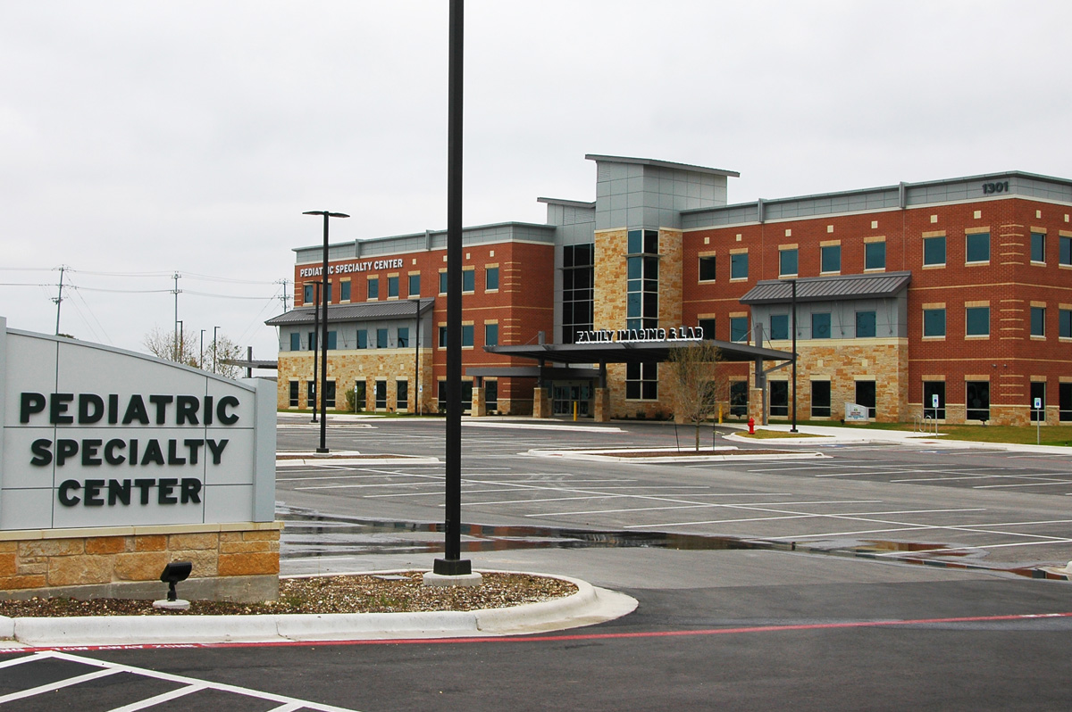
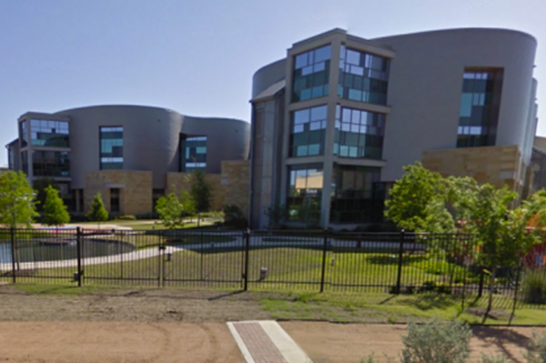
Central Austin
1301 Barbara Jordan Blvd
Suite #300
Austin, TX 78723
Cedar Park
1301 Medical Parkway
Suite #330
Cedar Park, TX 78613
Specialty Care Center
Dell Children’s Medical Center
4900 Mueller Blvd
Austin, TX 78723

Slide 4
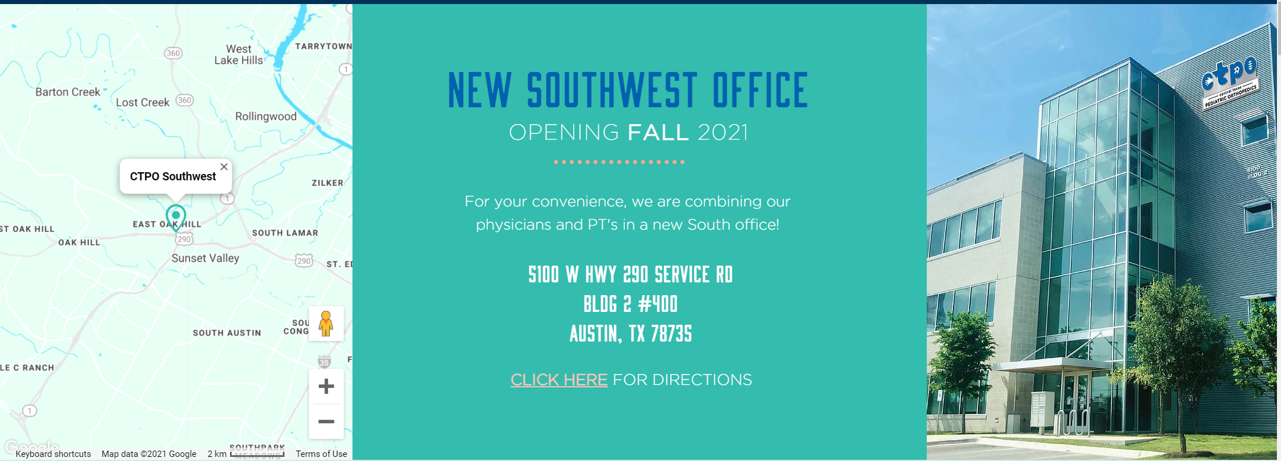

Slide 5

Incidence of Brain Injury:
Over 450,000 children a year
  Greater than 37,000 are severe → 1.3 million life years affected
Age determines cause
  < 5 years → fall
  5-14 years → fall, sports, car crash
  > 15 years → car crash
Significant cost
  145,000 children living with TBI disability → $60 billion

Slide 6
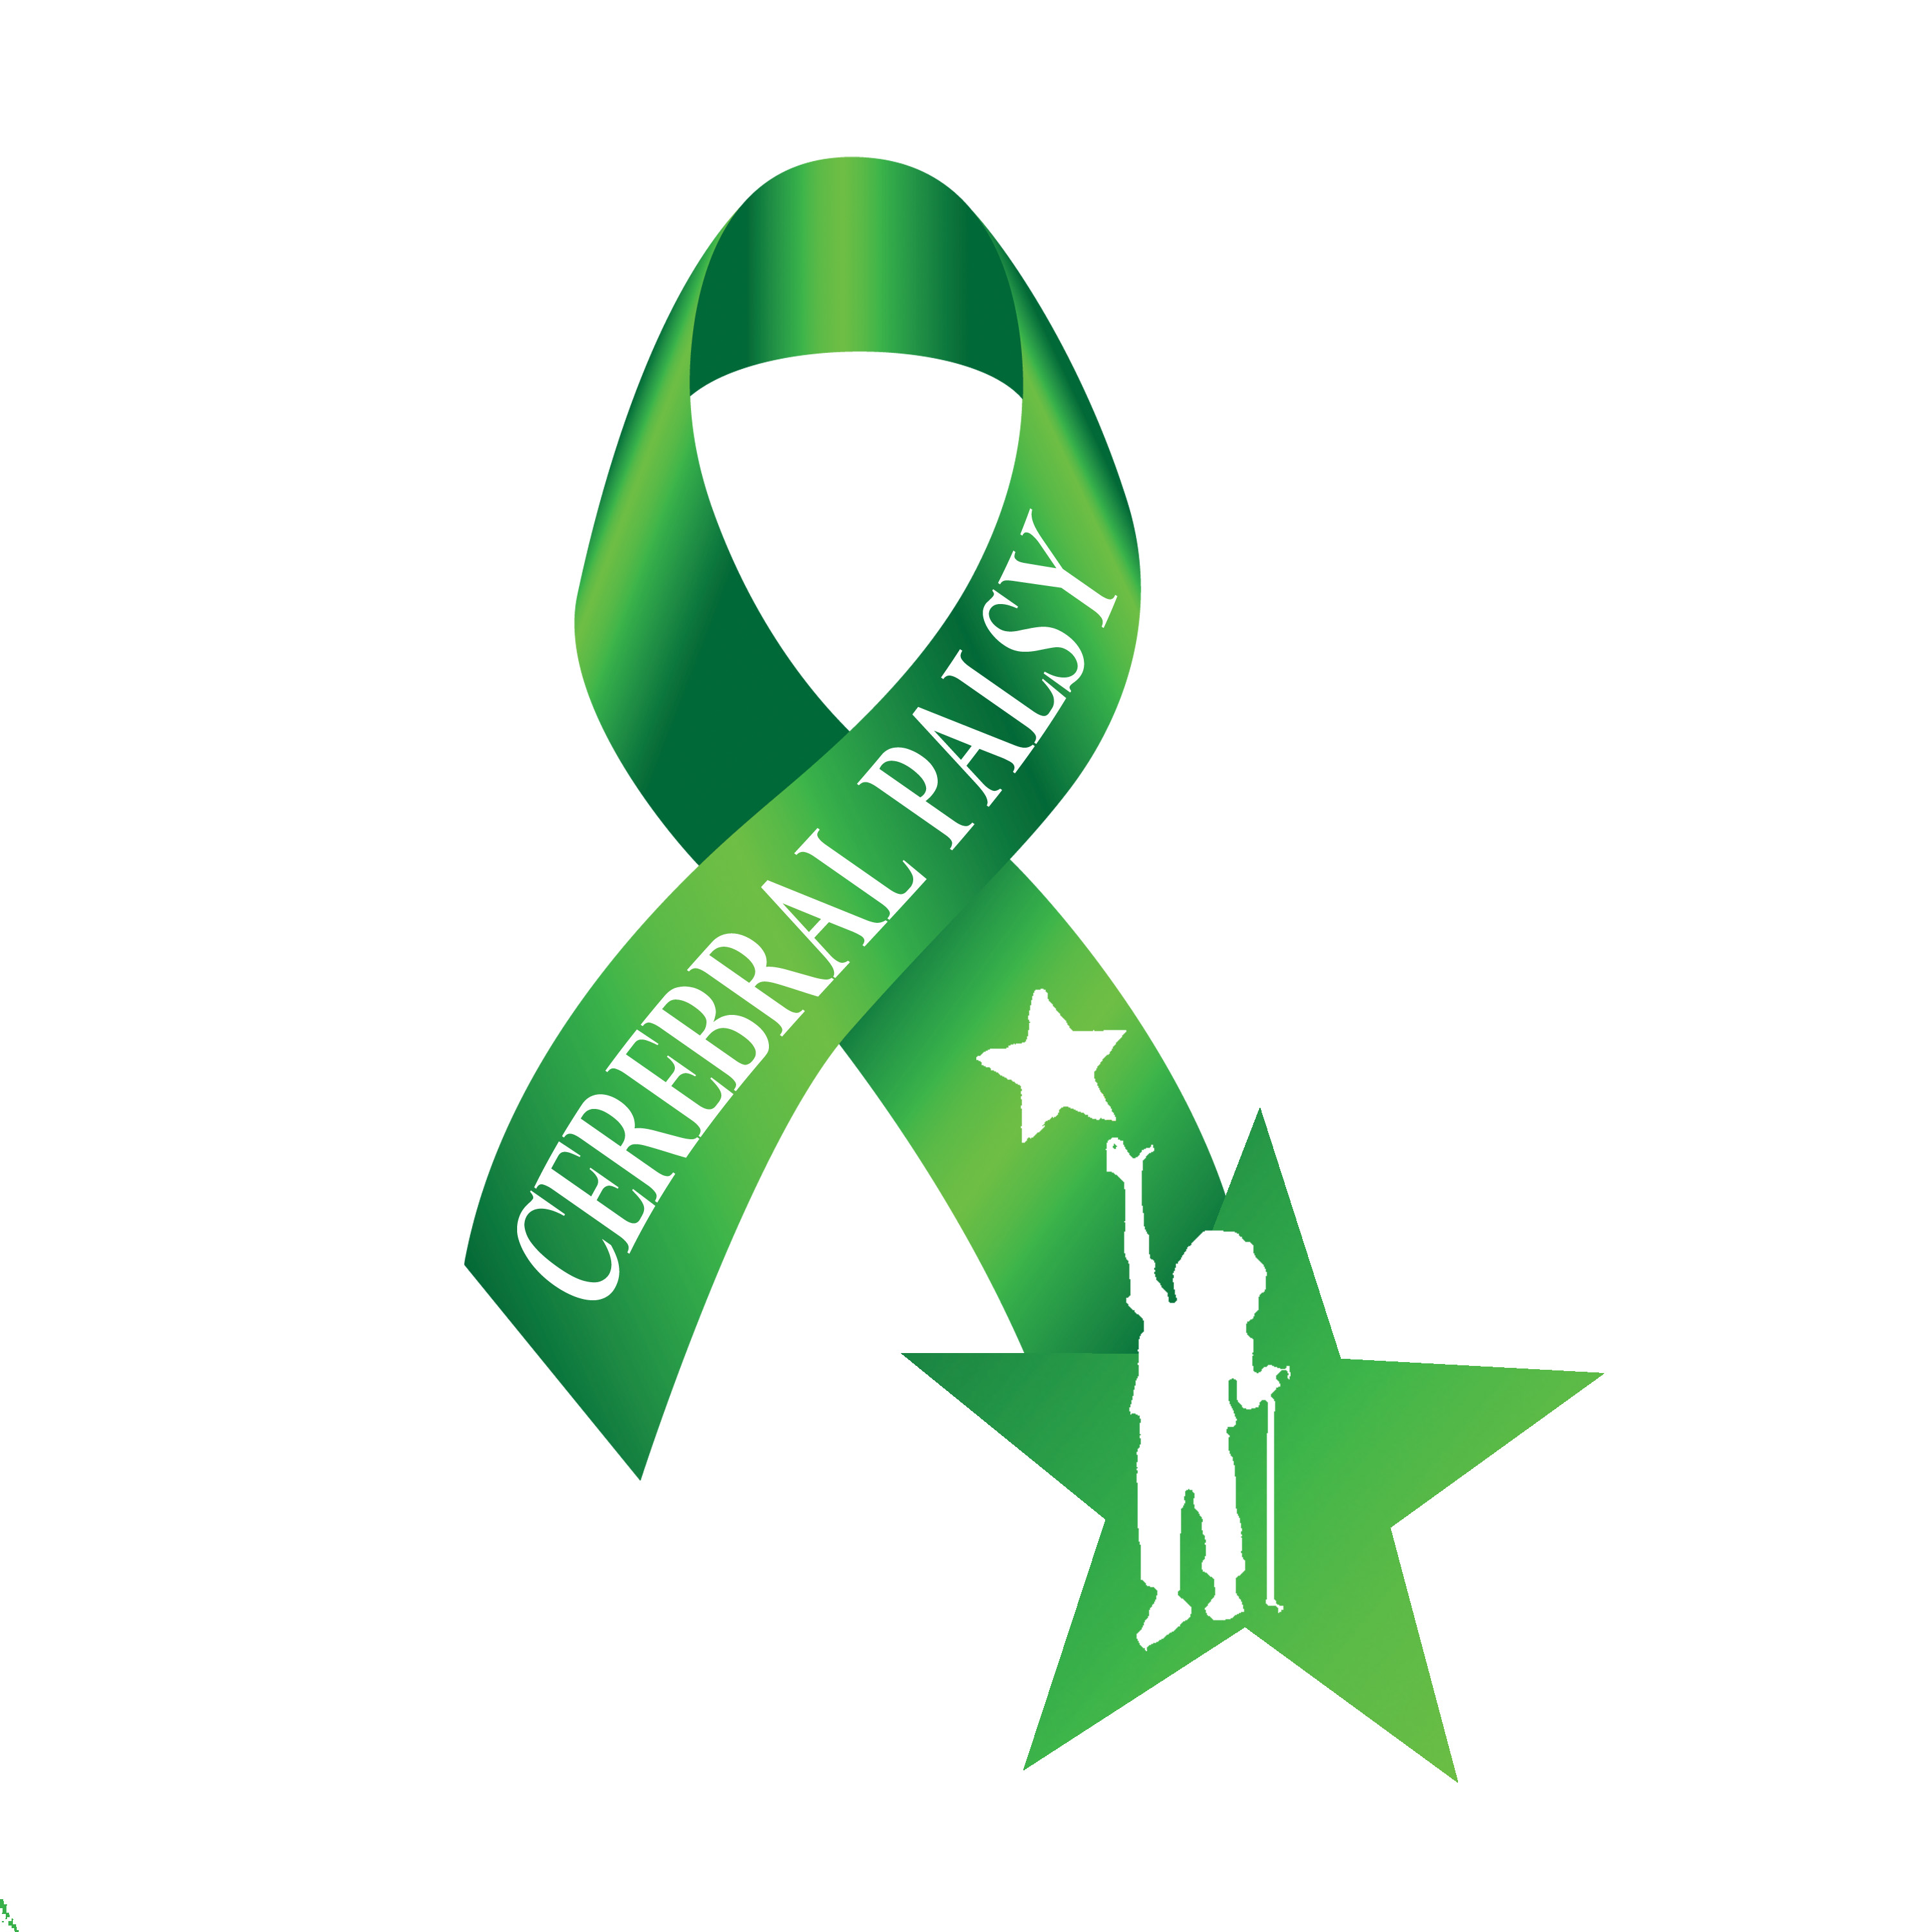
TBI Is Only Part of the Story:
Cerebral palsy → static, non-progressive brain injury < 2 years of age
Constant prevalence since the 1980’s
  2.4 children per 1000 live births
3 Causes
  Congenital → genetic mutations
  Neonatal → intraventricular hemorrhage
  Post-natal → non-accidental trauma

Slide 7

Why You Need an Orthopedic Surgeon:
Brain injury affects bones and muscles!
  Spasticity, flaccidity, dystonia, ataxia
  Affects gait, seating tolerance, ADL’s, etc
  Managing spastic tone improves quality of life
PM&R and Orthopaedic Partnership
  Supported by Dell Children’s
  PT, Orthotists, Social Workers, and many more!
Surgery isn’t always a last resort
  Early intervention can prevent major surgery later

Slide 8
The Upper Extremity:
Typical Deformity:
  Shoulder → adduction + internal rotation
  Forearm → pronation
  Wrist → flexion + ulnar deviation
  Hand → finger flexion + thumb-in-palm
Functional Impairment:
  Reaching, grasping, releasing, manipulation
  Cosmesis
  Pain

Slide 9
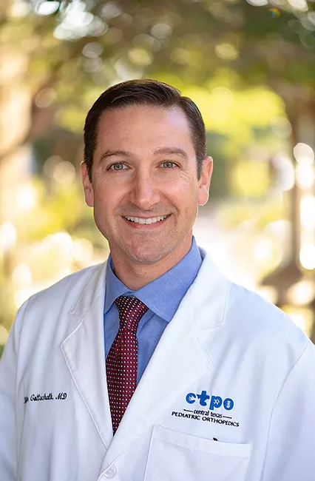
The Upper Extremity:
Non-Operative Management:
  Physiotherapy
  Bracing
Operative Management:
  Elbow → contracture release
  Wrist → tendon transfer vs. arthrodesis
  Fingers/Thumb → botox vs. tendon transfer
Notes:
Elbow → contracture release through transverse incision allowing for Z lengthening of biceps and brachialis muscles
Wrist → flexible deformity can use Green transfer (FCU to ECRB). Can improve forearm pronation and wrist flexion
Severe contracture improved with fusion with dorsal wrist plate → little functional gain, but hand hygiene improved. Satisfaction high
Fingers → correction of wrist flexion may reveal underlying finger flexion contractures. Managed with either botox and/or tendon transfers
Thumb → various tendon transfers depending on type and severity of deformity

Slide 10
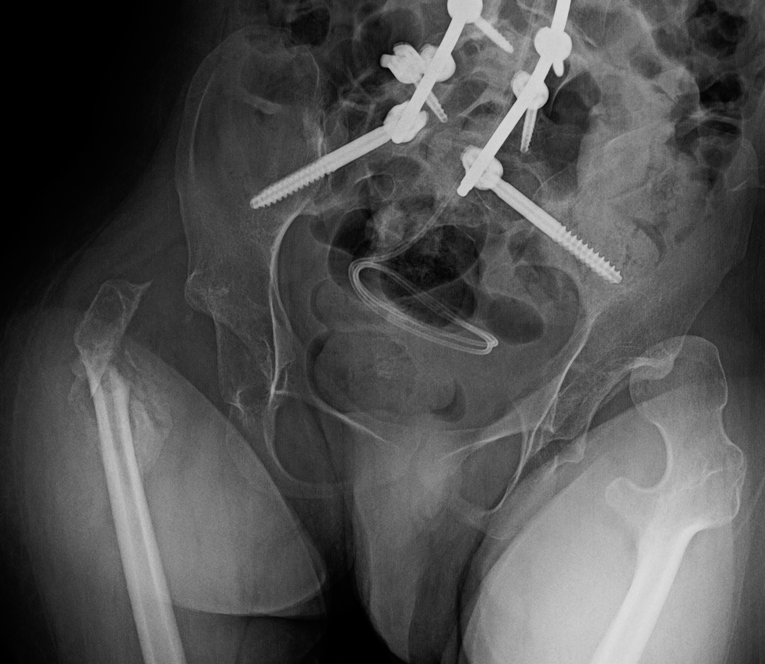
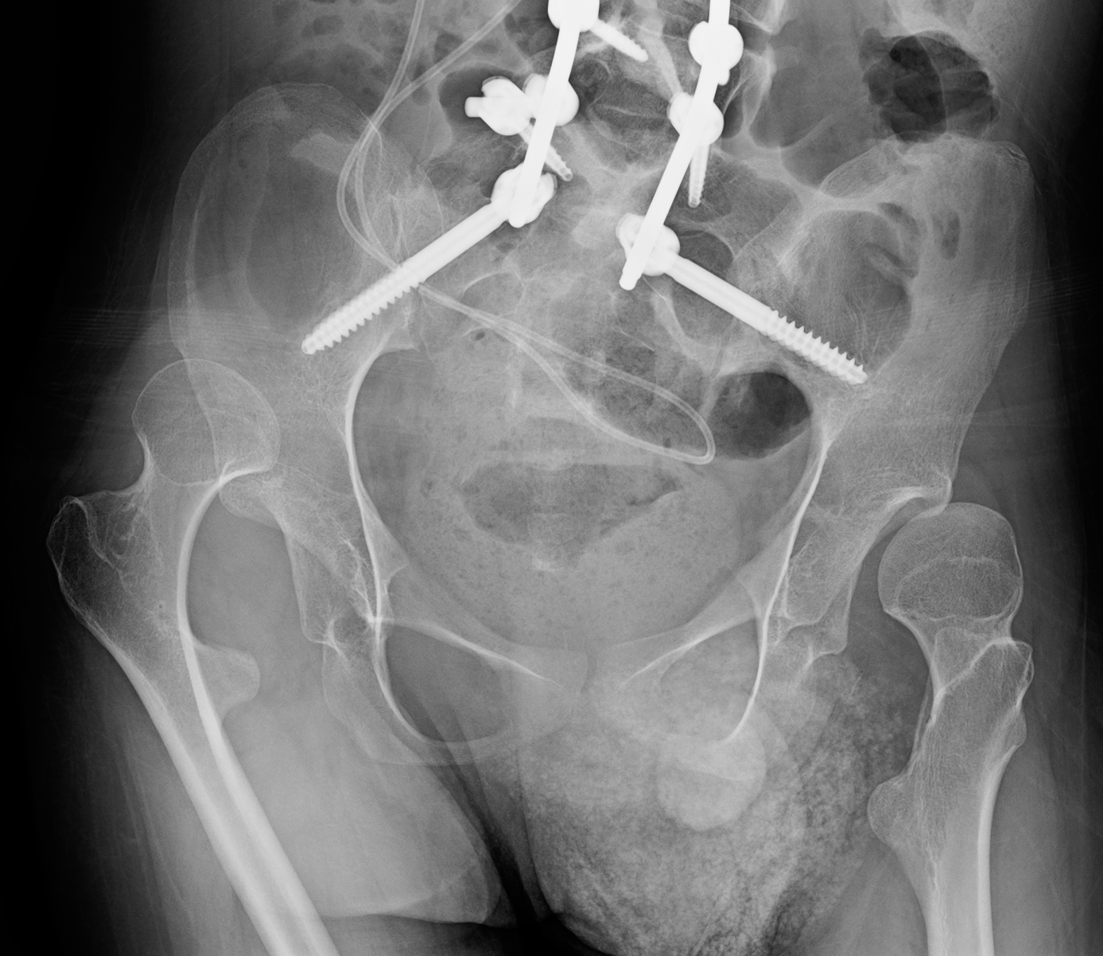
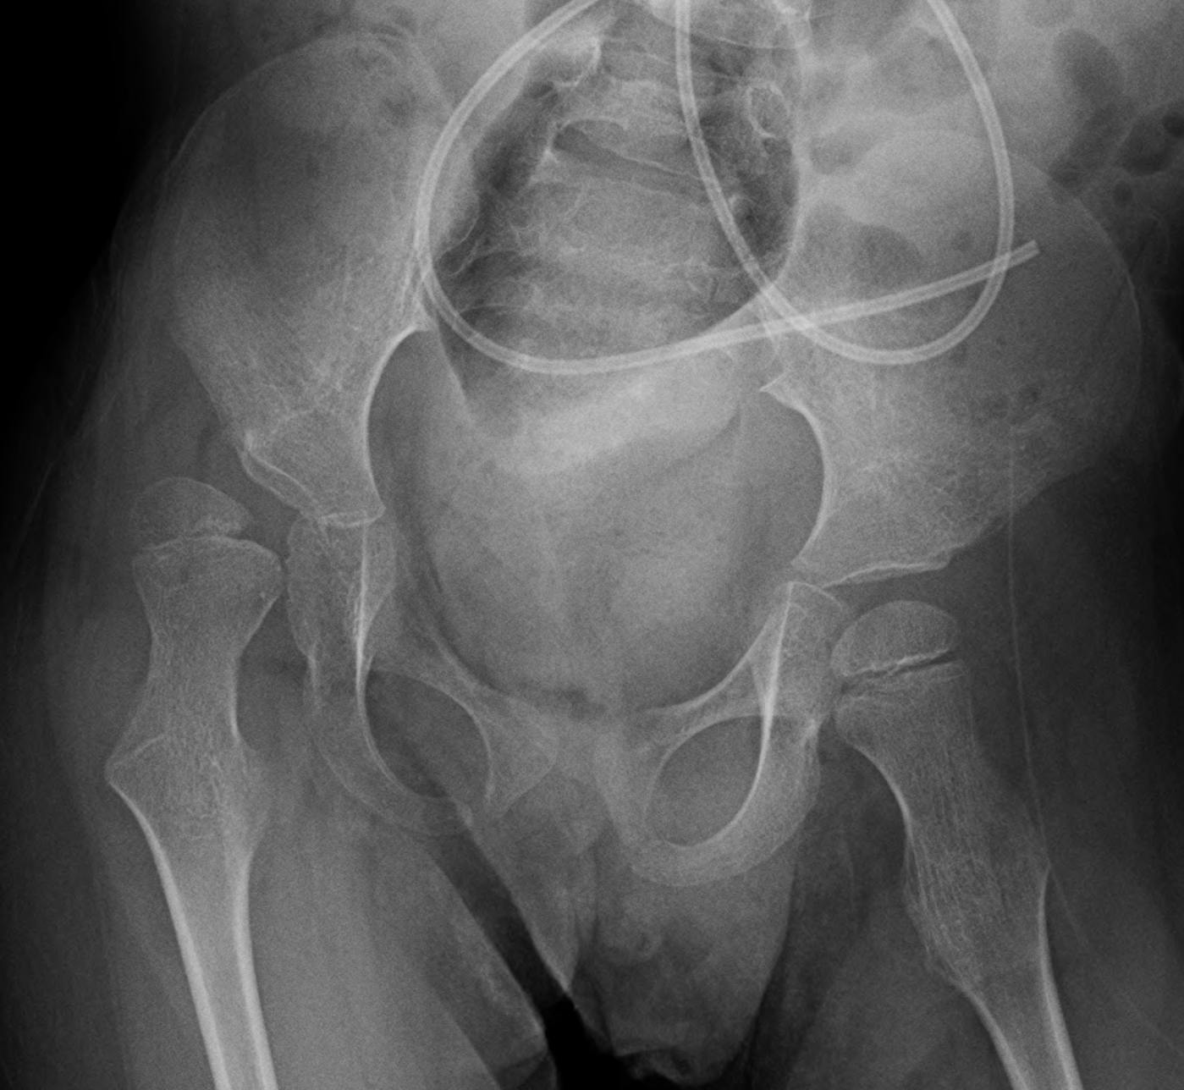
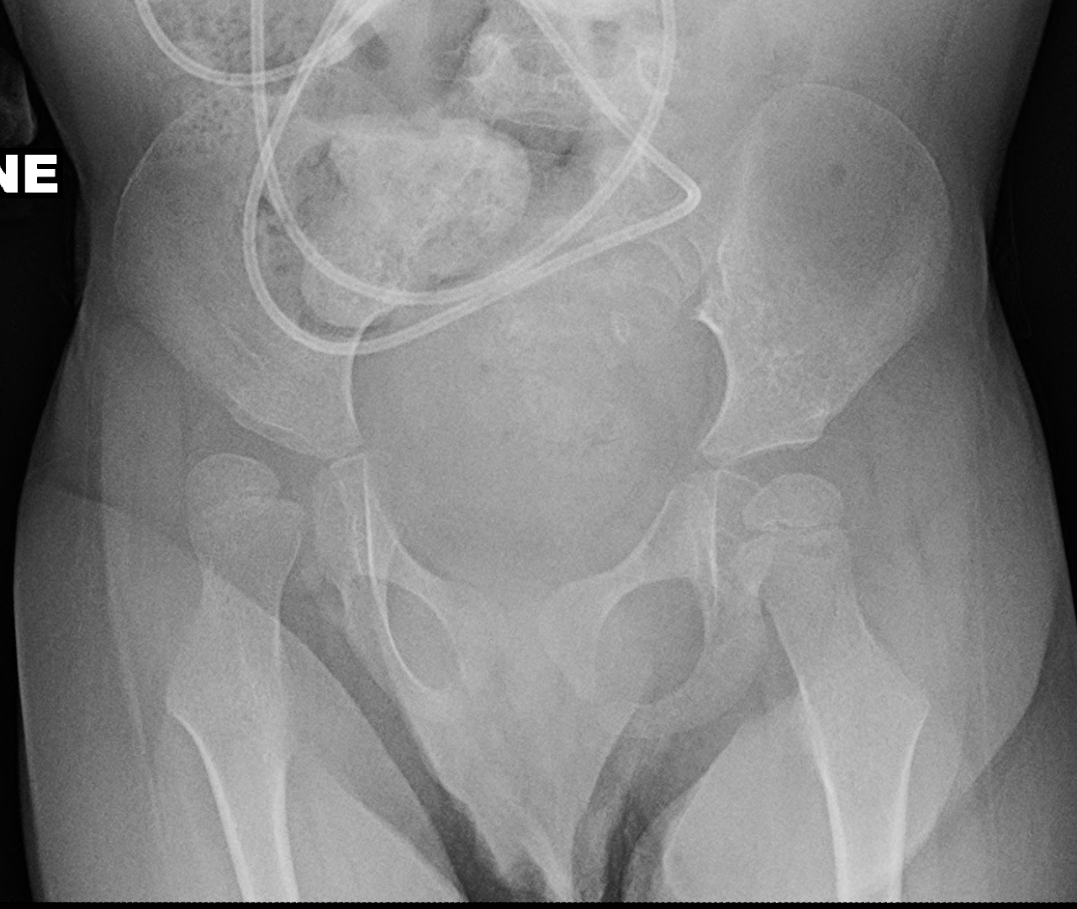
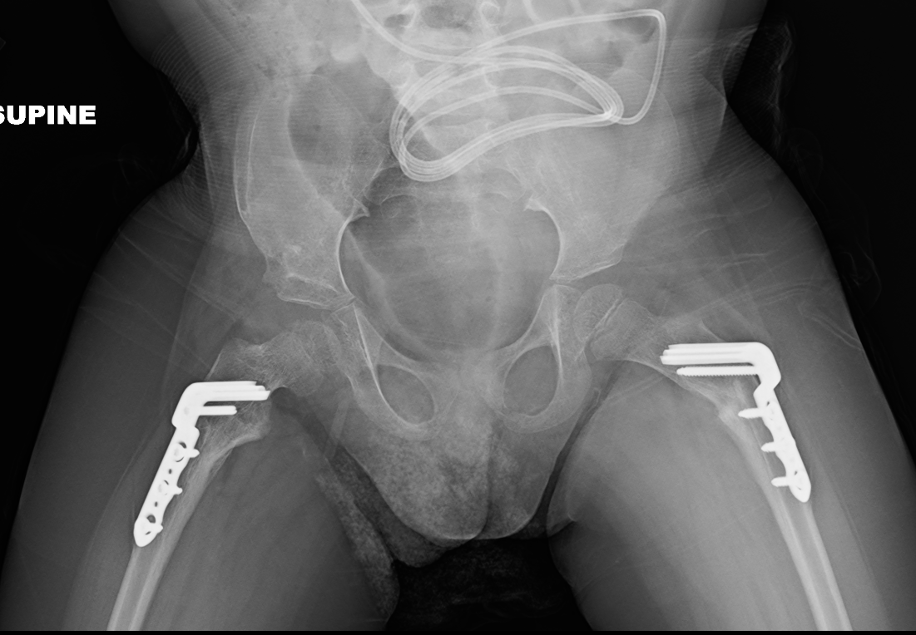
The Hips:
Typical Deformity:
  Adductor & flexor contracture
  Leads to progressive subluxation
  Eventual dislocation
Functional Impairment:
  Loss of motion → hip abduction
  Difficulty with diapering/perineal care
  Dislocated hips → arthritis → pain → decreased sitting

Slide 11
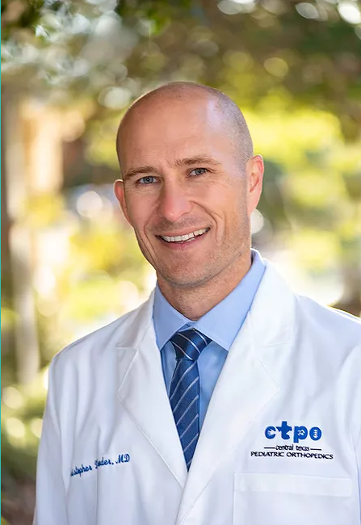
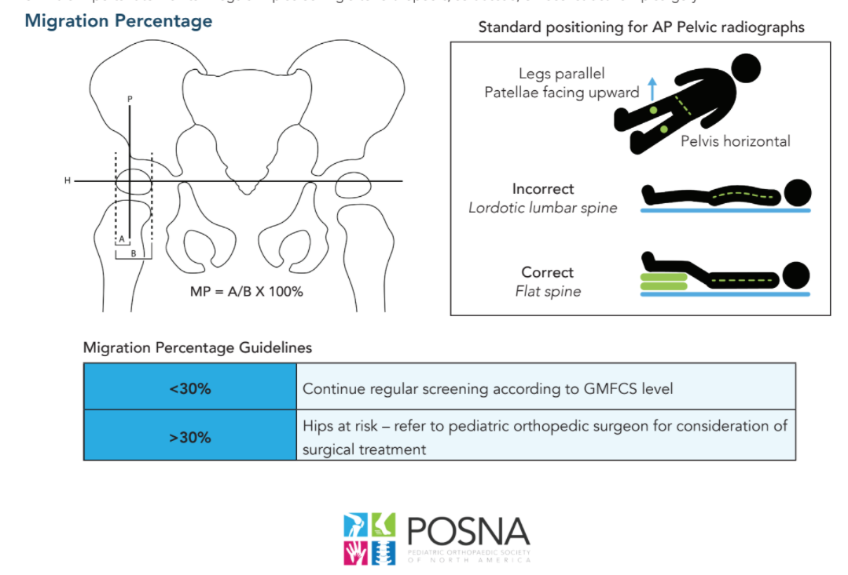
The Hips:
Non-Operative Management:
  Surveillance is key!
  Botox + physical therapy
Operative Management:
  Soft tissue releases
  Varus derotational osteotomy
  Pelvic osteotomy

Slide 12
The Knees:
Typical Deformity:
  Flexion contracture
Functional Impairment:
  Crouch gait
  Difficulty with transfers

Slide 13
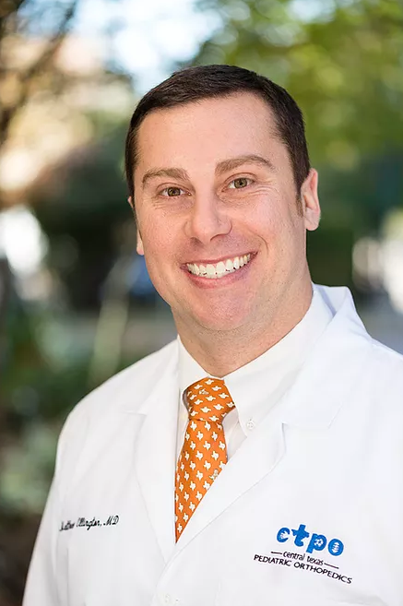
The Knees:
Non-Operative Management:
  Botox + physical therapy
  Knee immobilizers
Operative Management:
  Hamstring lengthening
  Posterior capsule release
  Extension osteotomy

Slide 14
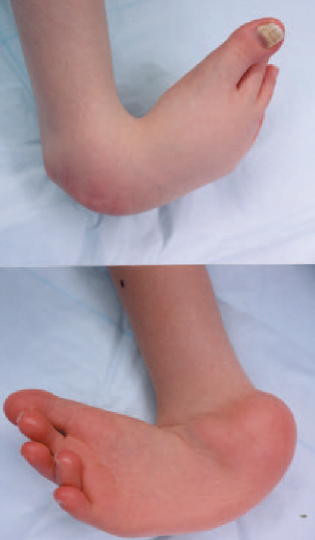
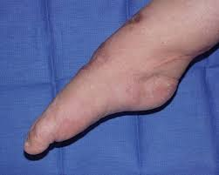
Foot and Ankle
Typical Deformity:
  Equinus contracture
  Flat feet
Functional Impairment:
  Gait impairment
  Skin breakdown
  Inability to wear shoes
  Difficulty with positioning in wheelchair

Slide 15
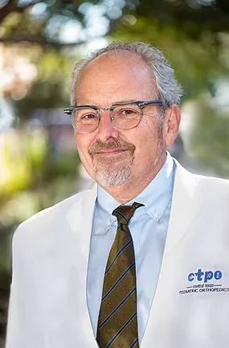
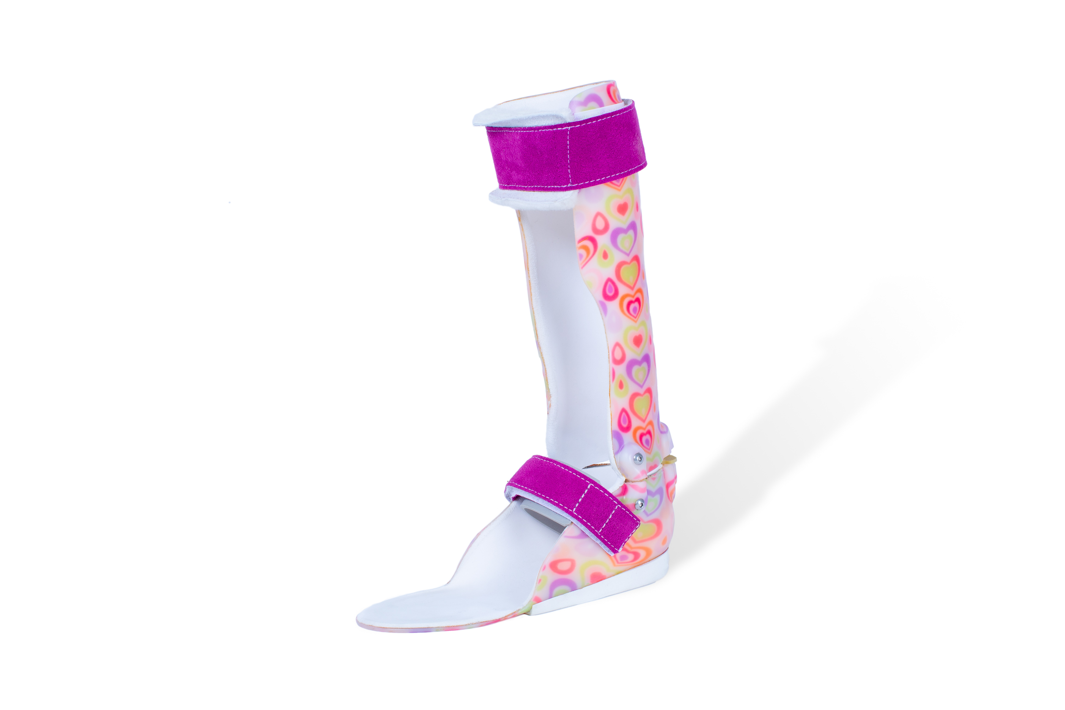
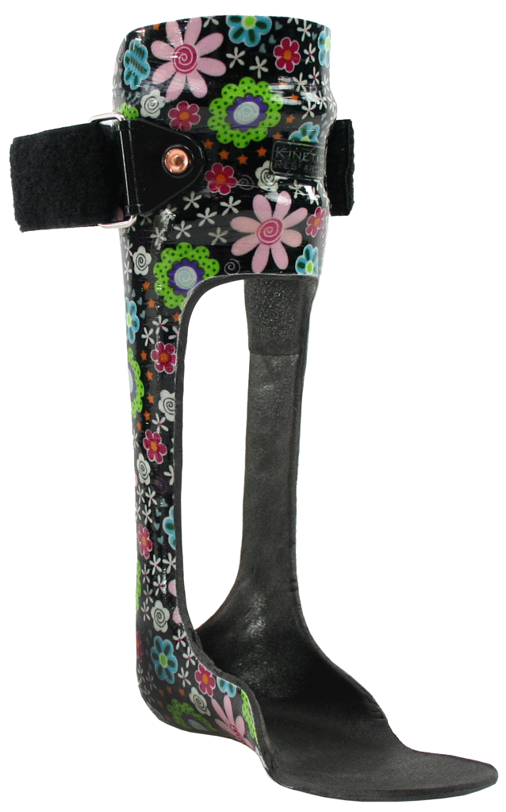
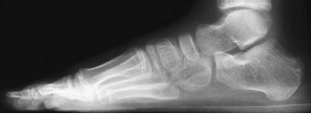
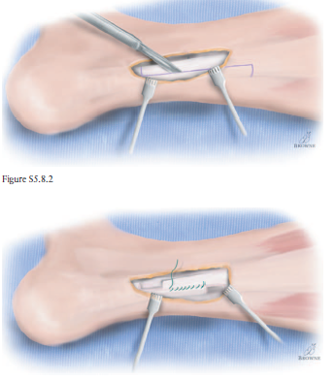
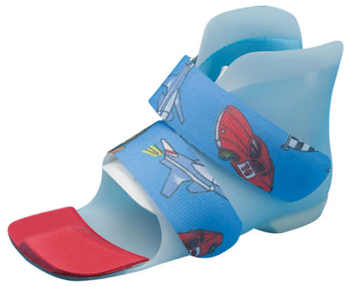
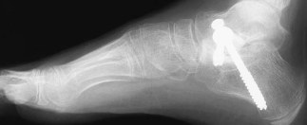
Foot and Ankle
Non-Operative Management:
  Botox + physical therapy
  Bracing → AFO vs. GRAFO vs. SMO
Operative Management:
  Heel cord lengthening
  Flat foot reconstruction

Slide 16
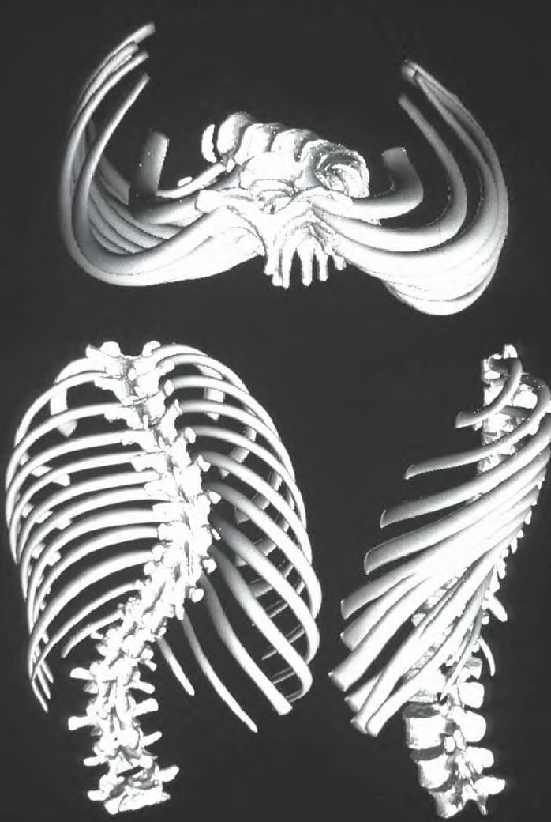
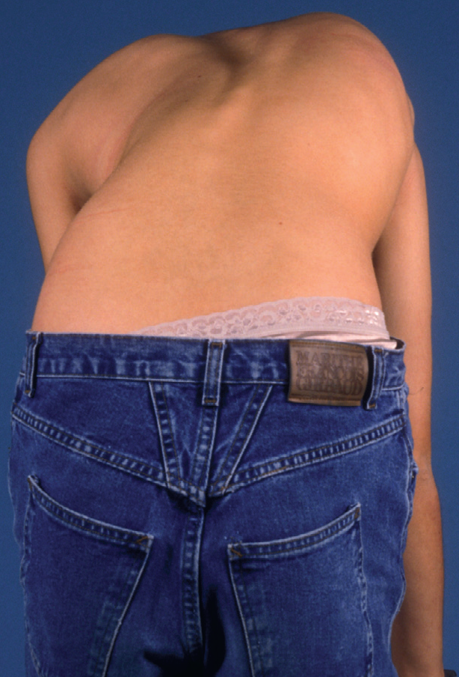
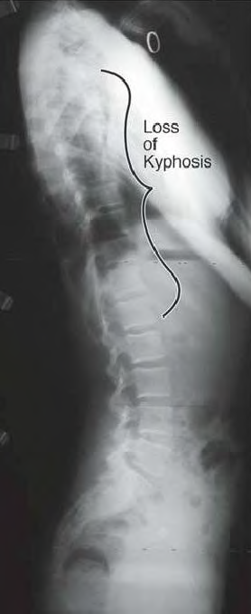
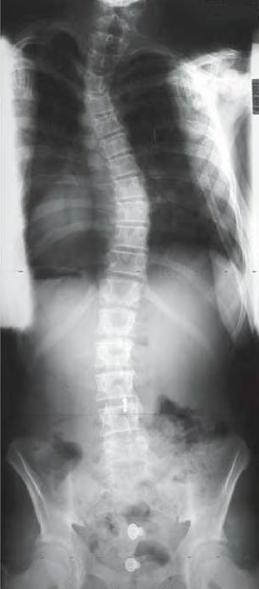
The Spine: What is Scoliosis?
3D Deformity:
  Frontal plane (coronal)
  Side plane (sagittal)
  Rotation (axial)

Slide 17
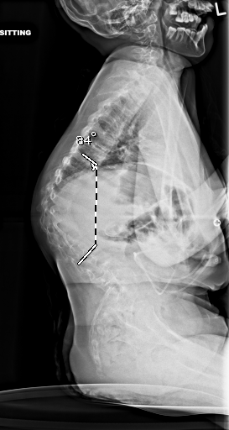
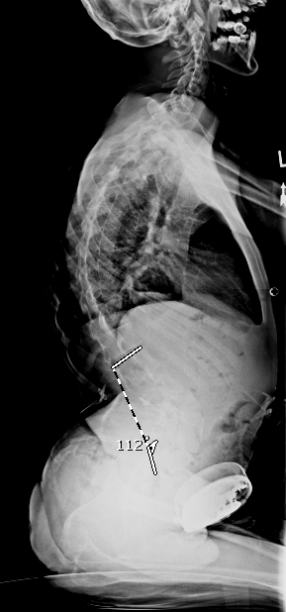
Curves After Brain Injury are Different!
Hyperkyphosis
  Increased forward curve
  Common at mid-portion of spine
  Watch for pressure sores
  Difficulty with seating
Hyperlordosis
  Increased sway in lower spine
  Can increase pressure on ischium
  Difficulty with seating

Slide 18
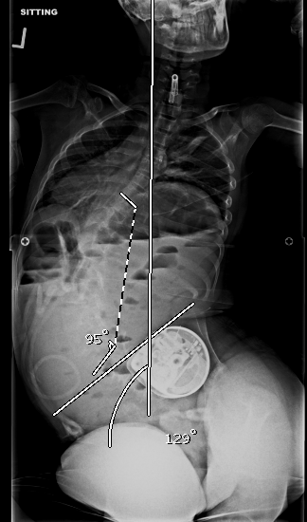
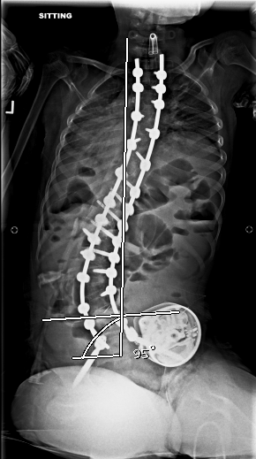
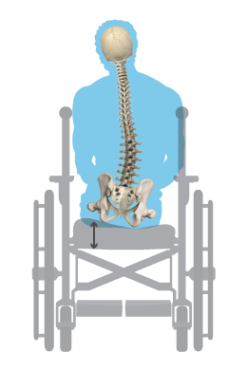
Don’t Forget About the Pelvis!
Pelvis tilts opposite of large curves
Ribs can impinge on the pelvis
Uneven pressure on the ischium
Pelvic obliquity > 12˚ → uneven weight distribution

Slide 19
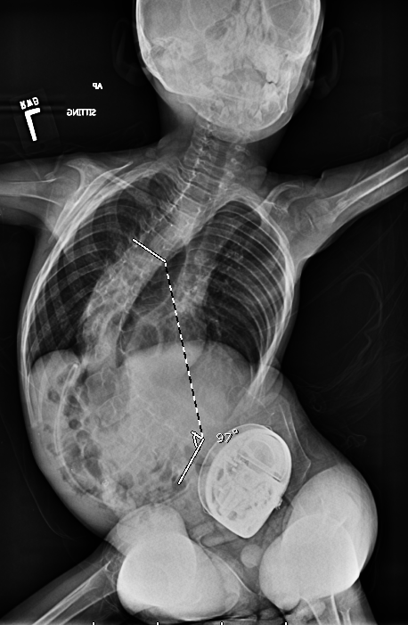
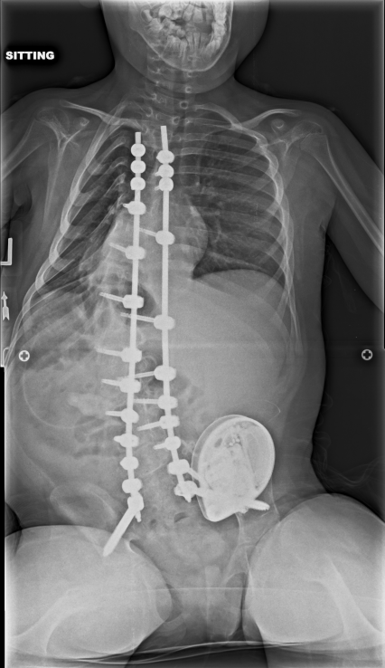
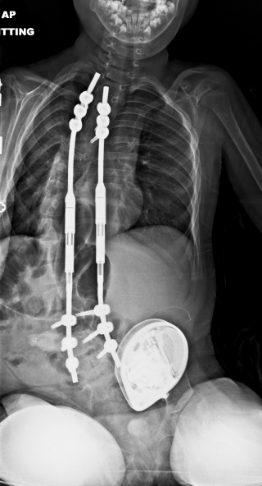
Why Does Your Child Develop Scoliosis?
Exact mechanism → unknown
More severe brain injury → more likely to have scoliosis
  70% of severe CP patients have a curve

Slide 20
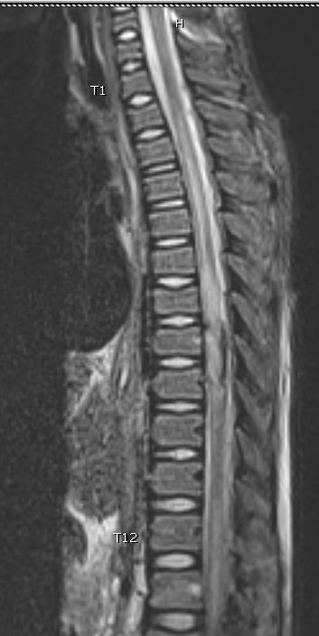
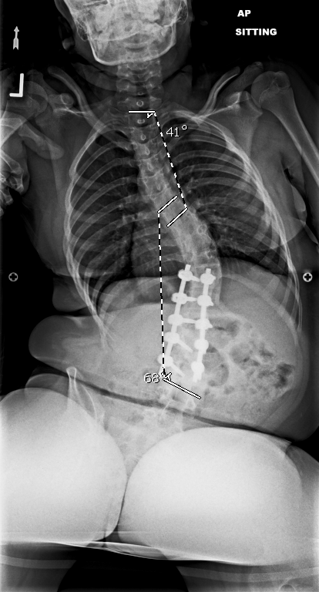
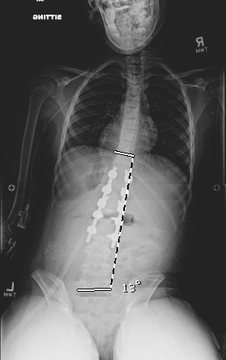
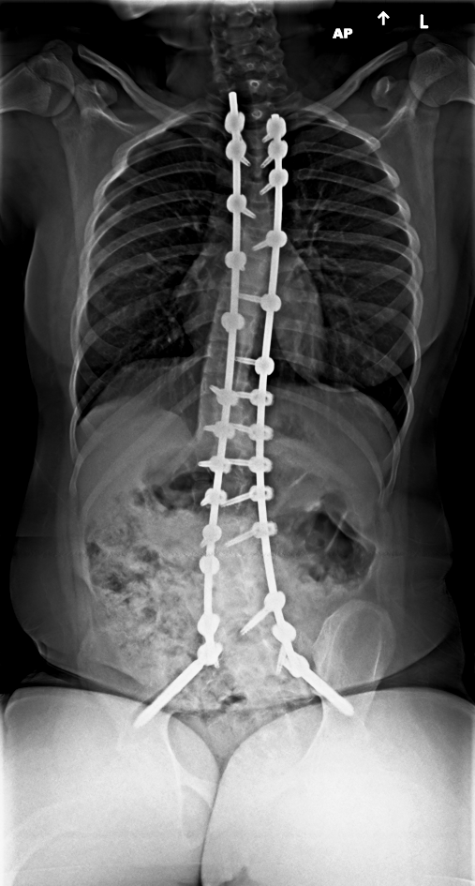
Scoliosis After Spinal Cord Injury:
Cord Injury with > 1 year of growth remaining → 98% develop scoliosis
3 Causative Factors
  Muscle weakness and imbalance
  Unreduced fractures
  From surgical intervention

Slide 21
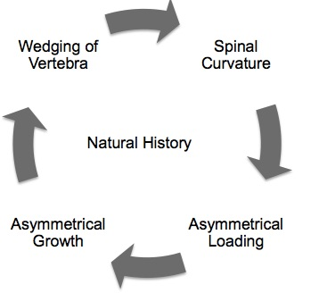
My Two Cents…
Brain injury → Muscle imbalance
Muscle imbalance → asymmetric sitting
Asymmetric sitting → abnormal stress on growth plates
Abnormal stress on growth plates → scoliosis

Slide 22
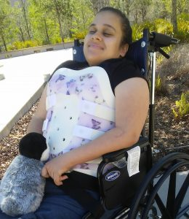
Non-Operative Treatment:
Physical Therapy → core strength and seated position
Well-molded wheelchair backs
Bearing weight improves bone health
No definitive evidence bracing prevents or delays surgery

Slide 23
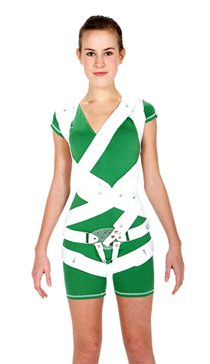
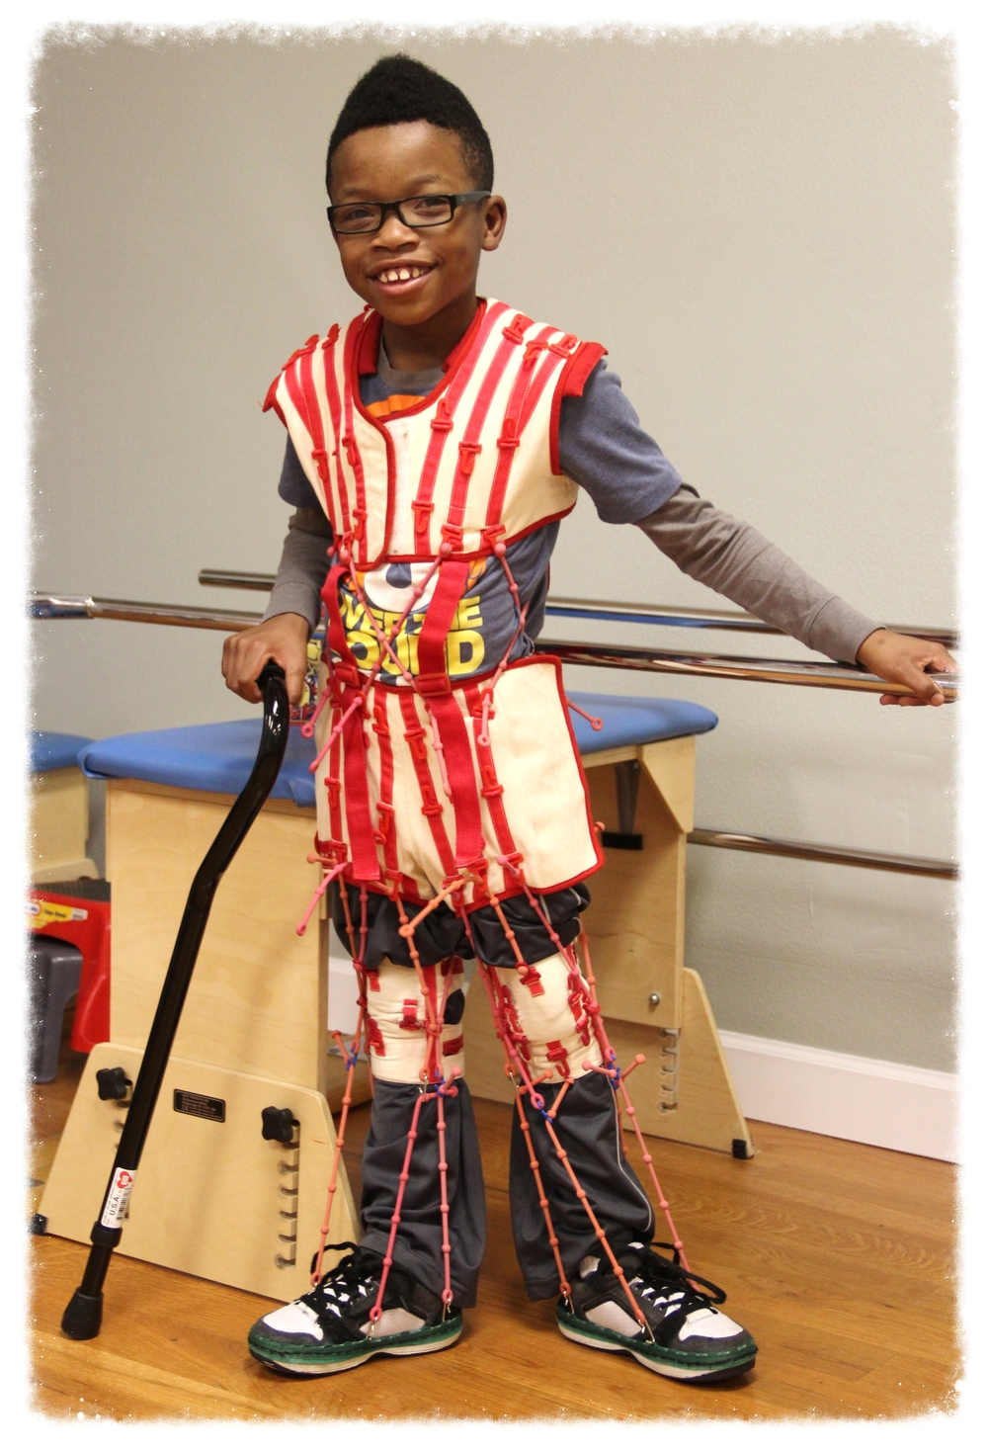
Should My Child Wear a Brace?
What are your goals?
Only rigid braces have any efficacy
  At least 12 hours a day
Soft braces do not prevent scoliosis
  Role in therapy and seating comfort

Slide 24
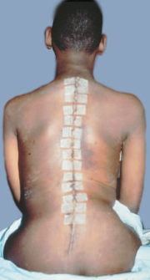
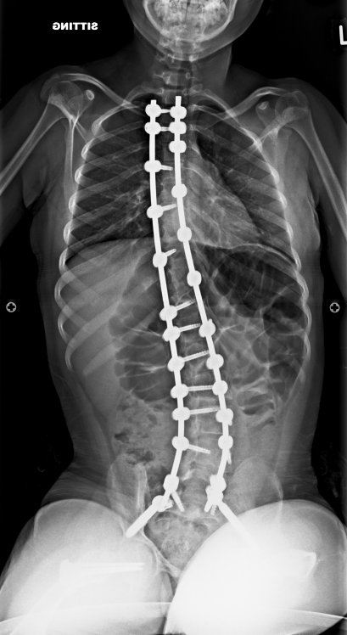
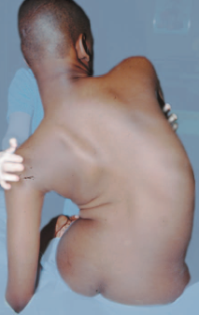
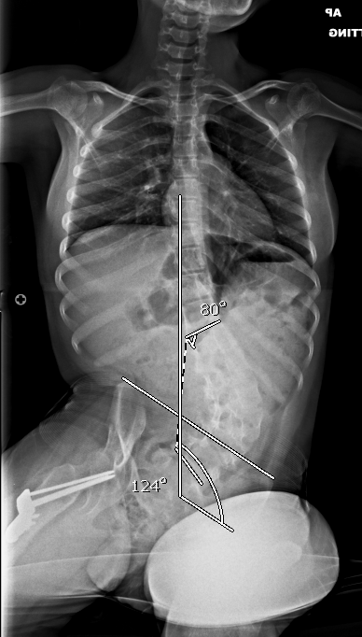
Surgical Treatment:
My threshold → curves > 50˚
  Usually…
Spine surgery is elective!
Surgery can improve quality of life

Slide 25
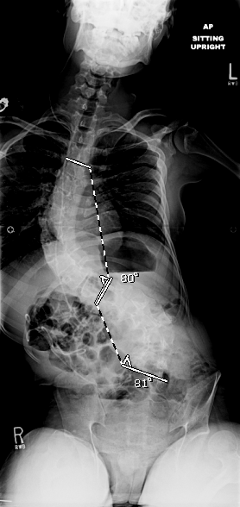
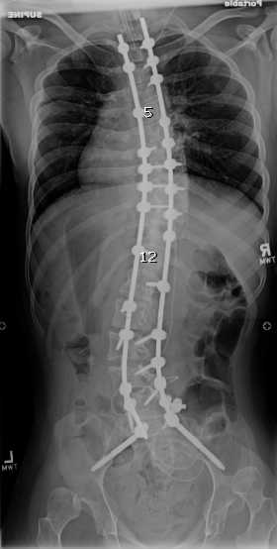
Surgical Treatment: How is it Done?
Single incision in the back
Spinal muscles moved to the side
Screws and rods inserted
3-5 days in the hospital
Return to full activity by 3-6 months

Slide 26




Surgical Treatment: How to Have Success
Gather the troops!
Healthy child → fewer complications
  Nutritional evaluation critical
Know your surgical team
Don’t be afraid to ask questions!

Slide 27
Conclusion:
Brain injuries affect many children annually
Severity of brain injury correlates with risk for orthopaedic pathology
Early non-operative intervention key for upper and lower extremities
Define your treatment goals with your surgeon
Surgery, when done well, improves quality of life

Slide 28

Thank You!

